Slide 1
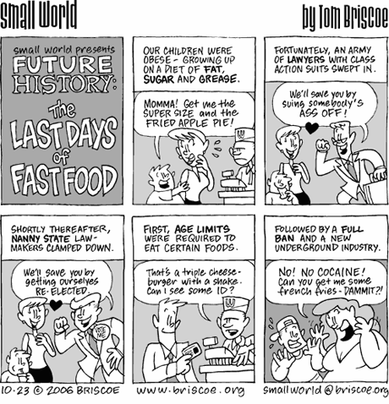
The Digestive System
Chapter 23
Chemical Digestion of Specific Food Groups

Slide 2
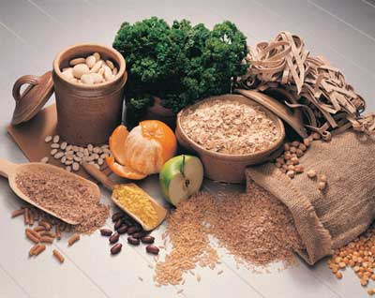
Digestion of Carbohydrates
All carbohydrates have to be broken down into monosaccharides before absorption can take place
Monosaccharides → simple sugars → monomers of carbohydrates → glucose, fructose, galactose → absorbed immediately

Slide 3
Digestion of Carbohydrates
Disaccharides → sucrose (table sugar), lactose (milk sugar), maltose (grain sugar).
Polysaccharides → glycogen and starch
Most carbohydrates in our diet are in the form of starch.

Slide 4
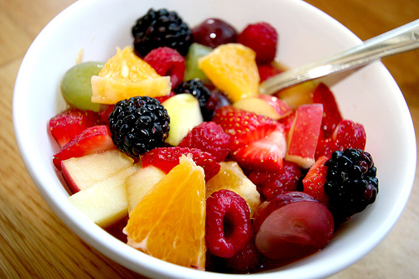
Digestion of Carbohydrates
Salivary amylase → breaks down starch into oligosaccharides → smaller fragments of 2-8 linked glucose molecules
Works best in slightly acidic to neutral environment of mouth (pH 6.75-7). Starch digestion will continue until it has been inactivated by the acidic environment of the stomach.

Slide 5
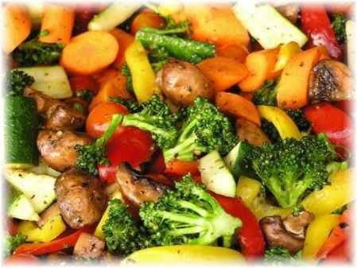
Digestion of Carbohydrates
Pancreatic amylase → in small intestine → within 10 minutes of entering the small intestine, starch is entirely converted to various oligosaccharides.
Brush border enzymes → further digest the oligosaccharides into monosaccharides so that they can be absorbed

Slide 6
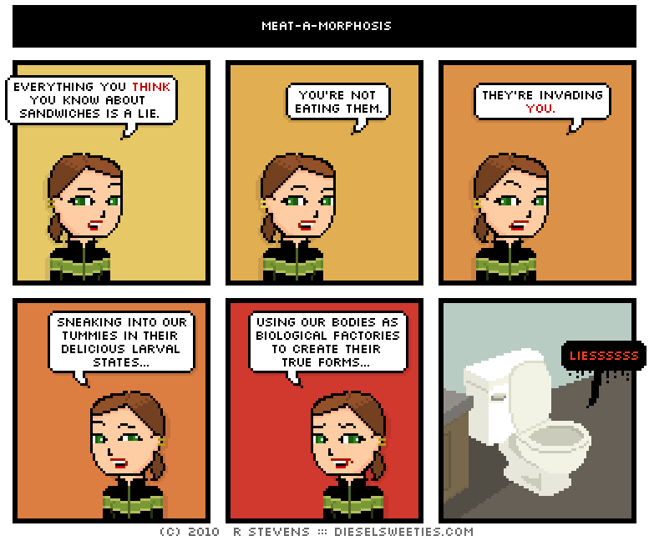
Digestion of Proteins
Starts in the stomach and continues in the small intestine
All proteins in the diet must be broken down into amino acids before they can be absorbed into the blood stream.
Proteins → long chains of amino acids

Slide 7
Digestion of Proteins
Pepsin → functions optimally in the acidic pH of the stomach (1.5-2.5).
Breaks down proteins into smaller chains large of polypeptides

Slide 8
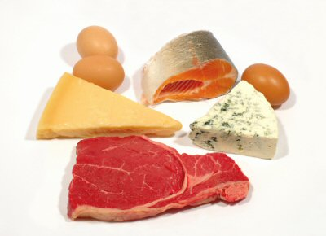
Digestion of Proteins
Trypsin → function optimally in the basic environment of the small intestine
Breaks down the polypeptide chains into smaller peptides
Brushborder enzymes → further break down the peptide chains into amino acids for absorption

Slide 9
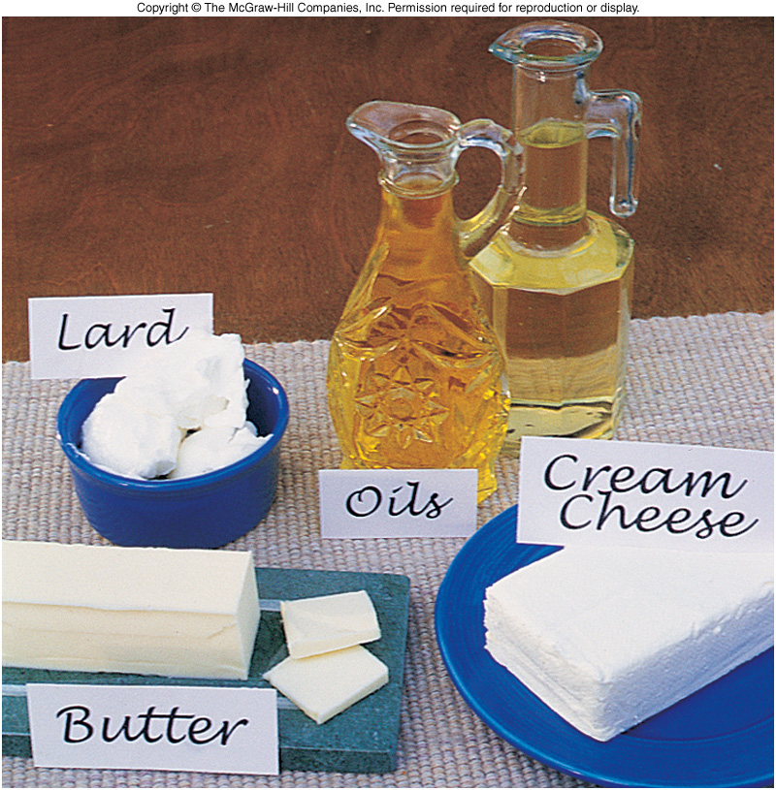
Digestion of Lipids
Small intestine is sole site of lipid digestion.
Triglycerides → neutral fats or triacyglycerols are most abundant fats in the diet.
Triglycerides and their breakdown products are insoluble in water, fats need special “pretreatment” with bile salts to be digested and absorbed.

Slide 10
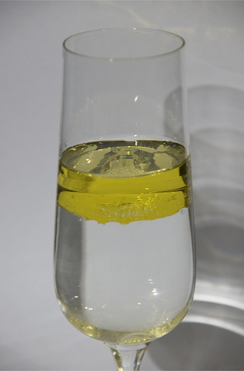
Digestion of Lipids
In aqueous solutions, lipids form large fat globules, and only the lipid molecules at the surfaces of such fatty masses are accessible to the water-soluble lipase enzymes.
Resolved when lipids are mixed with bile salts. The bile salts have both polar and nonpolar regions. Their nonpolar (hydrophobic) parts cling to the fat molecules, and their polar parts allow them to repel each other and interact with water. As a result , fatty droplets are pulled off the large fat globules, and a stable emulsion.

Slide 11
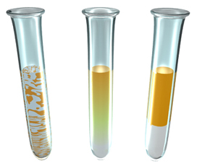
Digestion of Lipids
Emulsification does not break the chemical bonds, it just reduces the attraction between fat molecules so that they can be more widely dispersed. This process vastly increases the number of triglyceride molecules exposed to the pancreatic lipases.

Slide 12
Digestion of Lipids
Without bile, lipids would be incompletely digested in the time food is in the small intestine.
Fat digested end products → fatty acids and glycerol
Generally fat absorption is completed in the ileum. But in absence of bile, it happens so slowly that most of the fat passes into the large intestine and is lost in feces.

Slide 13
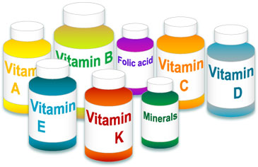
Vitamin Absorption
Small intestine absorbs most dietary vitamins, and the large intestine absorbs some of the K and B vitamins made by enteric bacteria.
Fat-soluble vitamins (A, D, E, and K) dissolve in dietary fats. If ingesting these vitamins, you need to also eat some fat containing foods otherwise little or no absorption of these vitamins will take place.
Water-soluble vitamins (B and C) absorbed easily

Slide 14
Electrolyte Absorption
Most are absorbed along the entire length of the small intestine.
Iron and calcium is limited to the duodenum.

Slide 15
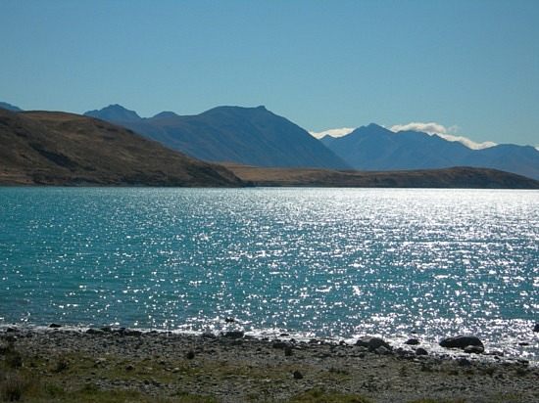
Water Absorption
Approximately 9 liters (2.4 gallons) of water enter the small intestine daily.
Water is most abundant substance in chyme.
95% of water is absorbed in small intestine by osmosis.

Slide 16
Homeostatic Imbalance – Celiac Disease
Aka – gluten sensitive enteropathy
Impaired nutrient absorption
Caused by an immune reaction to gluten, a protein plentiful in some grains (wheat, rye, barley).

Slide 17
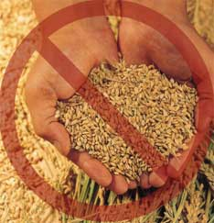
Homeostatic Imbalance – Celiac Disease
Breakdown products of gluten interact with molecules of the immune system in the GI with molecules of the immune system in the GI tract, which then mount an attack on the intestinal lining.

Slide 18
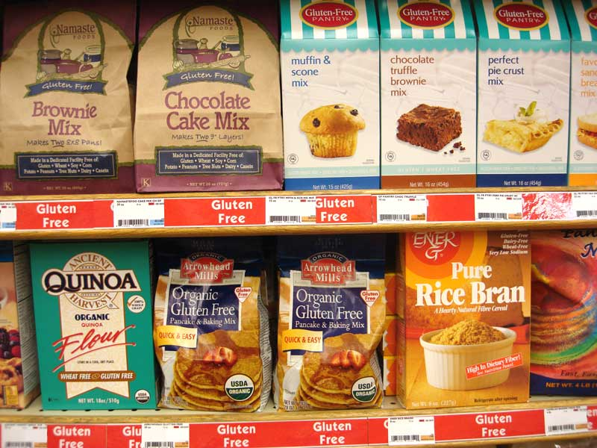
Homeostatic Imbalance – Celiac Disease
As a result, the intestinal villi are damaged and the length of the microvilli of the brush border is reduced. The resulting bloating, diarrhea, pain, and malnutrition are usually controlled by eliminating gluten-containing grains (all but rice and corn) from the diet.

Slide 19
