Slide 1
Chapter 3
Cells: The Living Units
Intro and Membrane

Slide 2
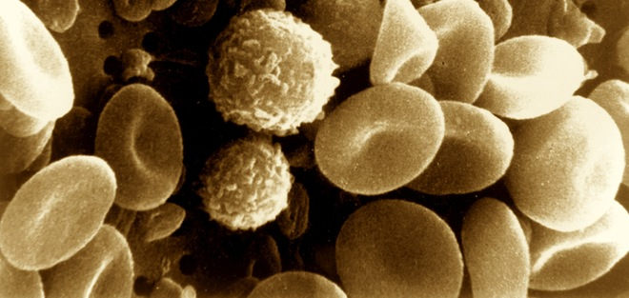
Factors that Join Cells
  Glycoproteins act as an adhesive
  Wavy contours of the membranes of adjacent cells fit together in a tongue and groove fashion
  Special membrane junctions (tight junction, desmosomes, gap junctions)

Slide 3
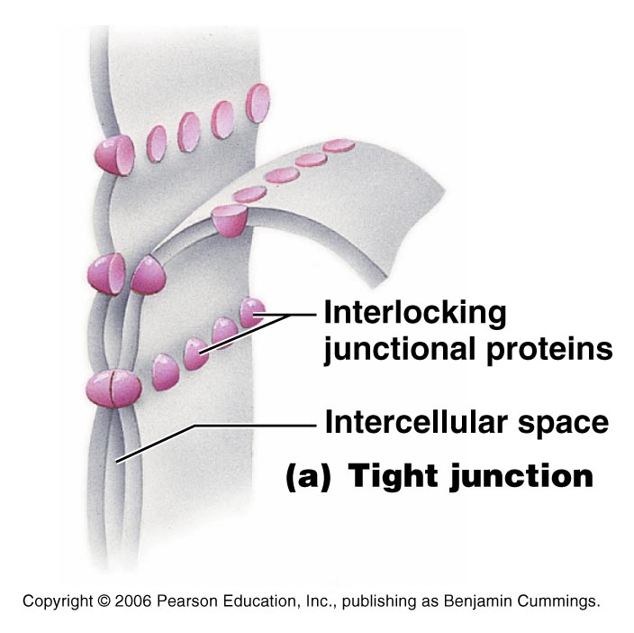
Special Membrane Junctions
Tight Junction
  Integral proteins of adjacent cells fuse together to form an impermeable junction that encircles the cell.
  Help to prevent molecules from passing through the extracellular space between cells.
  Found in lining of the digestive tract.

Slide 4
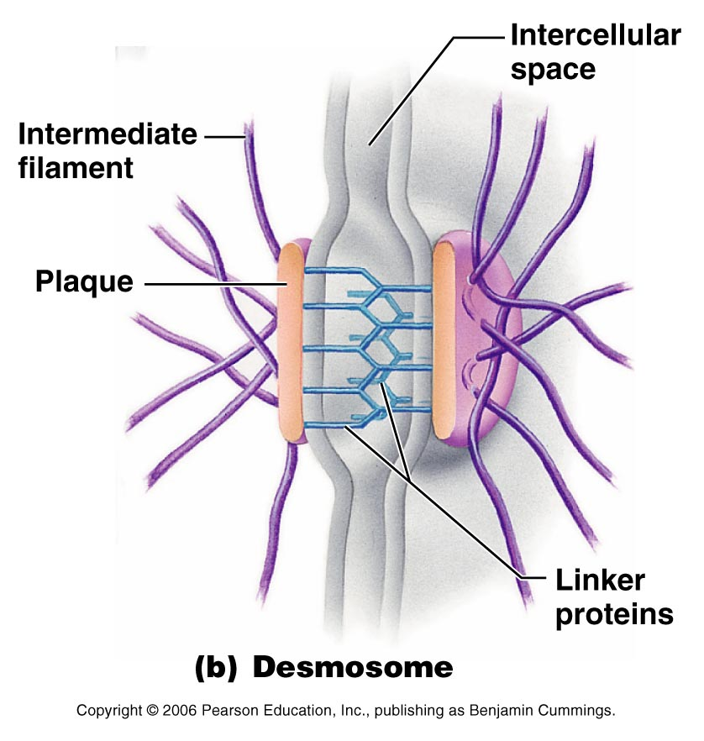
Special Membrane Junctions
Desmosomes
  “binding bodies” or anchoring junctions
  Like rivets to prevent cells from separating and distributes tension throughout a cellular sheet to reduce the chance of tearing.
  Present in skin and heart muscle

Slide 5
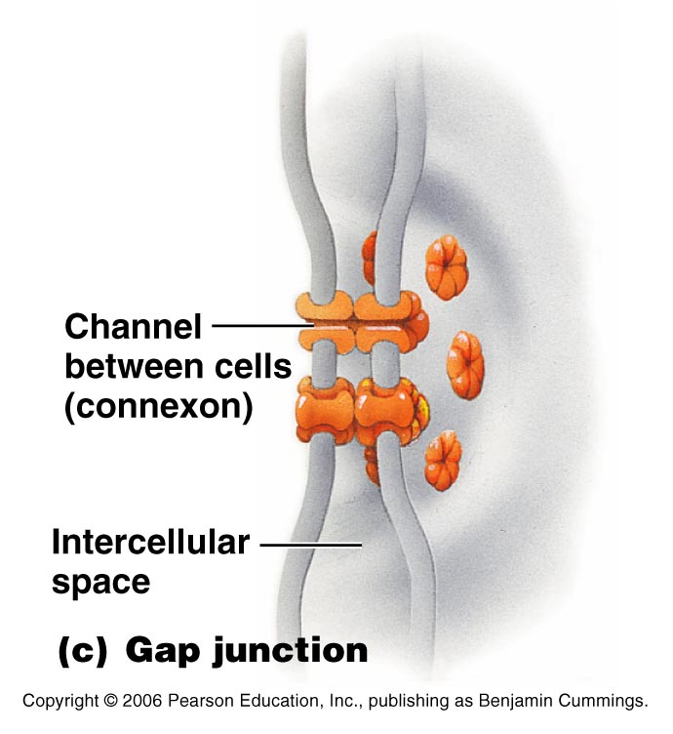
Special Membrane Junctions
Gap Junction
  “bond” or nexus
  Communicating junction between adjacent cells
  Cells are connected by hollow cylinders called connexons.
  Small molecules pass through the water filled channels from one cell to the next.
  Present in electrically excitable tissues like heart and smooth muscle

Slide 6
Functions of the Plasma Membrane
Cells are bathed in an extracellular fluid called interstitial fluid.
  Derived from the blood.
  Contains thousands of ingredients
    Amino acids, sugars, fatty acids, vitamins, hormones, neurotransmitters, salts, waste products, etc.
  Cells “take” from the interstitial fluid what they need when they need it.

Slide 7
Functions of the Plasma Membrane
The plasma membrane is selectively permeable
  Some substances can pass and others can’t
  Example → nutrients can enter, bad “stuff” can’t
  Example → Good “stuff” stays in the cell, bad “stuff” leaves

Slide 8
Membrane Transport
Passive Process
  Substances cross the membrane without any energy needed from the cell
Active Process
  Cell provides energy (ATP) to move substances through the membrane

Slide 9
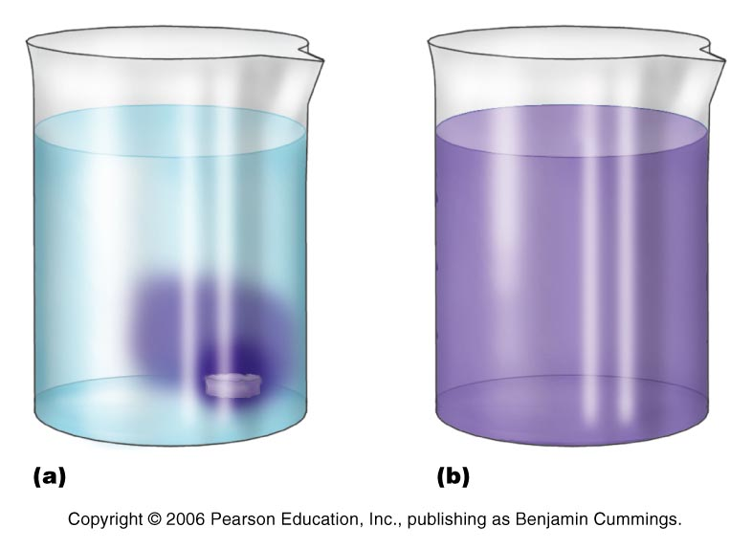
Membrane Transport - Passive
Diffusion
  Tendency of molecules or ions to scatter evenly throughout the environment
  Molecules move away from areas of high concentration to areas of low concentration (move down the concentration gradient)

Slide 10
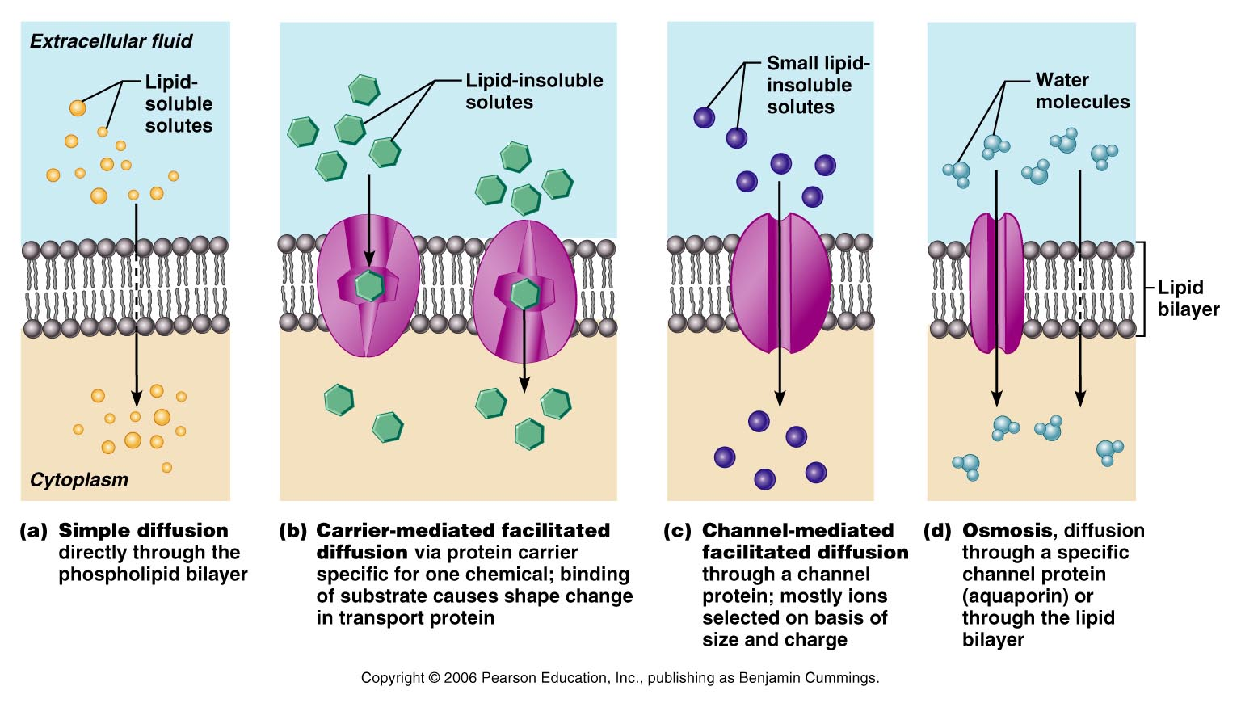
Membrane Transport - Passive
Simple diffusion
  Nonpolar and lipid-soluble substances diffuse directly through the lipid bilayer
  Oxygen, carbon dioxide, fat-soluble vitamins

Slide 11
Membrane Transport - Passive
Facilitated Diffusion
  Can’t move directly through the lipid bilayer, need some help

Slide 12
Membrane Transport - Passive
Facilitated Diffusion
  Carriers
    Uses transmembrane integral proteins
    Substance binds to protein, the transport protein changes shape, and substance is released

Slide 13
Membrane Transport - Passive
Facilitated Diffusion
    Channels
      Transmembrane integral proteins
      Substances move through the protein
      Either too big or insoluble to the lipid bilayer

Slide 14
Membrane Transport - Passive
Osmosis
  Diffusion of water (solvent) through a membrane
  Moves through the membrane or through channels
  Tonicity→ the ability of a solution to change the shape or tone of a cells by altering their internal water volume.

Slide 15
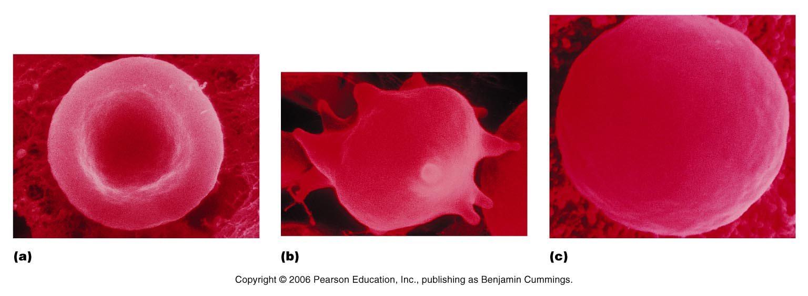
Membrane Transport - Passive
Isotonic
  Solution has the same concentration of nonpenetrating solutes as those found in cells. Cell does not change shape.

Slide 16
Membrane Transport - Passive
Hypertonic
  Solution has a higher concentration of nonpenetrating solutes than the cell. Cell loses water, so it shrinks to try and maintain an equilibrium.

Slide 17
Membrane Transport - Passive
Hypotonic
  Solution has a lower concentration of nonpenetrating solutes than the cell. Cell gains water to try and maintain an equilibrium

Slide 18
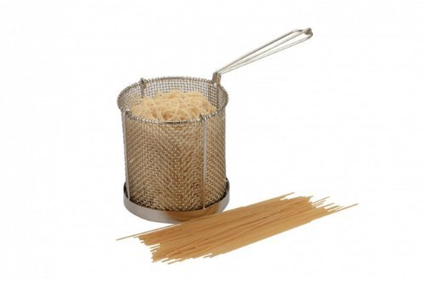
Membrane Transport - Passive
Filtration
  A pressure driven process that forces water and solutes through a membrane or capillary wall

Slide 19

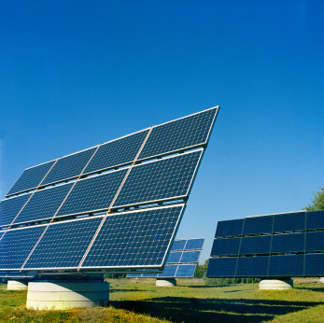
Membrane Transport - Active
Uses energy (ATP) to move solutes across the membrane

Slide 20
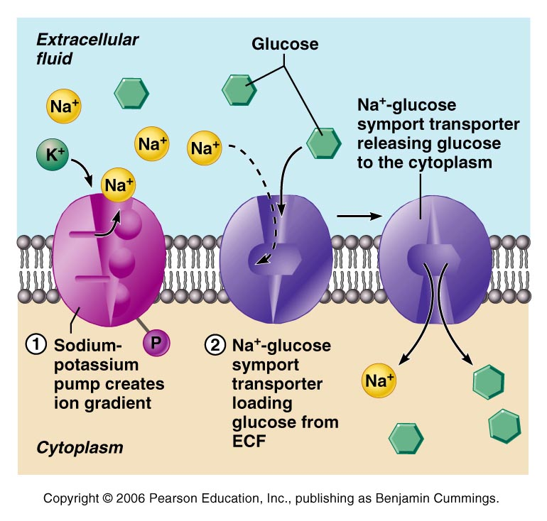
Membrane Transport - Active
Active Transport
  Like facilitated diffusion (carrier) but uses energy

Slide 21
Membrane Transport - Active
Vesicular Transport
  How large particles, macromolecules, and fluids are transported across the plasma membrane or within the cell.

Slide 22
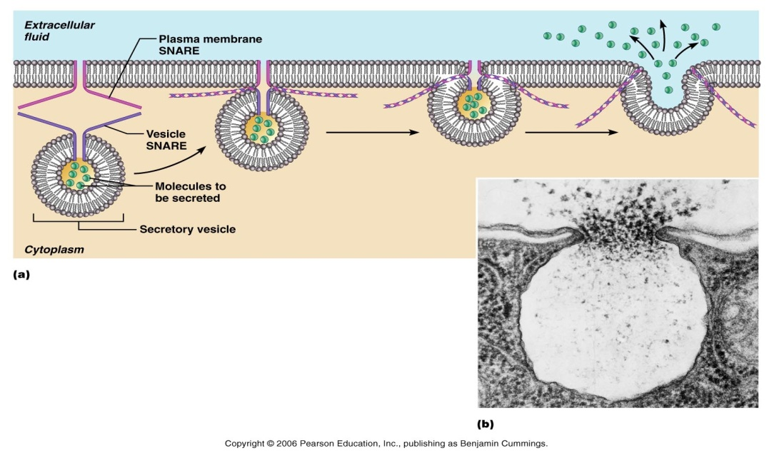
Membrane Transport - Active
Vesicular Transport
  Exocytosis
    “out of the cell”
    Substance first enclosed in a vesicle then moved outside the cell

Slide 23
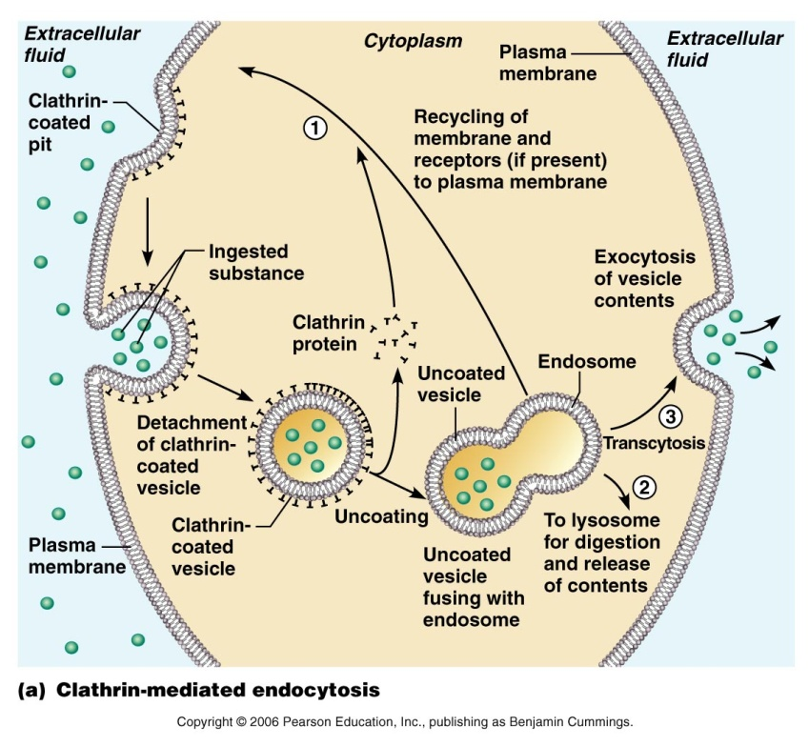
Membrane Transport - Active
Vesicular Transport
  Endocytosis
    “within the cell”
    Phagocytosis
    “cell eating”
    Some relatively large or solid material (i.e. bacteria, cell debris) is engulfed by the cell
    Particle binds to the receptors on the cell’s surface and the particle is then engulfed by the cell

Slide 24

Membrane Transport - Active
Vesicular Transport
  Pinocytosis
    “cell drinking”
    Same as phagocytosis, but with fluid

