Slide 1
Chapter 3
Cells: The Living Units
Organelles and Cell Cycle

Slide 2
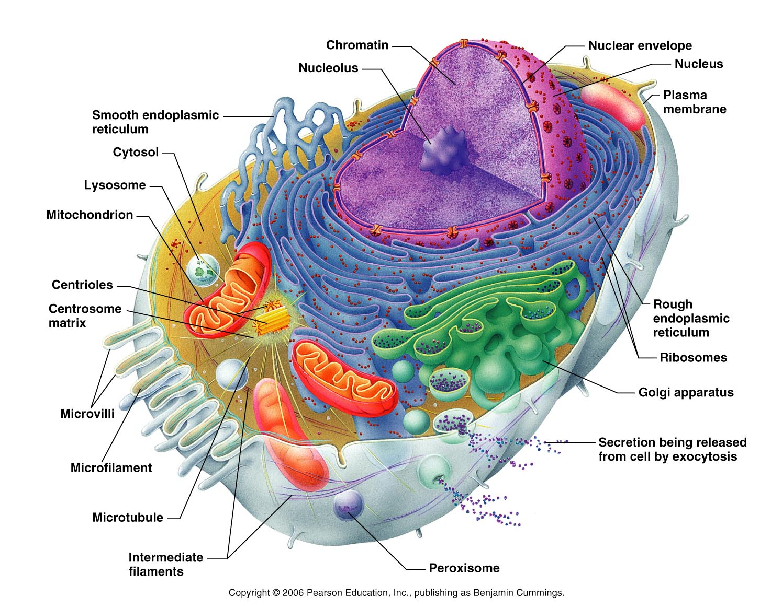
Cell Organelles
Cytoplasm
  Cellular material on the inside of the cell. The cellular region between the nuclear and plasma membrane. Major functional area of the cell.

Slide 3
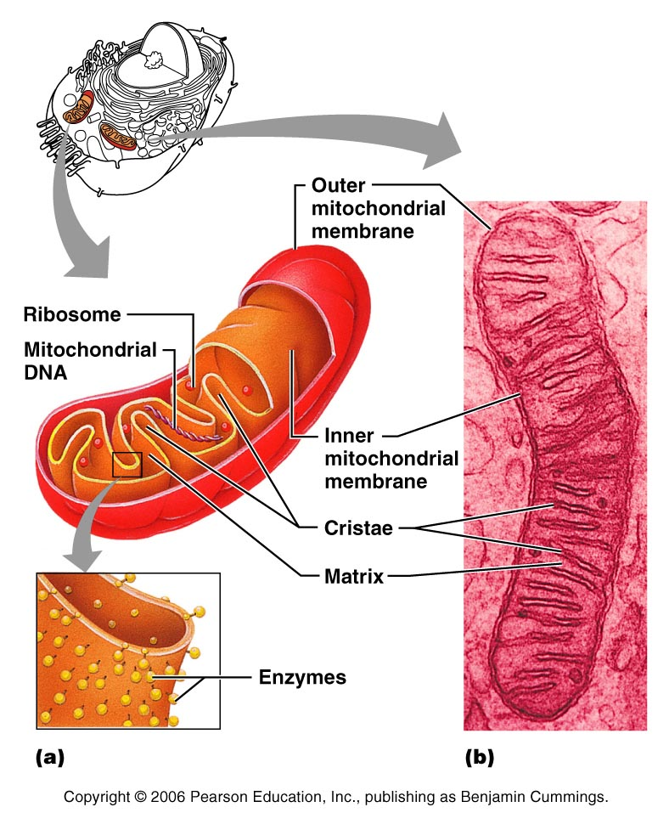
Cell Organelles
Mitochondria
  “Powerhouse of the cell” – Has a double membrane. Outer membrane smooth. Inner membrane folded inward → forms cristae. Cellular respiration (makes energy) takes place here. Found in cytoplasm.

Slide 4
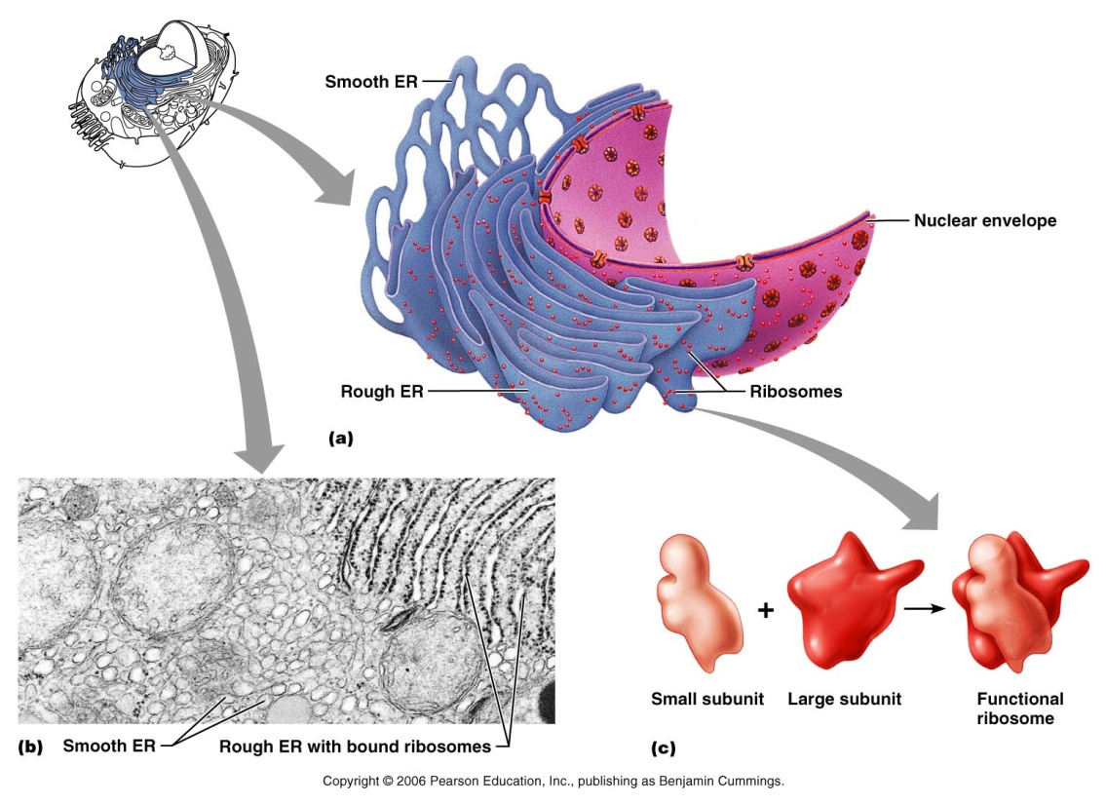
Cell Organelles
Ribosomes
  Protein synthesis takes place here. Either found free or bound to the ER

Slide 5

Cell Organelles
Rough ER
  Has ribosomes attached to the membrane. The membrane is continuous with the nuclear membrane. Its acts as a site for protein modification. “membrane factory”

Slide 6
Cell Organelles
Smooth ER
  Continuation of the rough ER. No role in protein synthesis. Site of lipid and steroid synthesis, lipid metabolism and drug detoxification. Skeletal and cardiac muscle have very elaborate smooth ER, otherwise other cells don’t really have much smooth ER

Slide 7
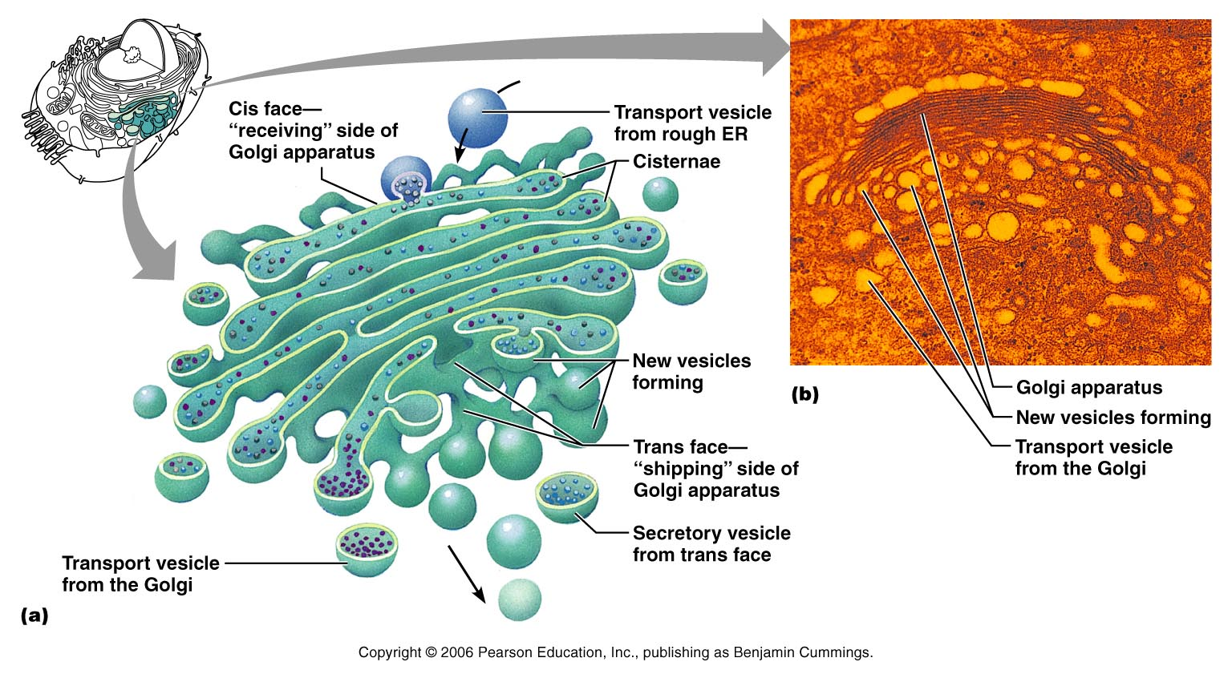
Cell Organelles
Golgi Apparatus
“ Traffic director” Packages, modifies, and segregates proteins for secretion from the cell, inclusion in lysosomes and incorporation of the plasma membrane

Slide 8
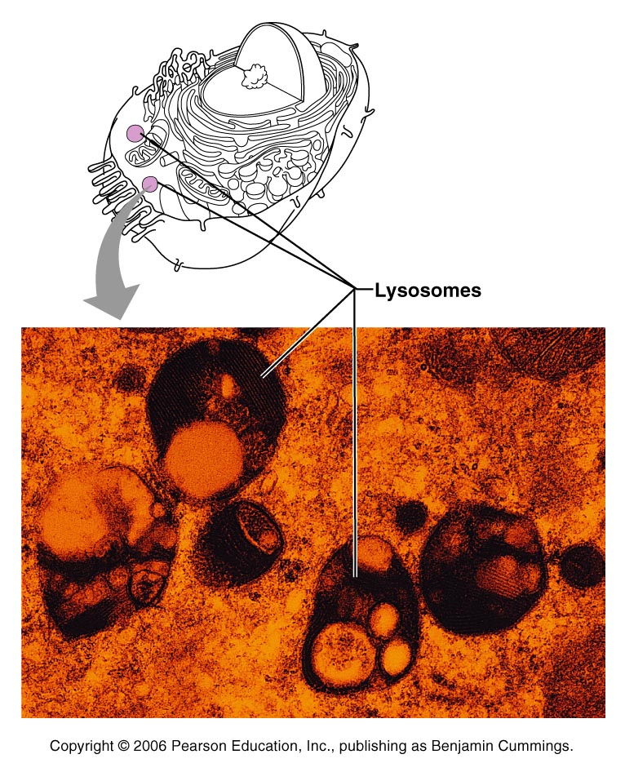
Cell Organelles
Lysosomes
“ disintegrator bodies” Spherical membranous bags containing digestive enzymes. Packaged by golgi. Sites of intracellular digestion, degrade worn out organelles, and tissues that are no longer useful, and release ionic calcium from bone. Can destroy whole cell!

Slide 9
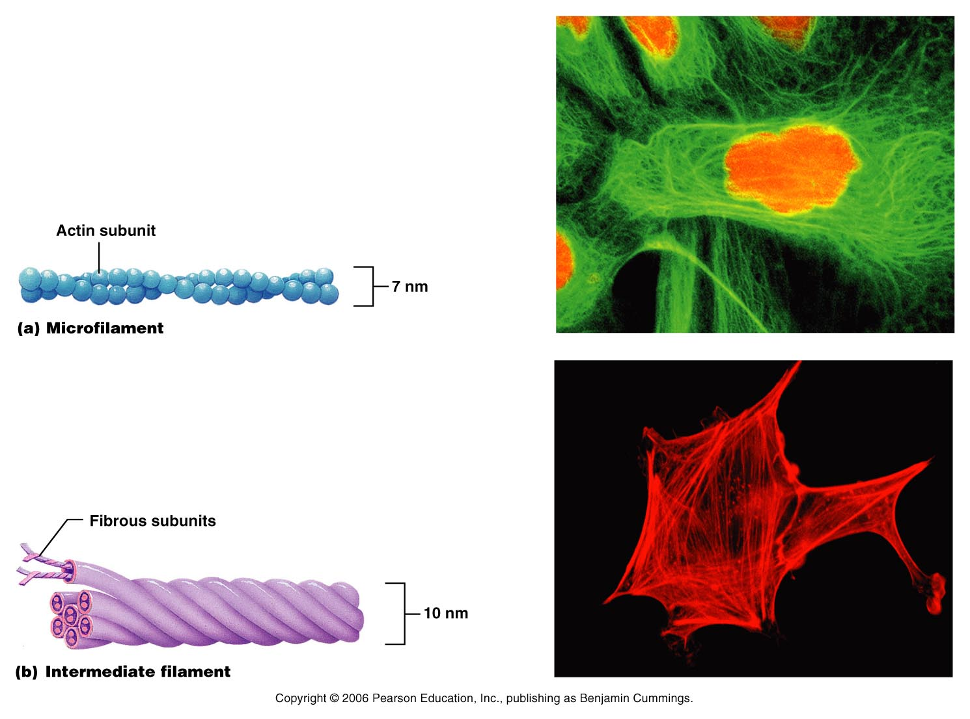
Cell Organelles
Microtubules
  Cylindrical structures made of tubulin proteins. Support the cell and give it shape. Involved in intracellular and cellular movements. Form the centrioles

Slide 10
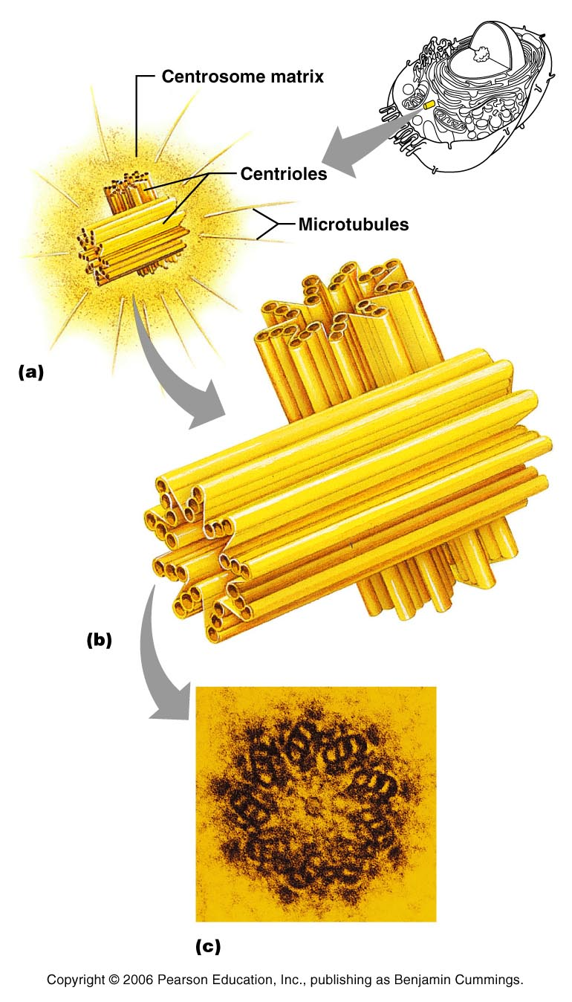
Cell Organelles
Centrioles
  Paired cylindrical bodies, each composed of nine triplets of microtubules. Organize a microtubule network during mitosis to form the spindle and asters. Form the bases of cilia and flagella

Slide 11
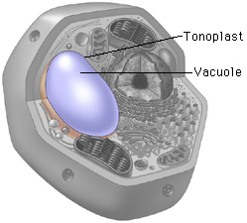
Cell Organelles
Vesicle/Vacuole
  Used for storage, comes from Golgi

Slide 12
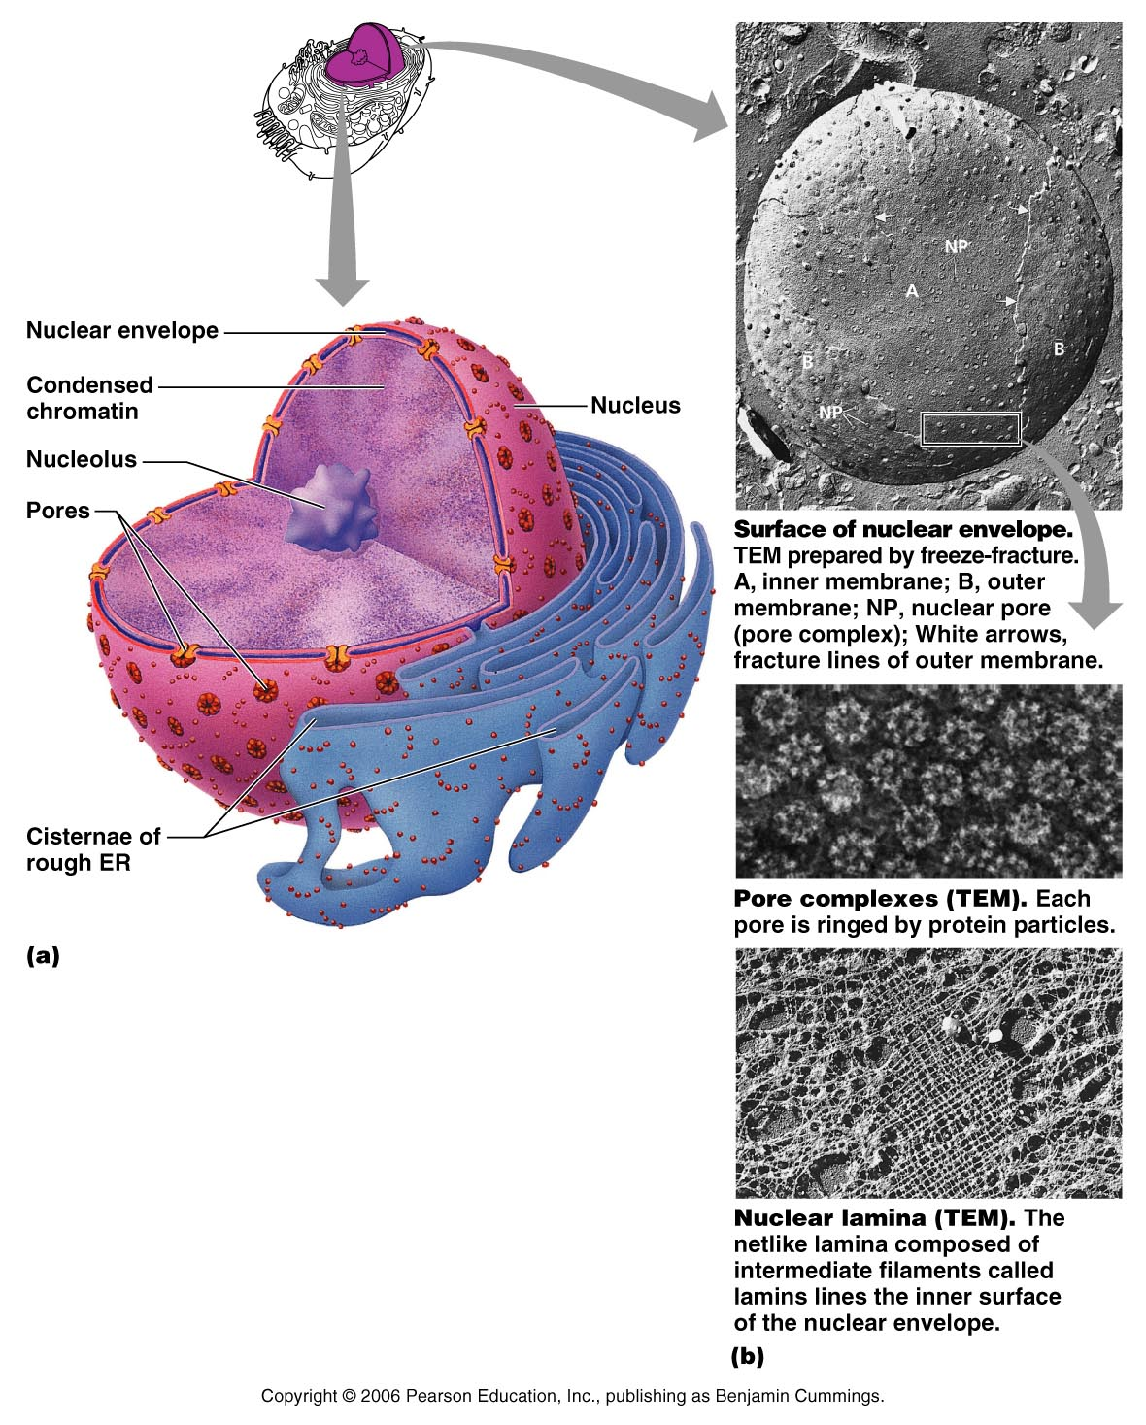
Cell Organelles
Nucleus
Largest organelle. Control center of the cell. Responsible for transmitting genetic information and providing the instructions for protein synthesis

Slide 13
Cell Organelles
Nuclear Membrane
  Separates the nucleoplasm from the cytoplasm and regulates passage of substances to and from the nucleus

Slide 14
Cell Organelles
Nucleoli
  Makes ribosomes

Slide 15
Cell Organelles
Chromatin
  Granular, threadlike material composed of DNA and histone proteins. DNA constitutes the genes.

Slide 16
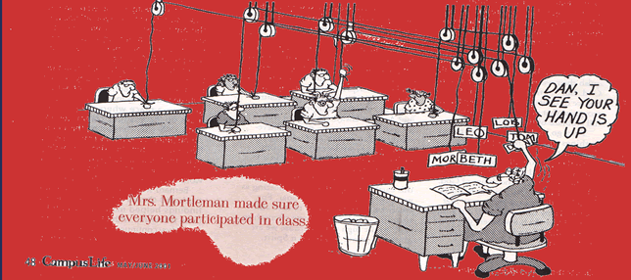

Slide 17
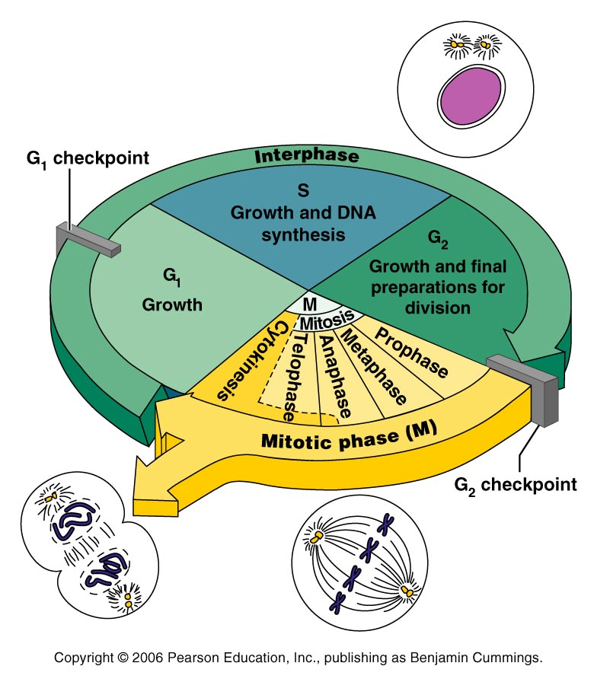
Cell Cycle
The life cycle of any cell – from the time the cell is formed until the time it goes through cell division
Includes Interphase, Mitosis (prophase, metaphase, anaphase, telophase) and cytokinesis

Slide 18
Interphase
G₀ Phase– nonreplicating part of interphase; cells that permanently cease dividing

Slide 19
Interphase
G₁ – Most of the growth, function, replication of extra organelles, and cellular development (metabolically active, synthesize proteins rapidly and grow vigorously). Length is variable - can last from minutes to hours. From days to years.

Slide 20
Interphase
S Phase - (synthesis) – DNA is synthesized

Slide 21
Interphase
G₂ – enzymes and proteins necessary for cell division are synthesized and moved to their proper sites. Brief. At the end of this phase the cell is ready to divide! ☺

Slide 22
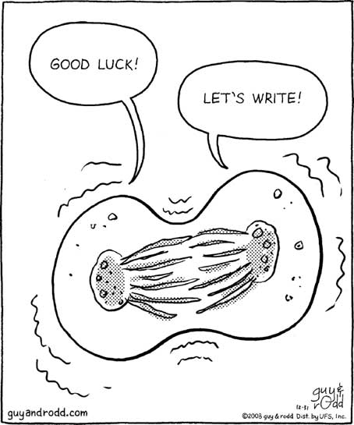
Cellular Division
Essential for growth and tissue repair (i.e. cuts)
Some cells wear away constantly (i.e. skin, intestinal lining)

Slide 23
Cellular Division
Some cells divide slowly but retain the ability to reproduce quickly if damaged (i.e. liver)
Some cells lose the ability to divide (i.e. nervous tissue, skeletal muscle, and cardiac muscle)

Slide 24
Mitotic Phase – Mitosis
Mitosis → When the replicated DNA is divided into two “new” cells

Slide 25
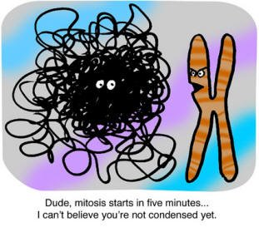
Mitotic Phase – Mitosis
Early Prophase
  Chromatin coils and condenses to form chromosomes.
  Because the DNA is replicated, there are two identical chromatids → they are held together by the centromere

Slide 26
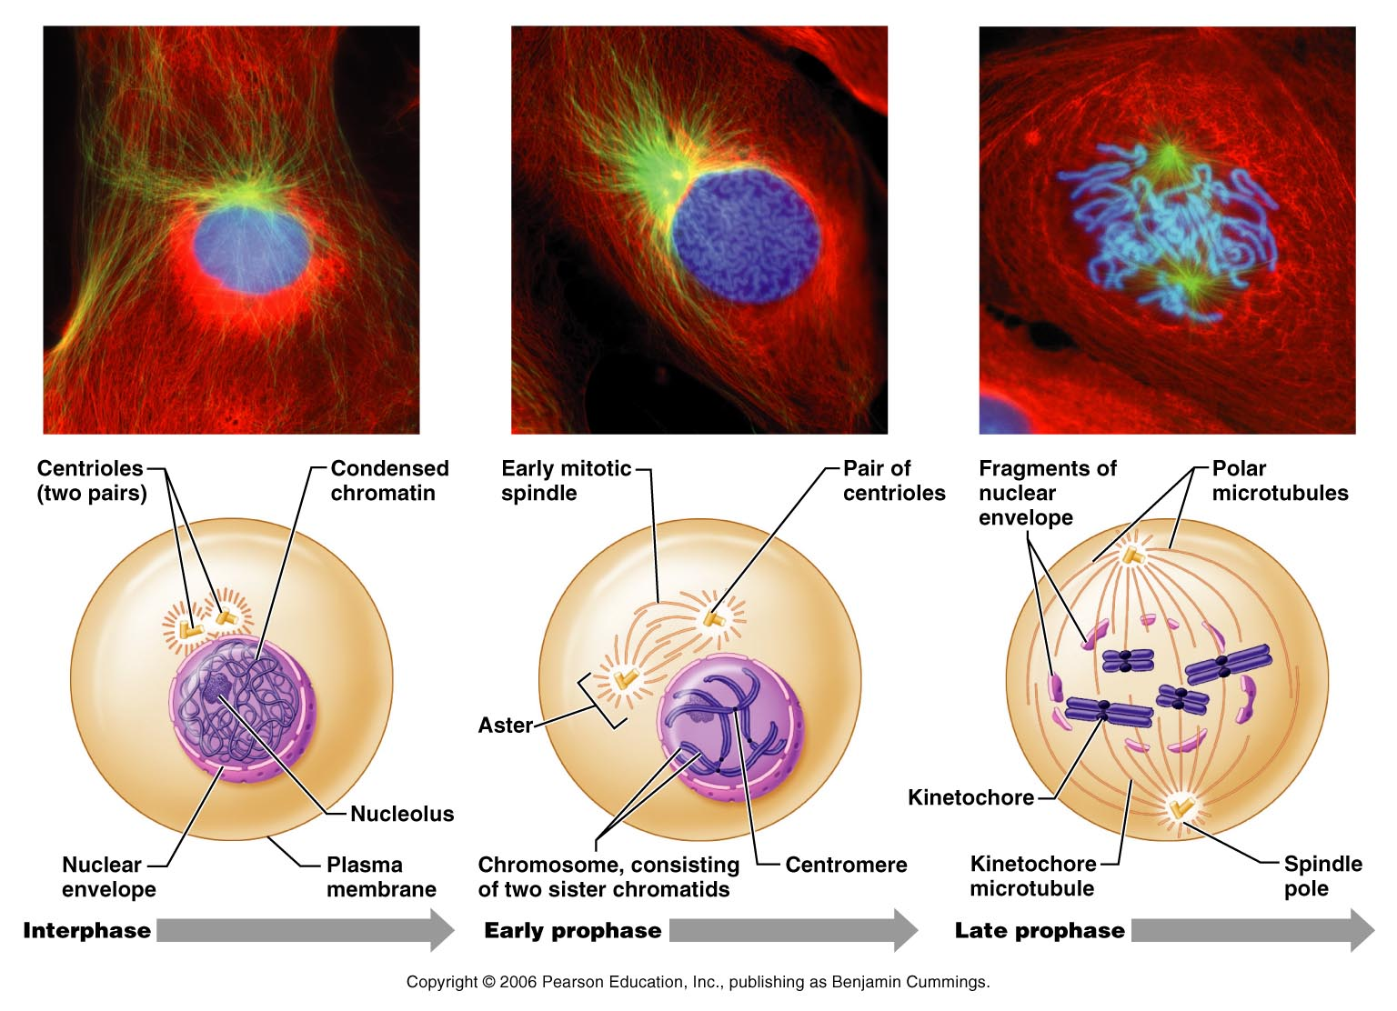
Early Prophase
  Nuceoli disappear
  Centrioles start moving to opposite sides of the cell
  Spindle fibers (organized by the centrioles) lengthen

Slide 27
Mitotic Phase – Mitosis
Late Prophase
  Centrioles still moving
  Nuclear membrane disappears
  Spindle fibers attach to the centromere (at the kinetochore)
  Chromosomes start to be pulled to the middle of the cell

Slide 28
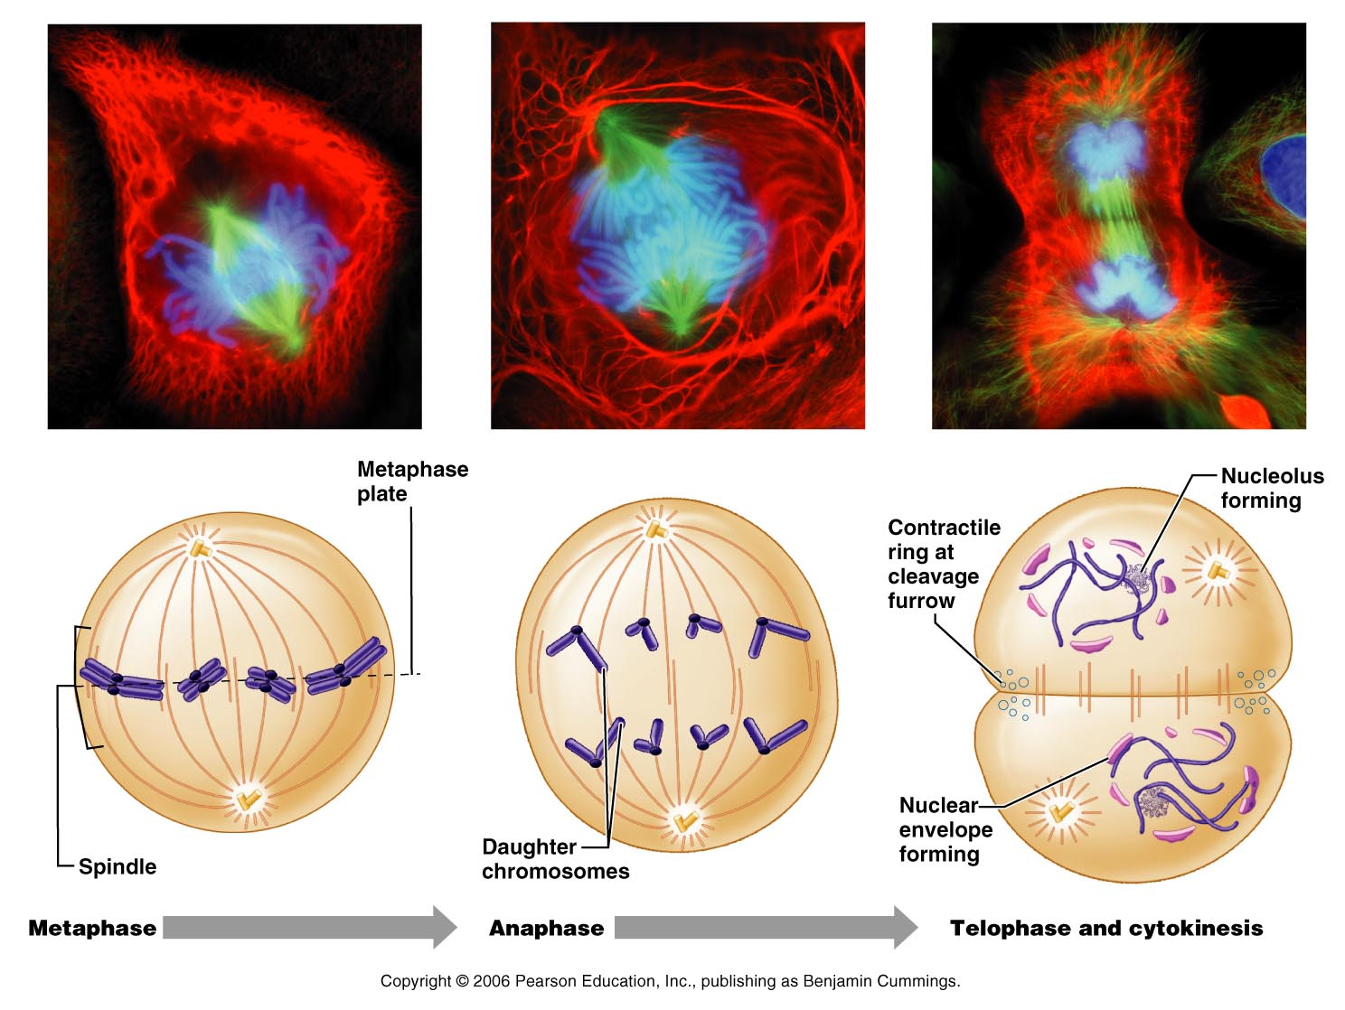
Mitotic Phase – Mitosis
Metaphase
  Chromosomes line up along the middle of the cell
  Centromeres are lined up at the exact middle of the cell.

Slide 29
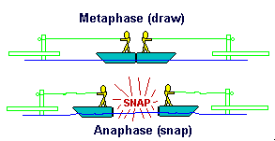
Mitotic Phase – Mitosis
Anaphase
  Begins when the centromeres are split and chromosomes are pulled to the opposite sides of the cell
  The cell starts to lengthen

Slide 30
Mitotic Phase – Mitosis
Telophase
  Begins when chromosomes stop moving
  Chromosomes uncoil
  Nuclear membrane reforms
  Nuceoli reappear
  Basically prophase in reverse

Slide 31
Mitotic Phase – Cytokinesis
The division of cytoplasm into two separate cells.
Begins during late anaphase and is completed after mitosis (telophase) ends.

Slide 32
Mitotic Phase – Cytokinesis
Plasma membrane is drawn inward to form a cleavage furrow.
Furrow deepens until cytoplasm and cell is pinched into two parts.
There are now two identical cells

Slide 33
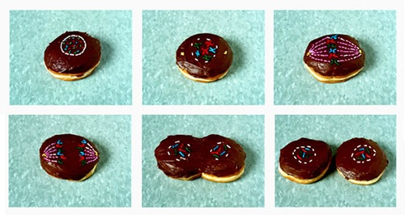

Slide 34
