Slide 1
Chapter 1
The Human Body: An Orientation

Slide 2
Maintaining Life!!
Organ systems don’t work in isolation; they work cooperatively to promote the well-being of the entire body.
Characteristics of living things!

Slide 3
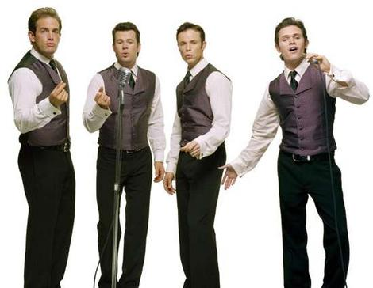
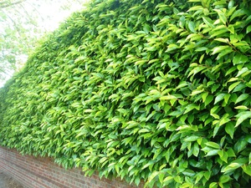
Necessary Life functions
Maintaining Boundaries
  Internal environment remains distinct from the external environment.
    Cells have a membrane
    Humans have skin

Slide 4
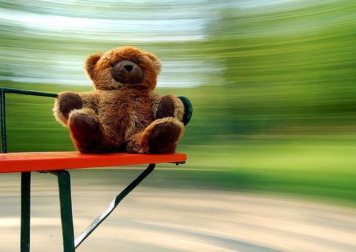
Necessary Life functions
Movement
  Propelling ourselves by using muscles
  Movement of substances inside the body such as blood, foodstuffs, urine, etc.
  Cellular level too

Slide 5
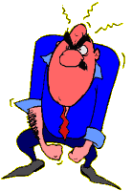
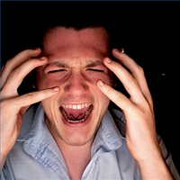
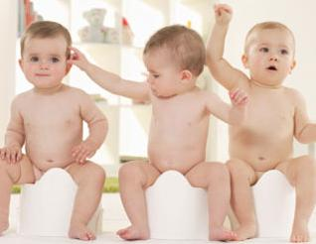
Necessary Life functions
Responsiveness or Irritability
  Ability to sense changes (stimuli) in the environment and respond to them.
    Cut your hand - pull your hand away → withdrawal reflex – don’t even think about it, just happens
    Nervous system is mainly in charge

Slide 6
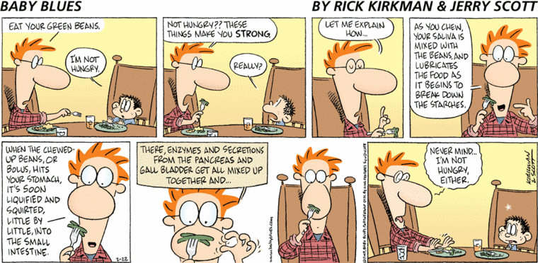
Necessary Life functions
Digestion
  Breaking down of ingested food into simple molecules that can be absorbed into the blood.

Slide 7
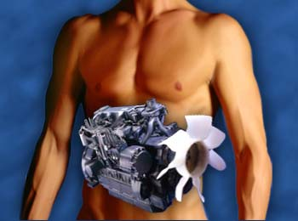
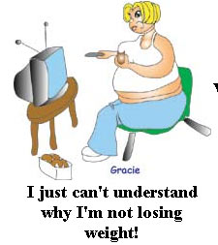
Necessary Life functions
Metabolism
  All chemical reactions that occur within body cells.
    Catabolism- breakdown of “stuff” into simpler parts
    Anabolism – synthesizing more complex cellular structures from simpler substances
    Cellular respiration – using nutrients and oxygen to produce ATP

Slide 8
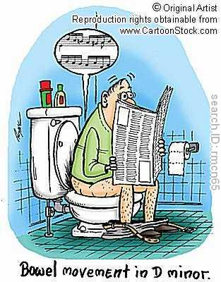
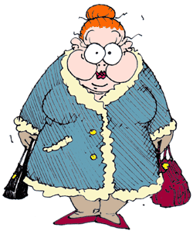
Necessary Life functions
Excretion
  Process of removing wastes from the body
  Digestive system and Urinary system and respiratory system

Slide 9
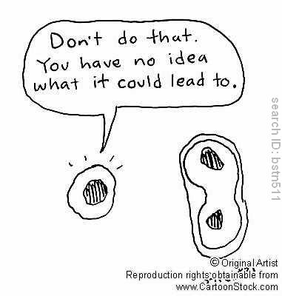
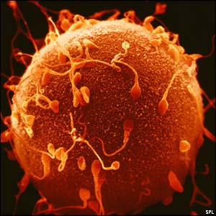
Necessary Life functions
Reproduction
  Cellular or organismal level
    Cellular level – one cell divides and becomes two
    Organismal – sperm and egg

Slide 10
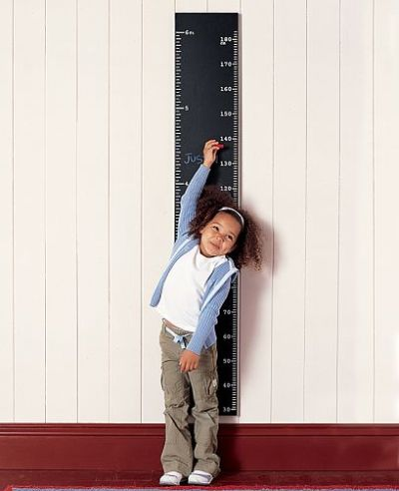
Necessary Life functions
Growth
  Increase in the size of a body part or the organism
  Usually accomplished by increasing the number of cells

Slide 11
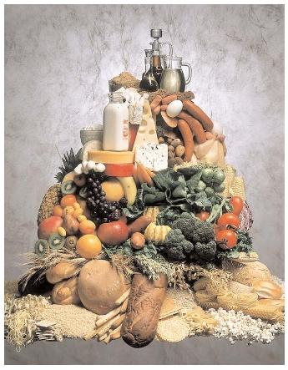
Survival Needs
Nutrients
  Taken in via the diet
  Contain the chemical substances used for energy and cell building
  Needed for cellular respiration

Slide 12
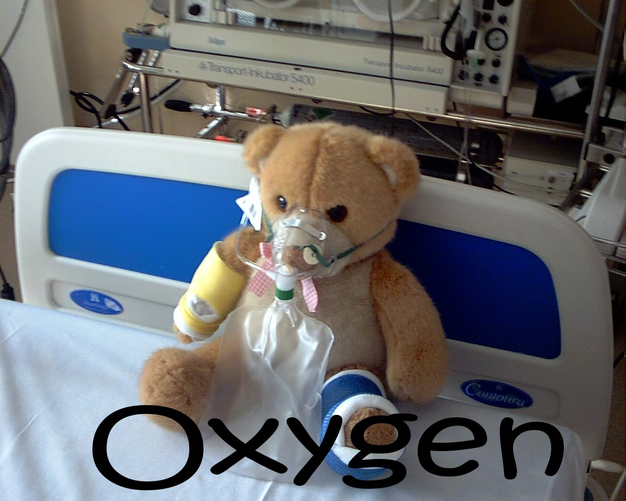
Survival Needs
Oxygen
  Cellular respiration (how cells get energy) needs oxygen!!
  Approximately 20% of the air we breathe is oxygen

Slide 13
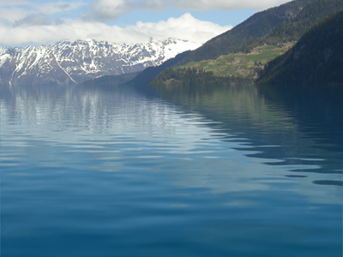
Survival Needs
Water
  60-80% of our body weight
  Needed for chemical reactions
  Needed for body secretions and excretions

Slide 14
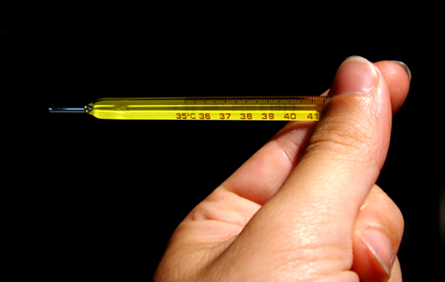
Survival Needs
Normal Body Temperature
  Needed for chemical reactions to occur
  Body temperature 98.6ºF
    Too low – chemical reactions stop
    Too high – chemical reactions occur too fast and proteins lose shape and stop working.

Slide 15
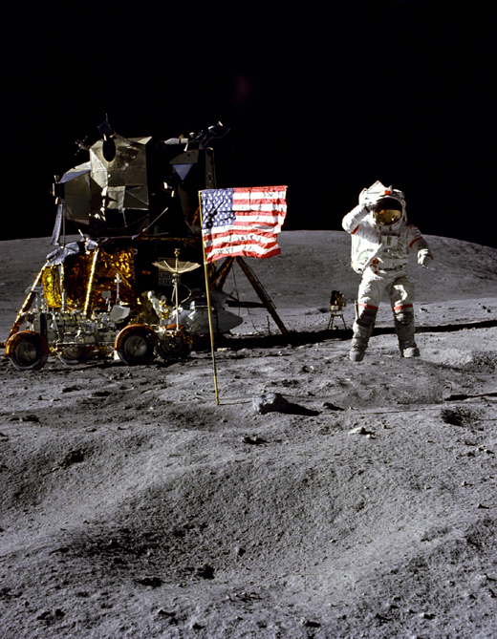
Survival Needs
Atmospheric Pressure
  Force that air exerts on the surface of the body.
  Needed for gas exchange in the lungs

Slide 16
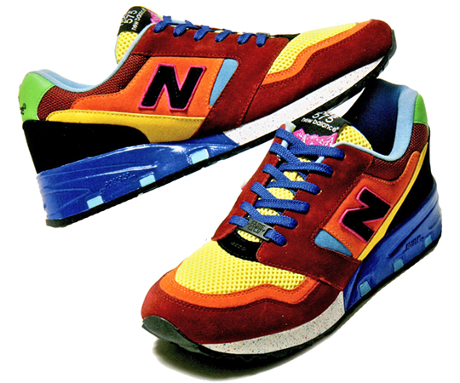
Homeostasis
The ability to maintain a relatively stable internal environment even though the outside is constantly changing
Dynamic state of equilibrium or balance
  vary a little, but not much

Slide 17
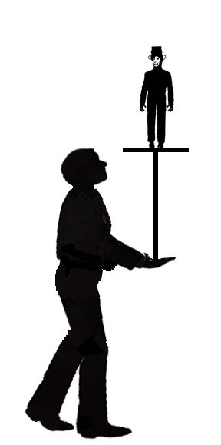
Homeostasis
Very complicated
All organ systems contribute to equilibrium
Controlled by nervous system and endocrine system

Slide 18
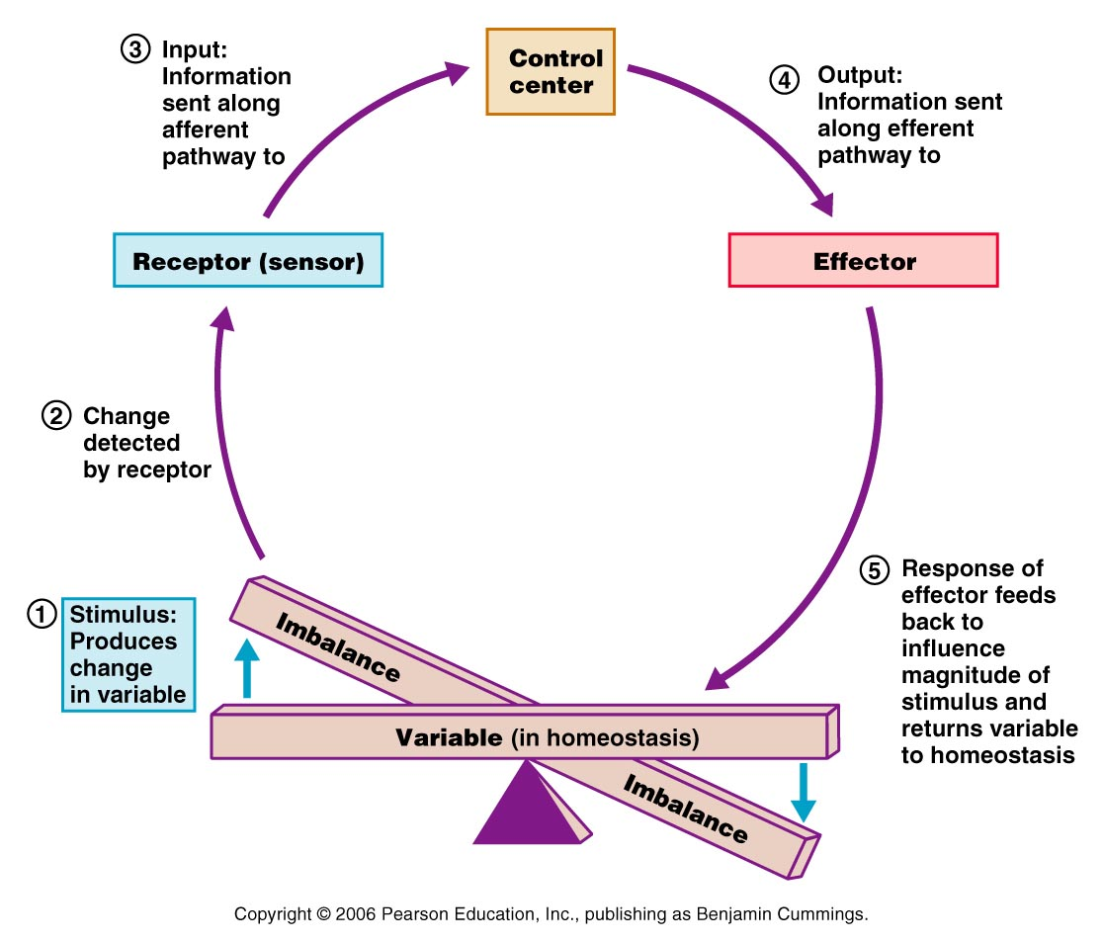
Homeostasis
Variable – what is being regulated

Slide 19
Homeostasis
Receptor (sensor) – monitors environment and responds to changes (stimuli)
  Sends information (input) to the control Center

Slide 20
Homeostasis
Control Center – receives input and determines the set point (the level or range the variable is to be maintained
  Analyzes the input and then determines the appropriate response or course of action

Slide 21
Homeostasis
Effector – provides the means for the control center’s response (output) to the stimulus
  The results of the response then feed back to influence the stimulus, either depressing it (negative) or enhancing it (positive)

Slide 22
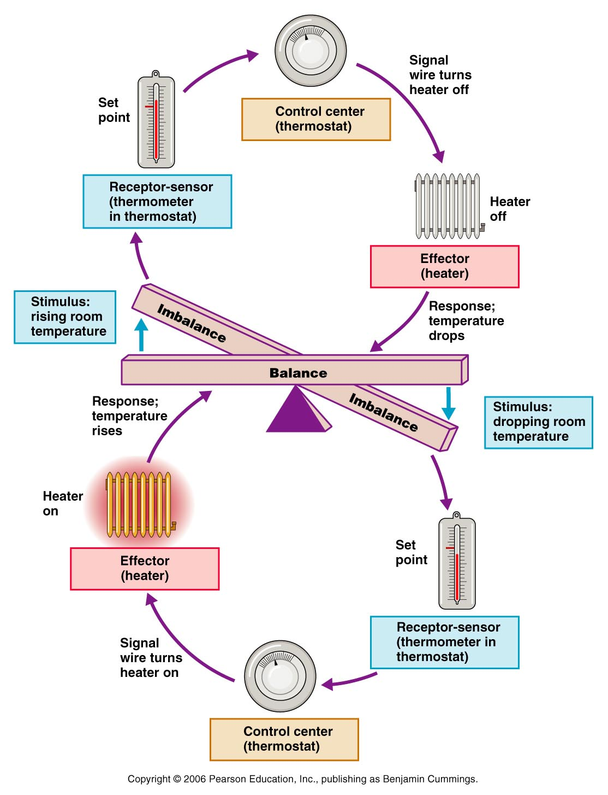
Homeostasis
Negative Feedback
  System shuts off the stimulus or reduces the intensity
  All to prevent sudden and severe changes in the body

Slide 23
Homeostasis
Negative Feedback
  Causes the variable to change in the opposite direction
  Heating/cooling systems, regulation of body temp
  Most common!

Slide 24
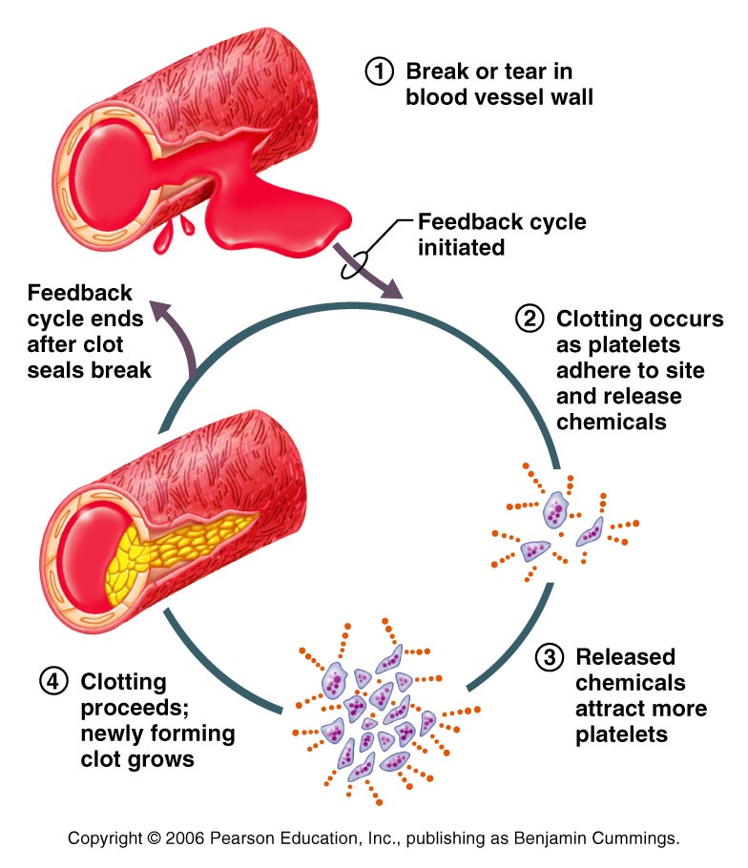
Homeostasis
Positive Feedback
  The result or response of the system is to enhance/exaggerate the original stimulus so that the activity (output) is accelerated
  Called cascades because they are likely to race out of control

Slide 25
Homeostasis
Positive Feedback
  Causes variable to change in the same direction
  Blood clotting, labor

