Slide 1
Chapter 1
The Human Body: An Orientation

Slide 2
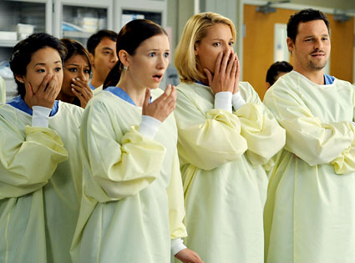
An Overview of A & P
Anatomy
  Study of the structure of body parts and their relationship to one another

Slide 3
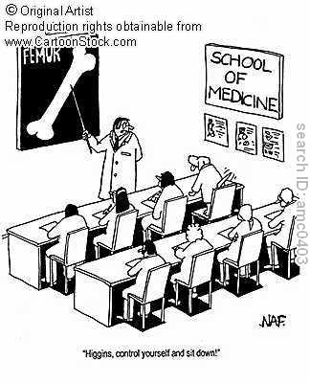
An Overview of A & P
Physiology
  How the parts of the body work and carry out their life-sustaining activities

Slide 4
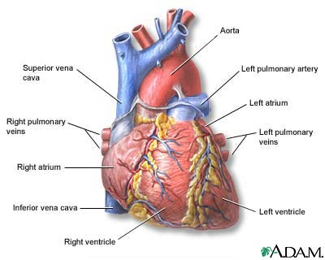
An Overview of A & P
Macroscopic (Gross) Anatomy
  Study of the body structures that are visible to the naked eye

Slide 5
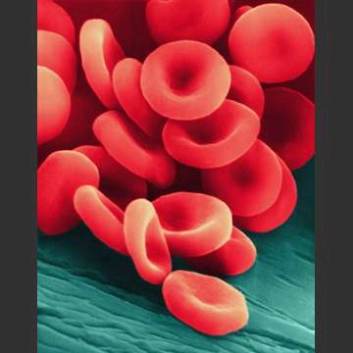
An Overview of A & P
Microscopic Anatomy
  Study of the body structures that are too small to be seen with the naked eye.

Slide 6
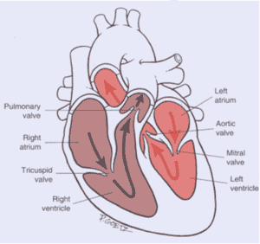
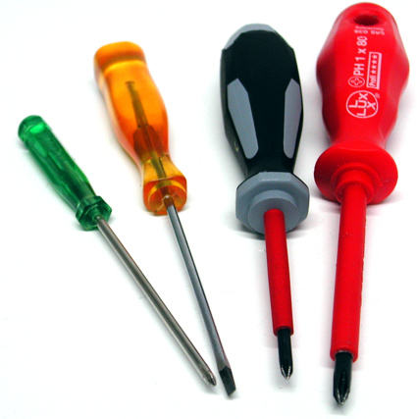
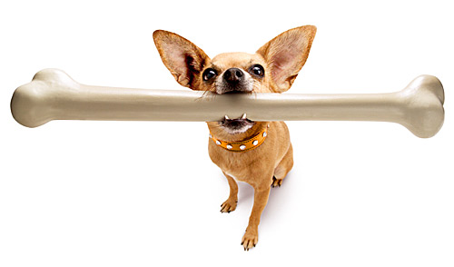
An Overview of A & P
Principle of complementarity of structure and function
  What a structure can do depends on its specific form!
    Bones can support because they contain hard mineral deposits
    Blood flows in one direction in the heart because of the valves.

Slide 7
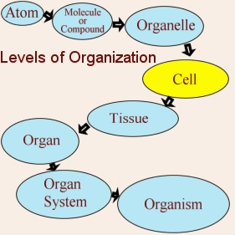
An Overview of A & P
Levels of Organization:
  Atom → Molecule → Organelle → Cell → Tissue → Organ → Organ System → Organism
  Carbon → Sugar → Mitochondria → Muscle Cell → Muscle → Stomach → Digestive → Human

Slide 8
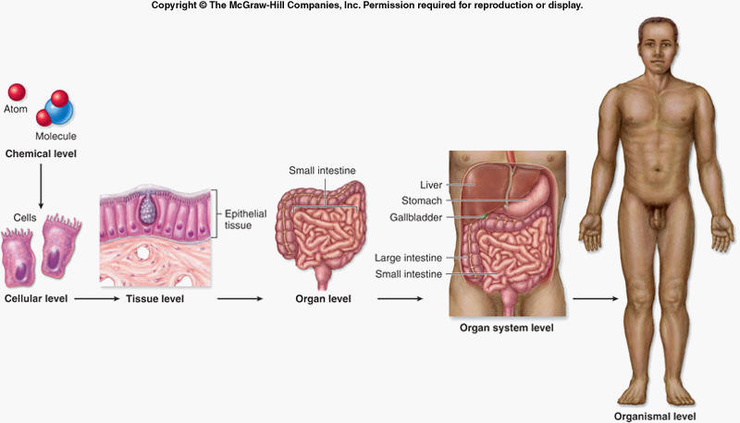
An Overview of A & P

Slide 9
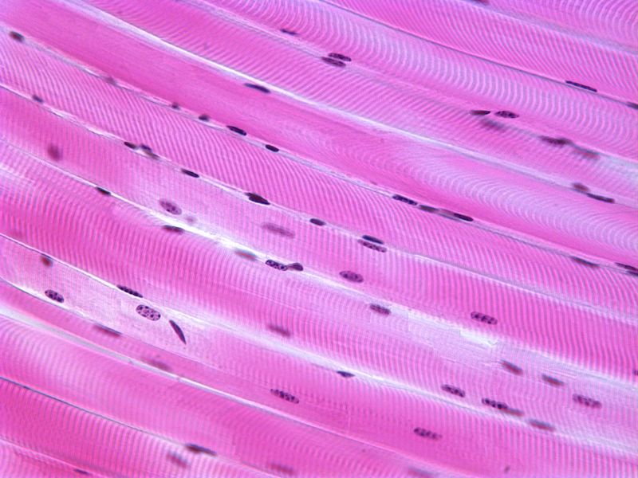
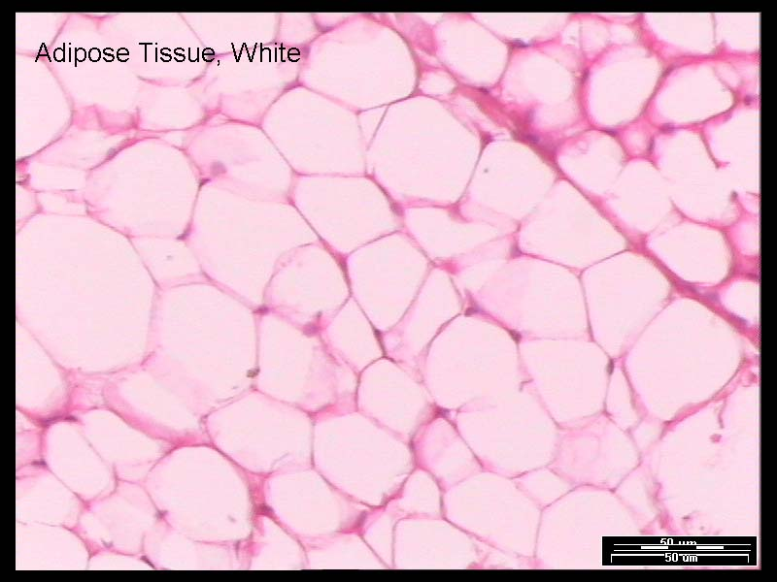
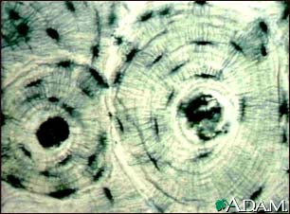
An Overview of A & P
Tissue
  A group of similar cells that have a common function

Slide 10
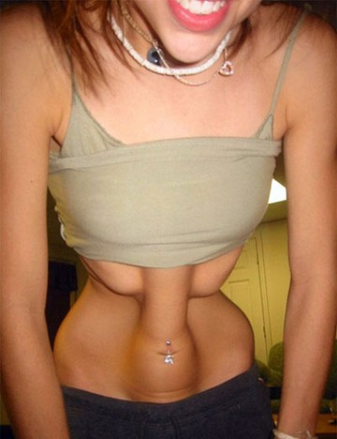
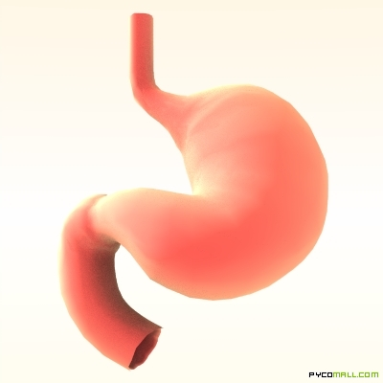
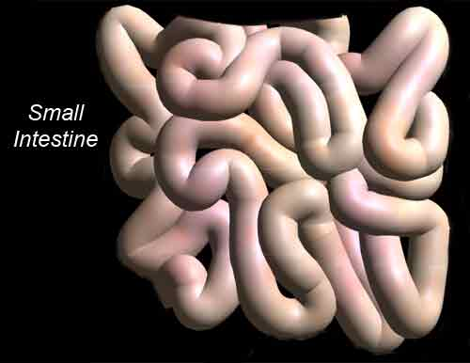
An Overview of A & P
Organ
  Structure that is composed of at least two types of tissue that perform a specific function

Slide 11
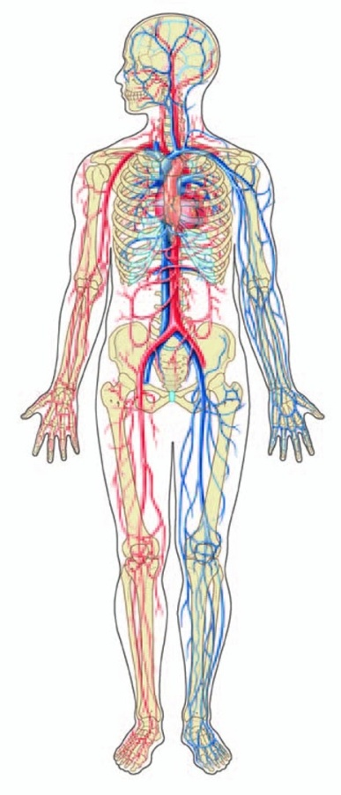
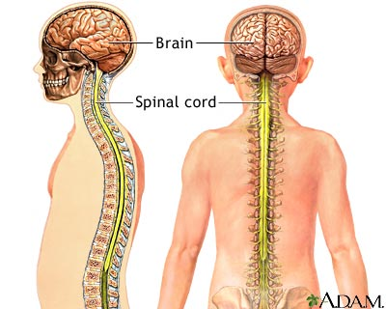
An Overview of A & P
Organ System
  Organs that work together to accomplish a common purpose.

Slide 12
An Overview of A & P
Organ Systems
  Integumentary
  Skeletal
  Muscular
  Lymphatic/Immunity
  Respiratory
  Digestive
  Nervous
  Endocrine (hormones)
  Cardiovascular
  Urinary
  Reproductive

Slide 13
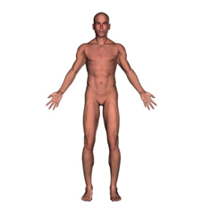
Anatomical Position
Standing erect
Feet slightly apart
Hands at sides
Palms facing forwards with thumbs facing out.
Directional terms refer to the body in the anatomical position, regardless of the actual position.

Slide 14
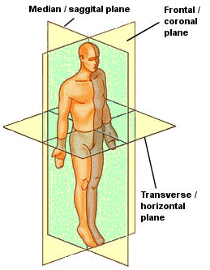
Body Sections and Directional Terms
Sagittal plane
  Vertical plane that divides the body into right and left sides
Mid-sagittal plane
  Vertical plane that divides the body into equal right and left sides

Slide 15
Body Sections and Directional Terms
Transverse Plane (horizontal/cross-sectional):
  Horizontal plane that divides the body into top (superior) and bottom (inferior) sections.

Slide 16
Body Sections and Directional Terms
Frontal Plane:
  Vertical plane that divides the body into front (anterior) and back (posterior) sections.

Slide 17
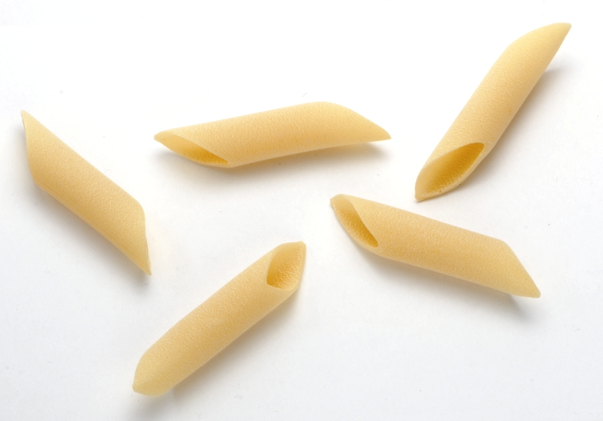
Body Sections and Directional Terms
Oblique section
  Cuts made diagonally between the horizontal and vertical planes
  Often confusing and difficult to interpret and are seldom used.

Slide 18
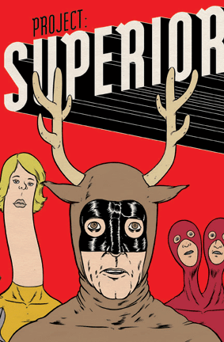
Body Sections and Directional Terms
Superior (Cranial)
  Towards the head or upper part of a structure of the body; above

Slide 19
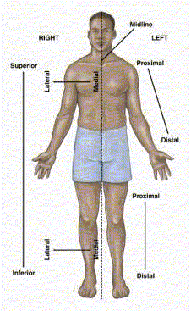
Body Sections and Directional Terms
Inferior (caudal):
  Away from the head or towards the lower part of a structure of the body; below

Slide 20
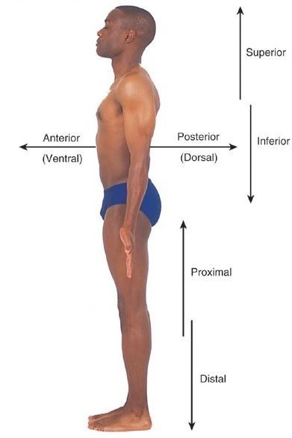
Body Sections and Directional Terms
Anterior (Ventral)
  Toward or at the front of the body; in front of

Slide 21
Body Sections and Directional Terms
Posterior (Dorsal)
  Toward or at the back of the body; behind

Slide 22
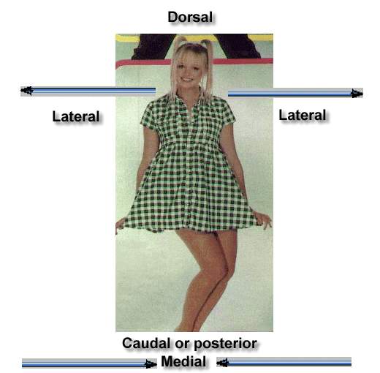
Body Sections and Directional Terms
Medial
  Towards or at the middle (midline) of the body

Slide 23
Body Sections and Directional Terms
Lateral
  Away from the middle of the body; to the side

Slide 24
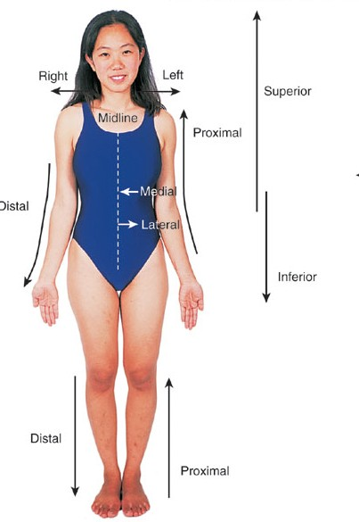
Body Sections and Directional Terms
Intermediate
  Between a more medial and lateral structure.

Slide 25
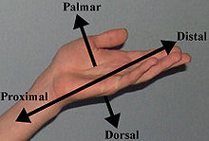
Body Sections and Directional Terms
Proximal
  Closer to the origin of the body part or the point of attachment of a limb to the body trunk

Slide 26
Body Sections and Directional Terms
Distal
  Farther from the origin of a body part or the point of attachment of a limb to the body trunk

Slide 27
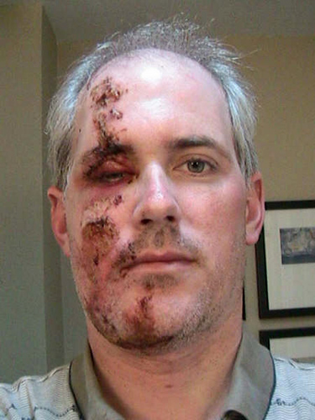
Body Sections and Directional Terms
Superficial (external)
  Toward or at the body surface

Slide 28
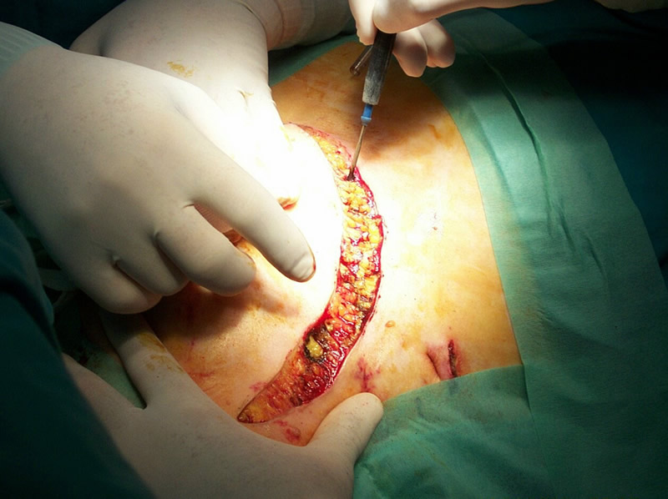
Body Sections and Directional Terms
Deep (internal)
  Away from the body surface; more internal

Slide 29
Body Sections and Directional Terms
The pinky is _________ to the index finger.
The chin is __________ to the nose.
The elbow is __________ to the wrist.
The muscle is __________ to the skin.

Slide 30
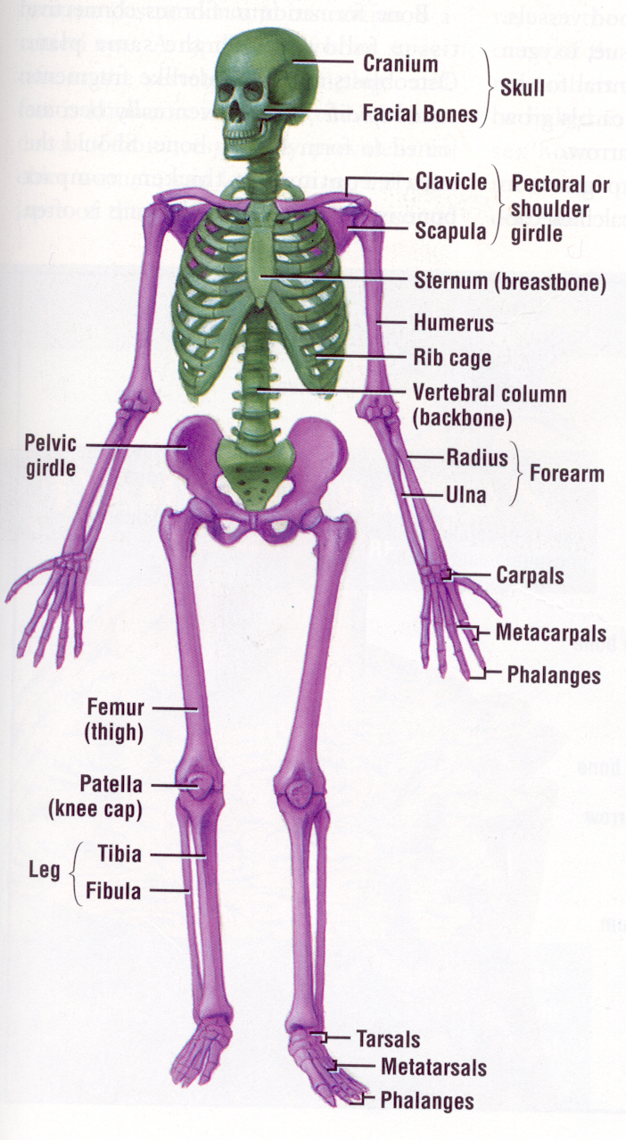
Regional Terms
Axial
  Axis of the body, consists of the head, neck, and trunk

Slide 31
Regional Terms
Appendicular
  The appendages or limbs of the body

Slide 32
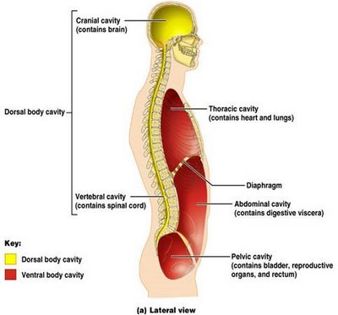
Body Cavities
Dorsal Body Cavity
  Body cavities towards the back of the body
  Broken down into the Cranial and Spinal Cavity

Slide 33
Body Cavities
Cranial Cavity
  Encases the brain

Slide 34
Body Cavities
Vertebral/Spinal Cavity
  Runs within the bony vertebral column, encloses the spinal cord

Slide 35
Body Cavities
Ventral Body Cavity
  More anterior and larger body cavity
  Broken down into the Thoracic Cavity and the Abdominopelvic Cavity
  Divided by the diaphragm

Slide 36
Body Cavities
Thoracic Cavity
  Surrounded by the rib cage
  Inferior border: diaphragm
  Divided into the Pleural Cavities and Mediastinum

Slide 37
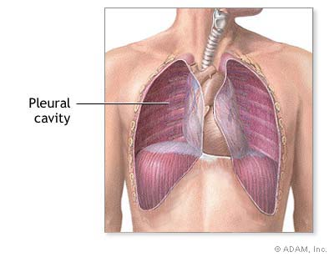
Body Cavities
Pleural Cavity
  Contains the lungs

Slide 38
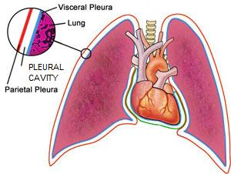
Body Cavities
Mediastinum
  Contains the pericardial cavity and also surrounds the esophagus, trachea, and some other organs.

Slide 39
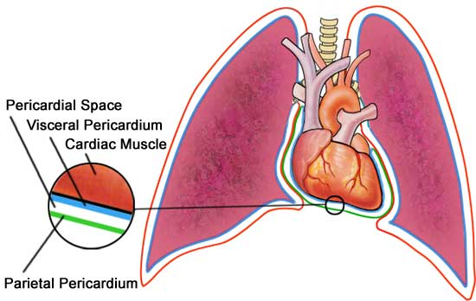
Body Cavities
Pericardial Cavity
  Encloses the heart

Slide 40
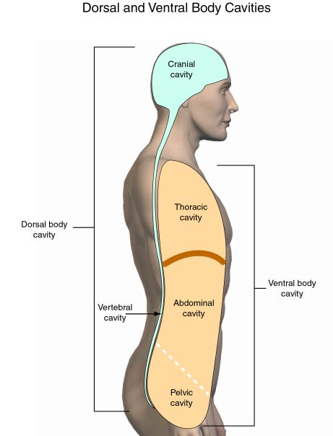
Body Cavities
Abdominopelvic Cavity
  Area below the diaphragm (ribs)
  Divided into the abdominal cavity and the pelvic cavity
  Superior border: diaphragm

Slide 41
Body Cavities
Abdominal Cavity
  Contains the stomach, intestines, spleen, liver, and other organs

Slide 42
Body Cavities
Pelvic Cavity
  Lies in the bony pelvis
  Contains the bladder, some reproductive organs, and the rectum

Slide 43
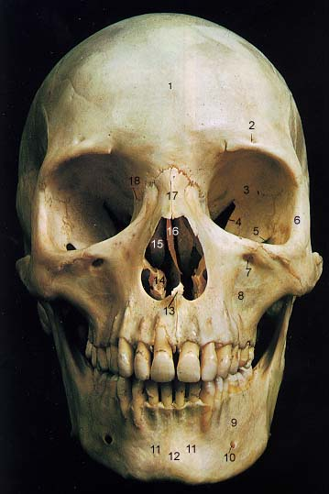
Body Cavities
Orbital Cavity
  In the skull
  House the eyes

Slide 44
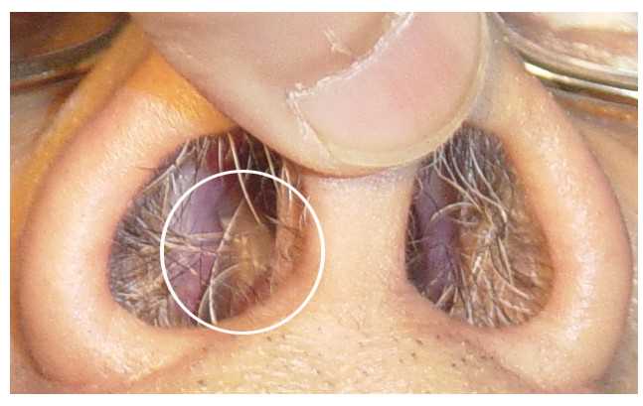
Body Cavities
Nasal Cavity
  Found in the skull (within and posterior to nose)
  Part of the respiratory passageways

Slide 45
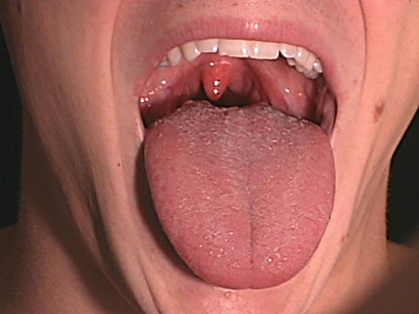
Body Cavities
Oral Cavity
  Mouth
  Contains teeth and tongue

Slide 46
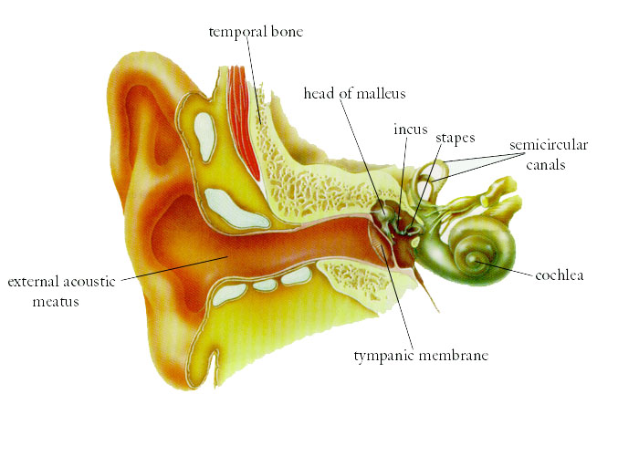
Body Cavities
Middle Ear Cavities
  Carved into the skull
  Lie just medial to the eardrums.
  Contain tiny bones that transmit sound vibrations to the hearing receptors in the inner ear.

