Slide 1
Chapter 1
The Human Body: An Orientation

Slide 2
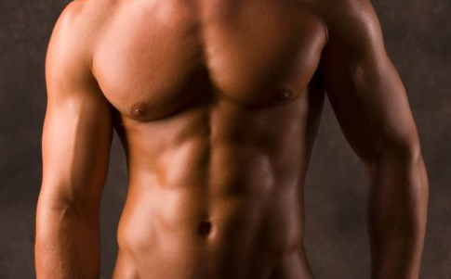
Regions/Parts of Body
Abdominal
  Abdomen

Slide 3
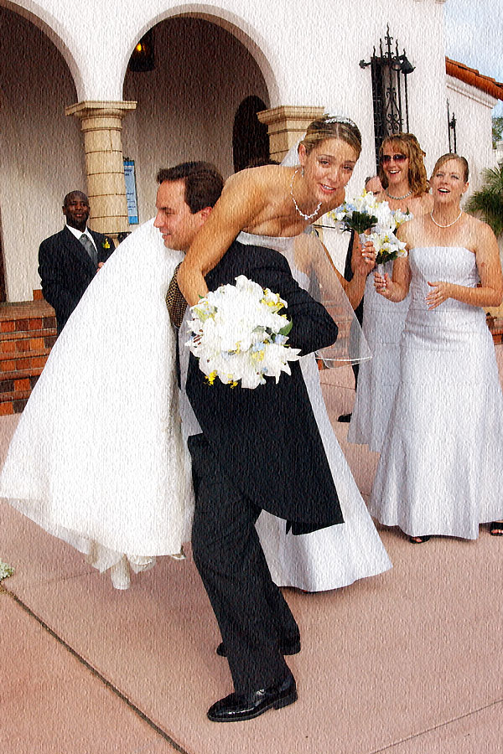
Regions/Parts of Body
Acromial
  Lateral point of sholder

Slide 4
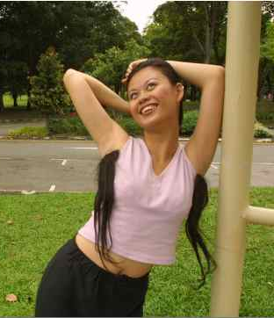
Regions/Parts of Body
Axillary
  Arm pit

Slide 5
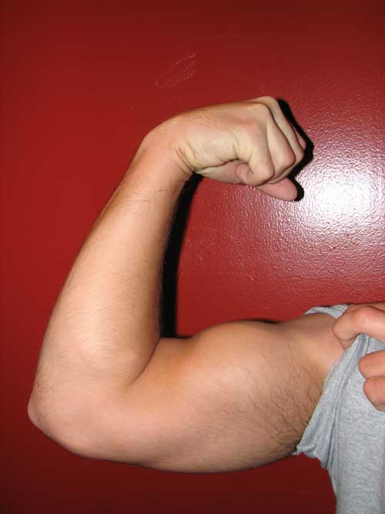
Regions/Parts of Body
Brachial
  Upper arm

Slide 6

Regions/Parts of Body
Buccal
  Cheek

Slide 7
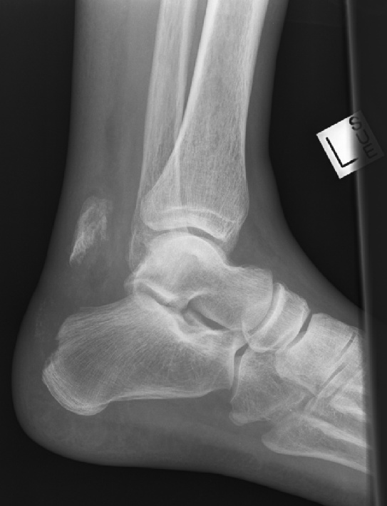
Regions/Parts of Body
Calcaneal
  Heel

Slide 8
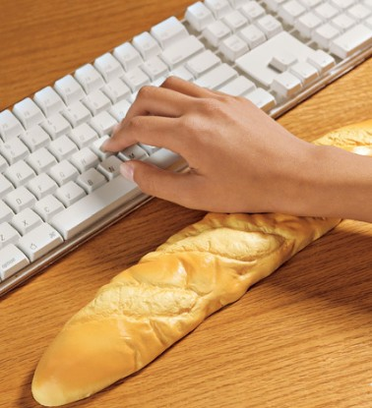
Regions/Parts of Body
Carpal
  Wrist

Slide 9
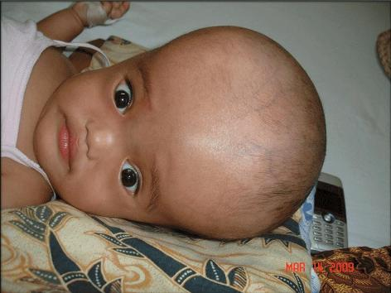
Regions/Parts of Body
Cephalic
  Head

Slide 10
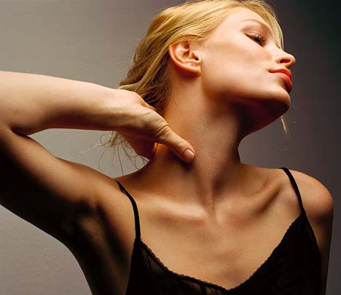
Regions/Parts of Body
Cervical
  Neck

Slide 11
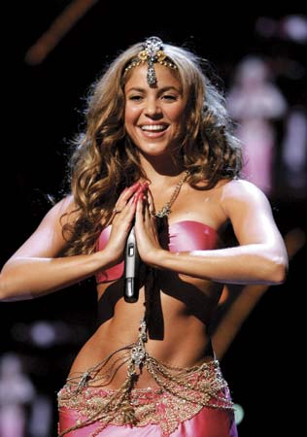
Regions/Parts of Body
Coxal
  Hip

Slide 12
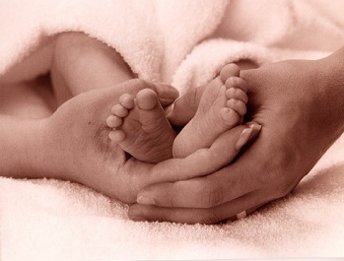
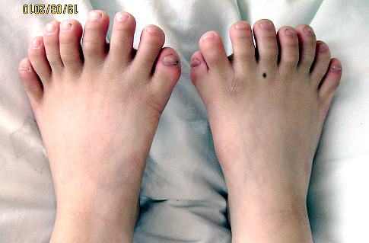
Regions/Parts of Body
Digital
  Fingers/Toes

Slide 13
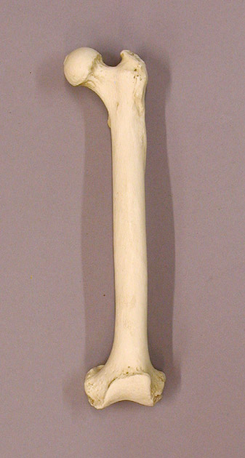
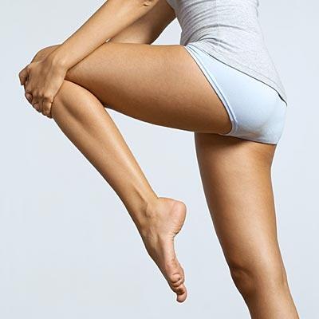
Regions/Parts of Body
Femoral
  Thigh

Slide 14
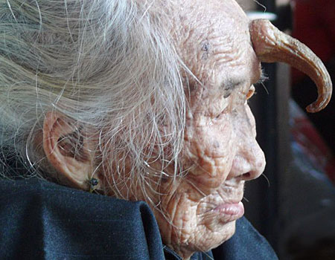
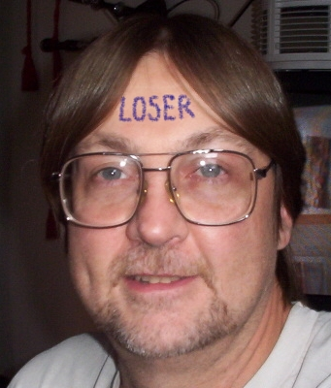
Regions/Parts of Body
Frontal
  Forehead

Slide 15
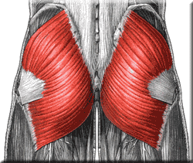
Regions/Parts of Body
Gluteal
  Buttocks

Slide 16
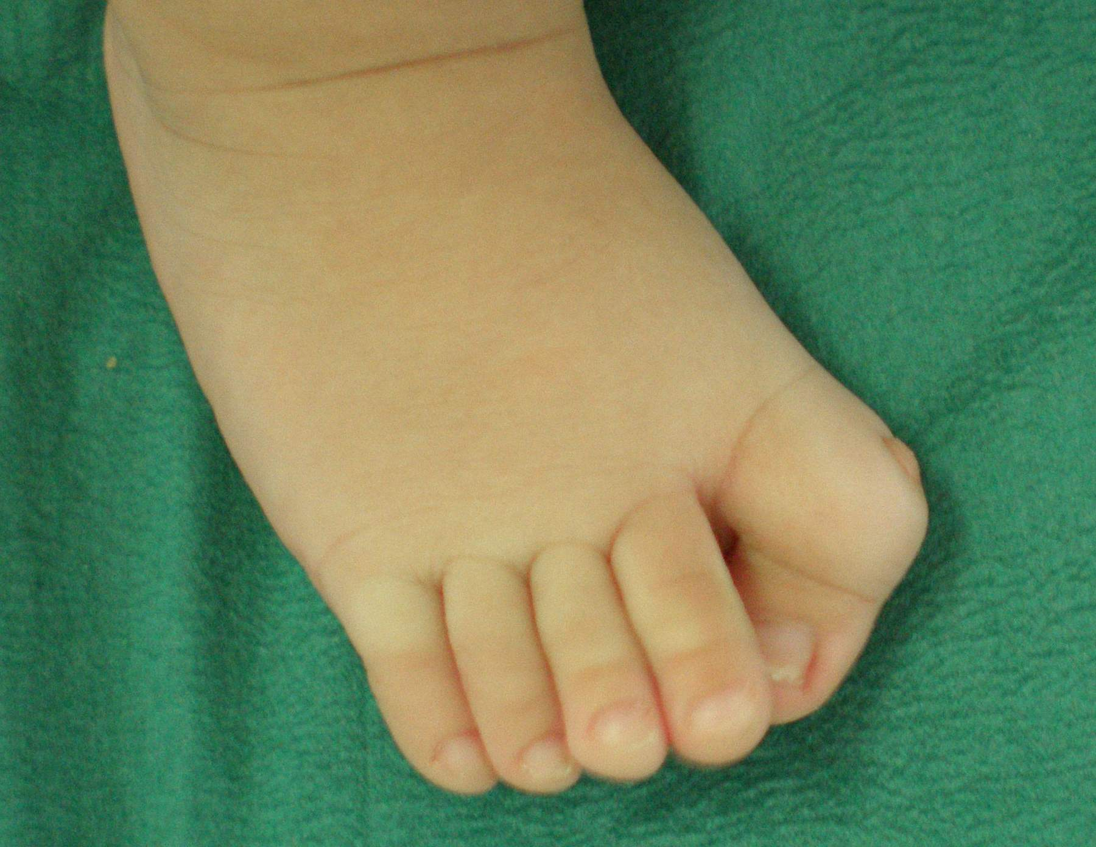
Regions/Parts of Body
Hallux
  Big Toe

Slide 17
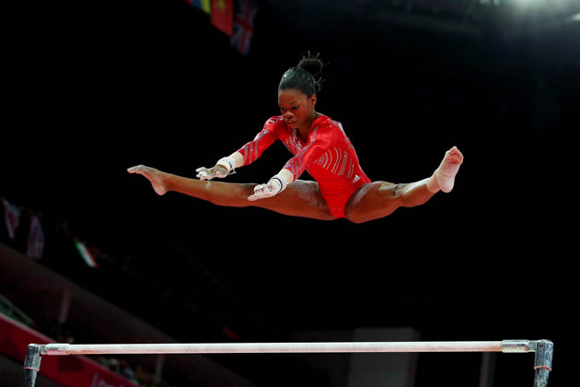
Regions/Parts of Body
Inguinal
  Groin

Slide 18
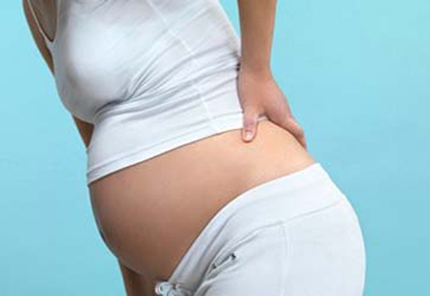
Regions/Parts of Body
Lumbar
  Lower back

Slide 19
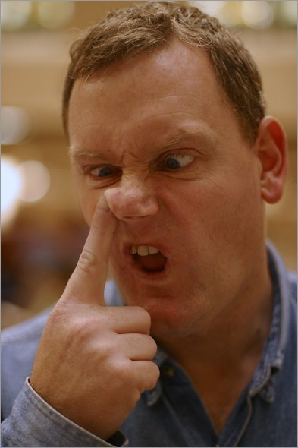
Regions/Parts of Body
Nasal
  Nose

Slide 20
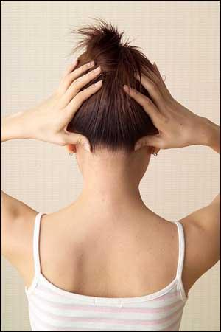
Regions/Parts of Body
Occipital
  Back of head or base of skull

Slide 21
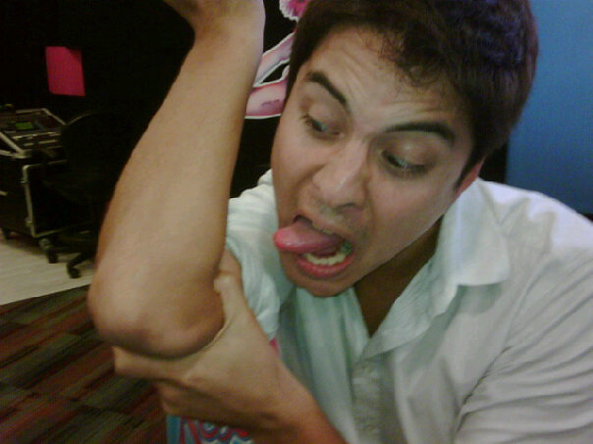
Regions/Parts of Body
Olecranal
  Back of the elbow

Slide 22
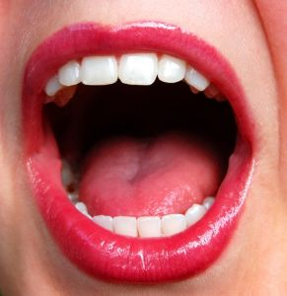
Regions/Parts of Body
Oral
  Mouth

Slide 23
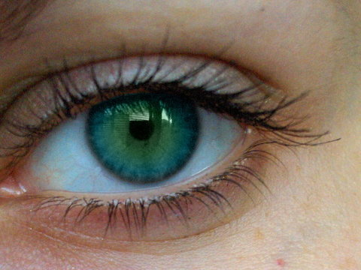
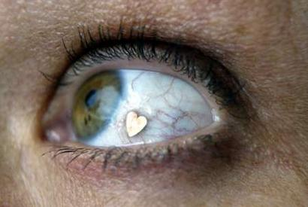
Regions/Parts of Body
Orbital
  Eye

Slide 24
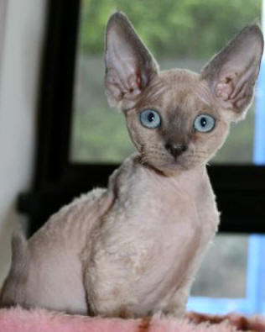
Regions/Parts of Body
Otic
  Ear

Slide 25
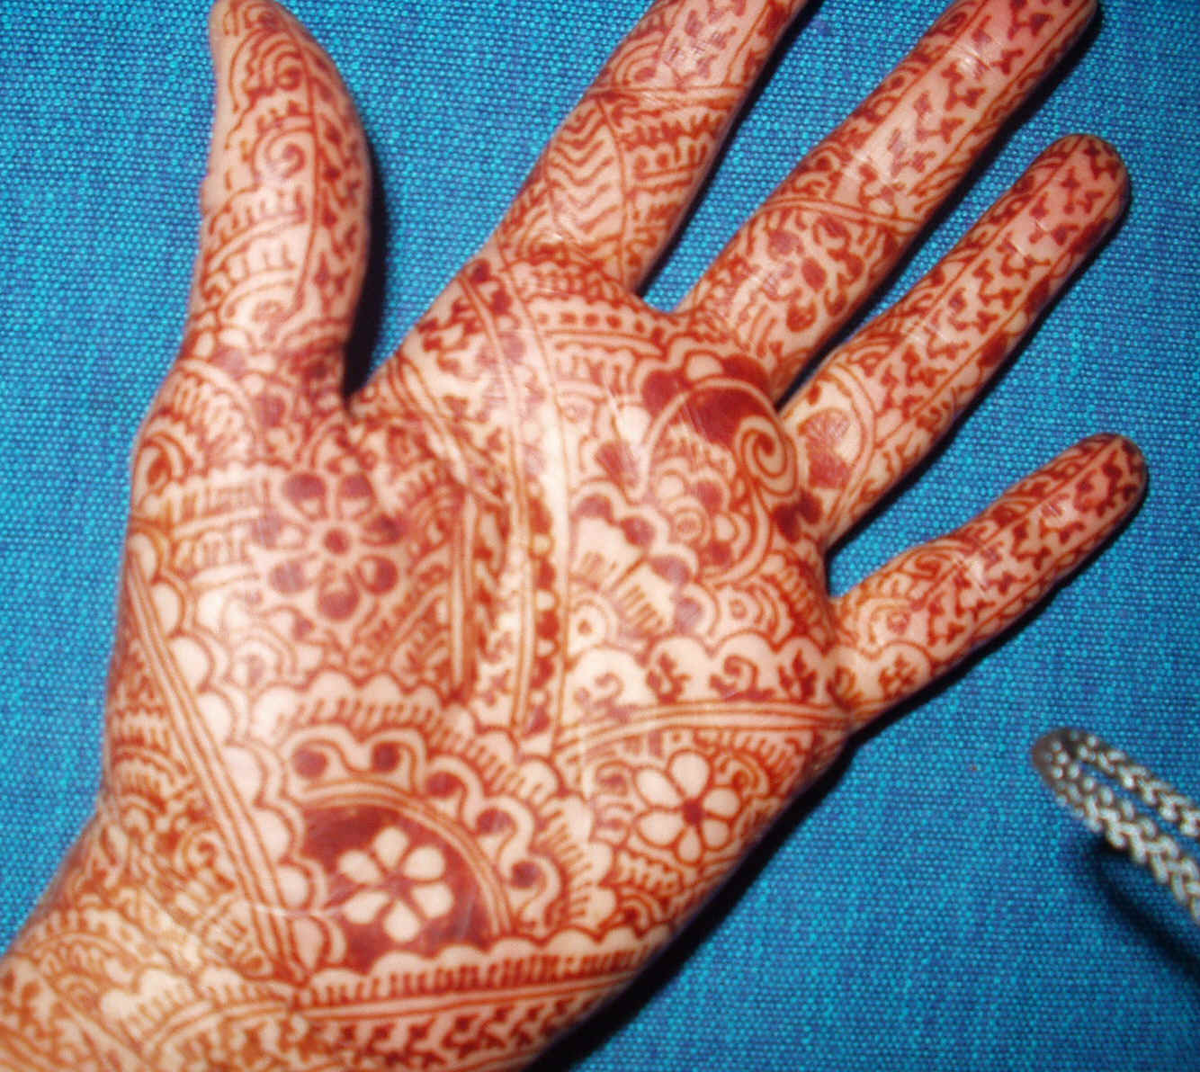
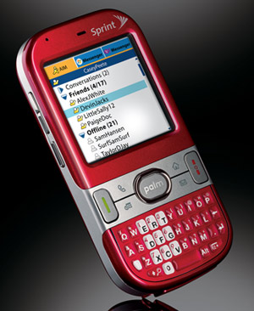
Regions/Parts of Body
Palmar
  Palm

Slide 26
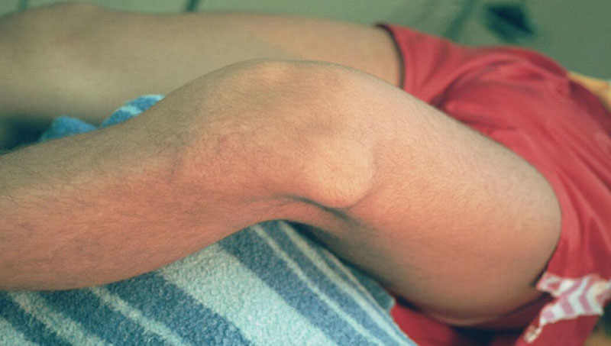

Regions/Parts of Body
Patellar
  Knee

Slide 27
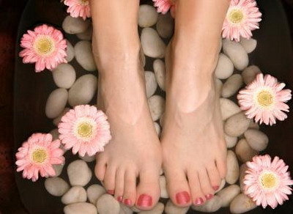
Regions/Parts of Body
Pedal
  Foot

Slide 28
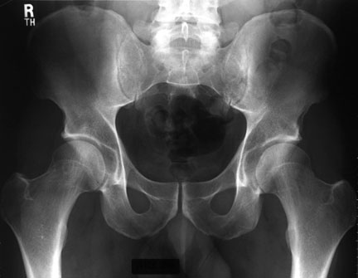
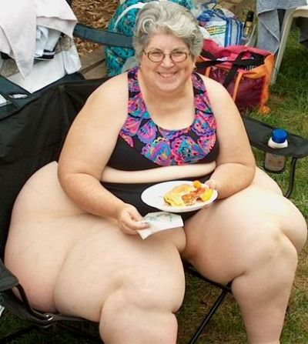
Regions/Parts of Body
Pelvic
  Hips

Slide 29
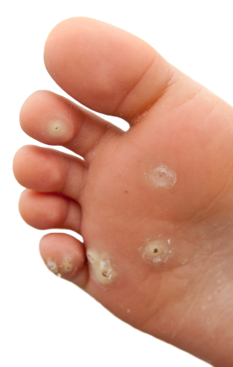
Regions/Parts of Body
Plantar
  Bottom /sole of foot

Slide 30

Regions/Parts of Body
Pollex
  Thumb

Slide 31
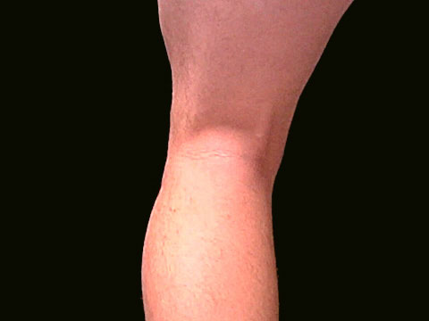
Regions/Parts of Body
Popliteal
  Back of knee

Slide 32
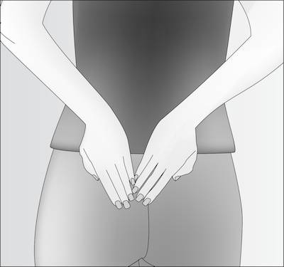
Regions/Parts of Body
Sacral
  Between the hips

Slide 33
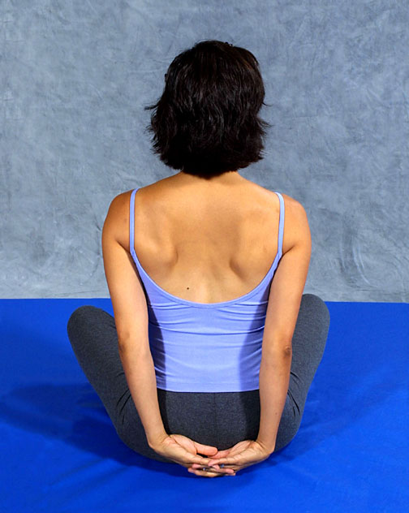
Regions/Parts of Body
Scapular
  Shoulder blade

Slide 34
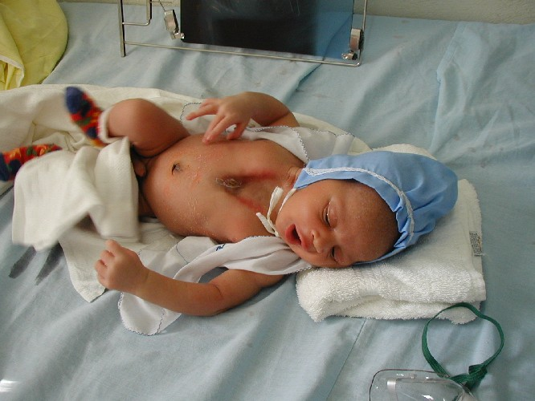
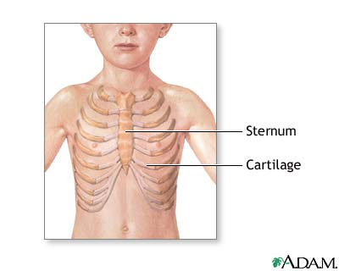
Regions/Parts of Body
Sternal
  Sternum/breastbone

Slide 35
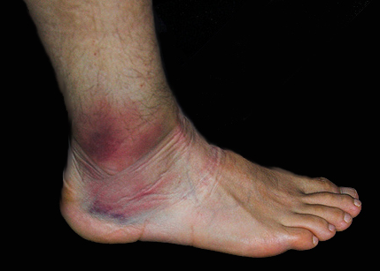
Regions/Parts of Body
Tarsal
  Ankle

Slide 36
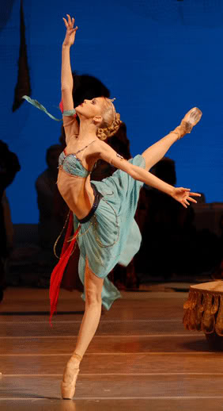
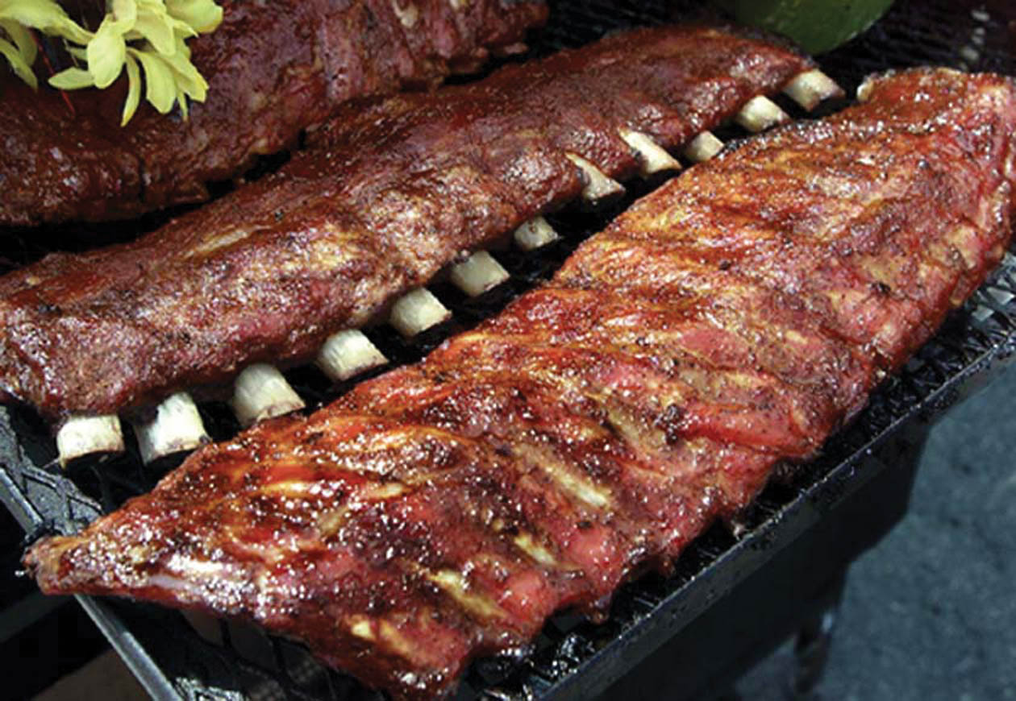
Regions/Parts of Body
Thoracic
  Chest/rib cage

Slide 37
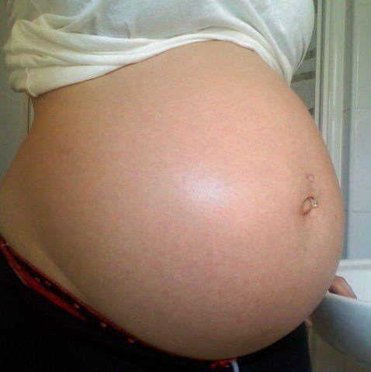
Regions/Parts of Body
Umbilical
  Navel/belly button

