Slide 1
Muscles of the Human Body!
Head and Neck

Slide 2
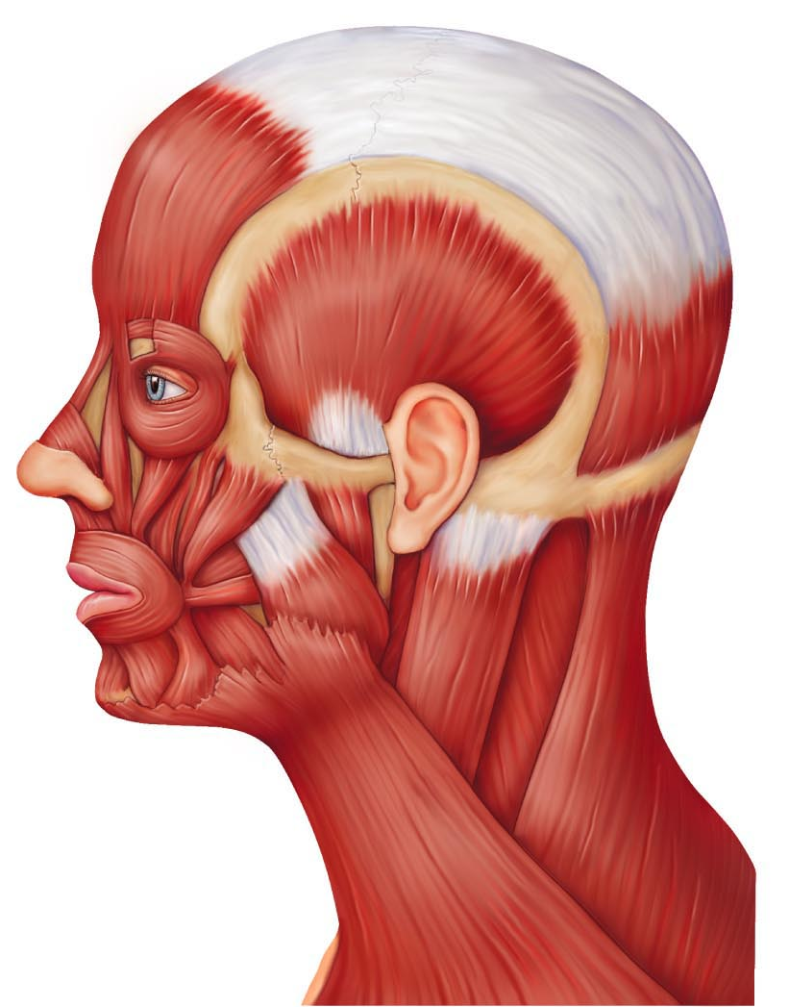
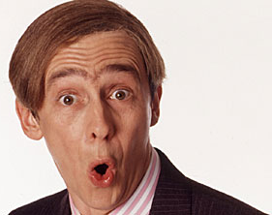
Frontalis
Raises eyebrows, wrinkles forehead

Slide 3
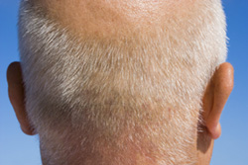
Occipitalis
Tenses and retracts scalp (moves it back)

Slide 4
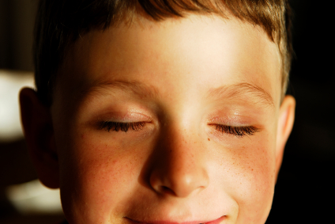
Orbicularis Oculi
Blinking of eye; squinting; draws eyebrows down

Slide 5
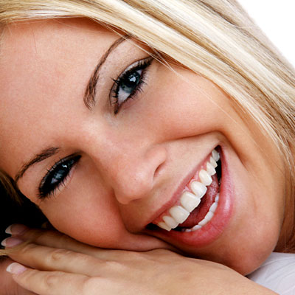
Zygomaticus
Raises lateral corners of mouth upwards; smiling muscle

Slide 6
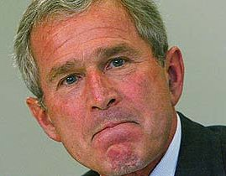
Risorius
Draws corner of lip laterally; synergist of zygomaticus

Slide 7
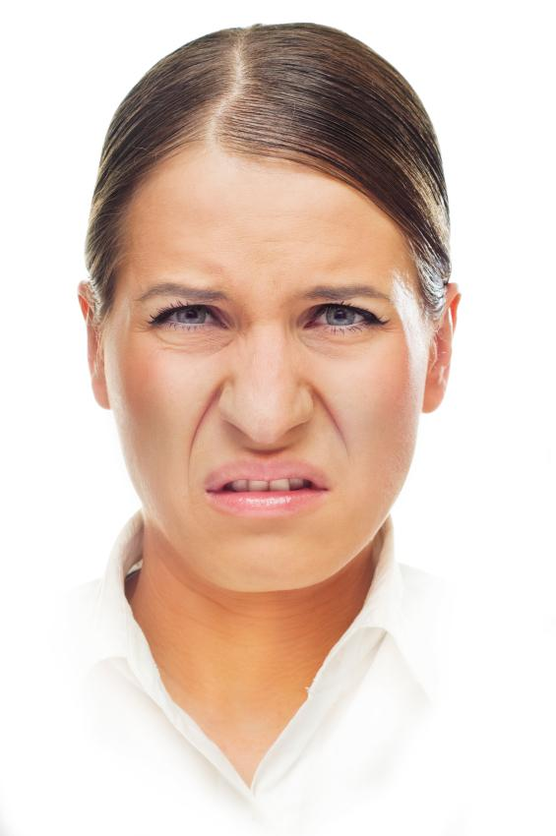
Levator Labii Superioris
Elevates upper lip

Slide 8
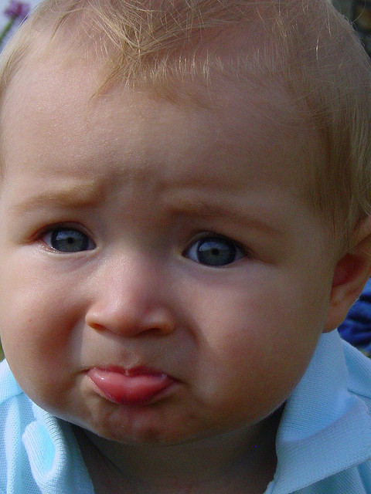
Depressor Labii Inferioris
Draws lower lip downward, as in a pout

Slide 9
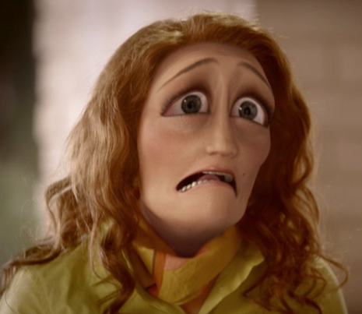
Depressor Anguli Oris
Draws corners of mouth downwards and laterally (“tragedy mask” grimace)

Slide 10
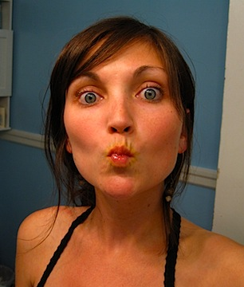
Orbicularis Oris
Closes Lips; purses and protrudes lips; kissing and whistling muscle

Slide 11
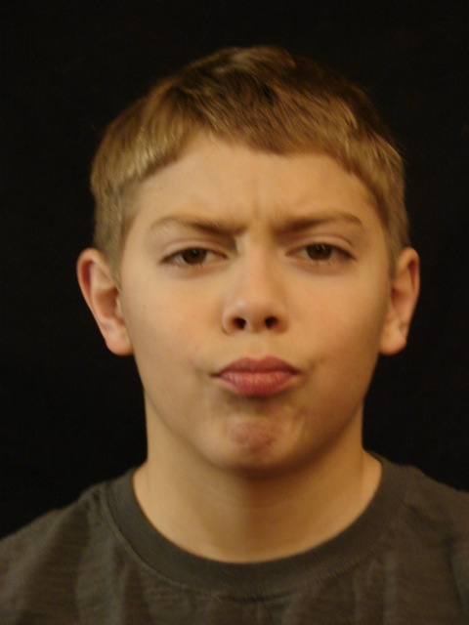
Mentalis
Protrudes lower lip; wrinkles chin

Slide 12
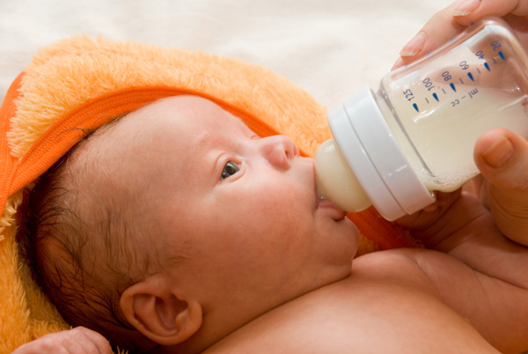
Buccinator
Compresses cheek, as in whistling and sucking, well developed in nursing infants. Holds food between teeth during chewing

Slide 13
Platysma
Helps depress mandible; pulls lower lip back and down (produces downward sag of mouth; tenses skin of neck (during shaving)

Slide 14
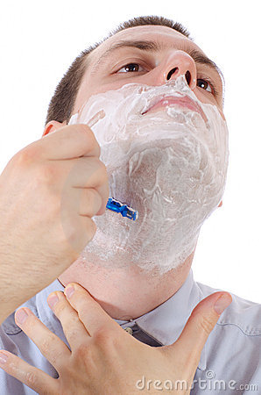
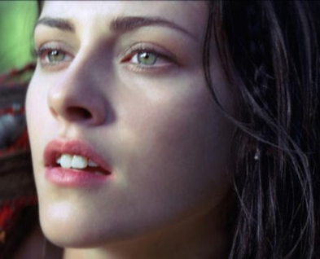
Platysma

Slide 15
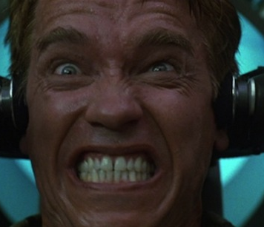
Masseter
Prime mover of jaw closure; Elevates mandible

Slide 16
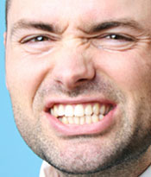
Temporalis
Synergist to masseter; Elevates mandible

Slide 17
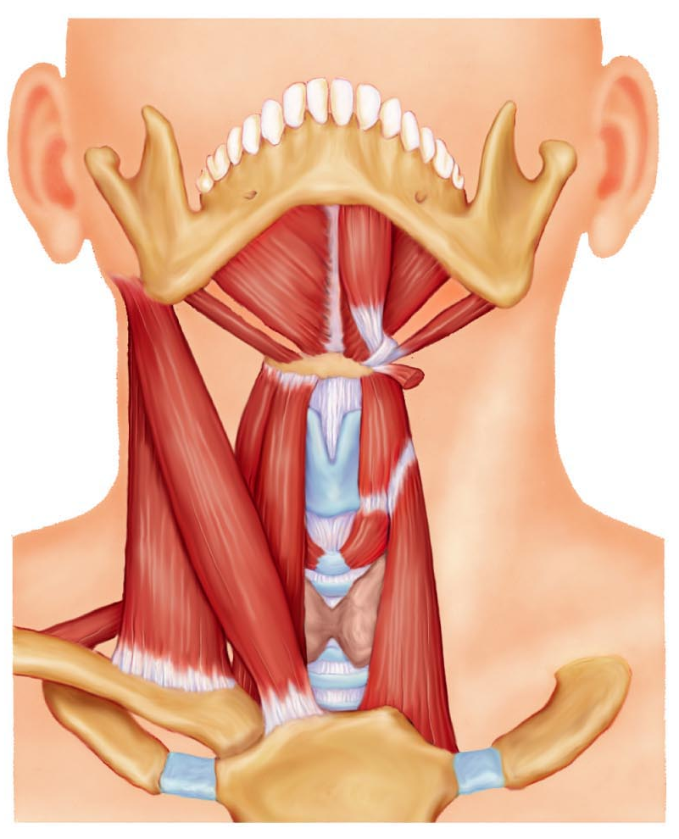
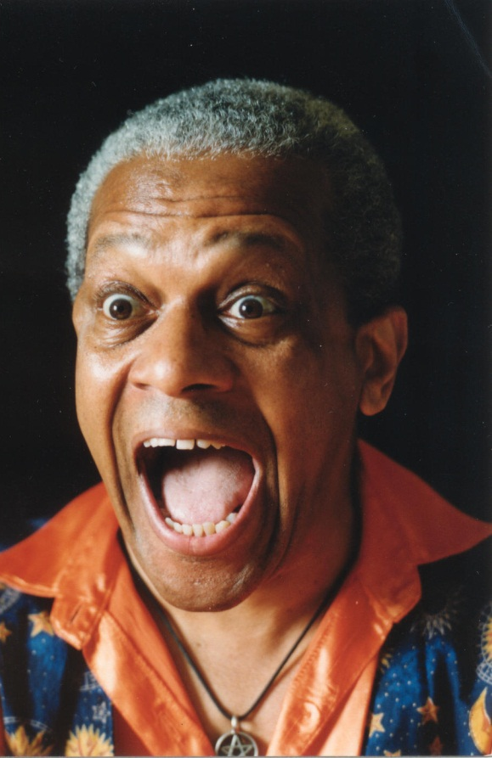
Digastric
Open mouth (depress mandible); elevates hyoid

Slide 18
Sternocleidomastoid
Prime mover of active head flexion; generally against resistance as when one raises head when lying on their back. Acting alone: each muscle rotates head toward shoulder on opposite side and tilts (laterally flexes) head to its own side.

Slide 19
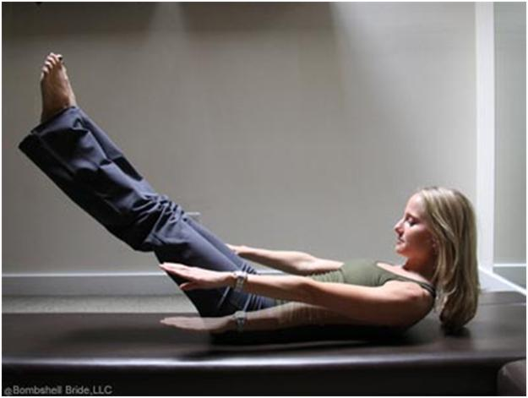
Sternocleidomastoid

Slide 20
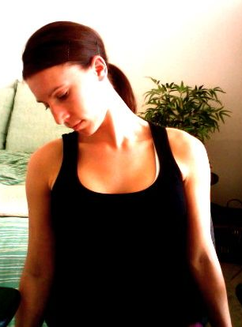
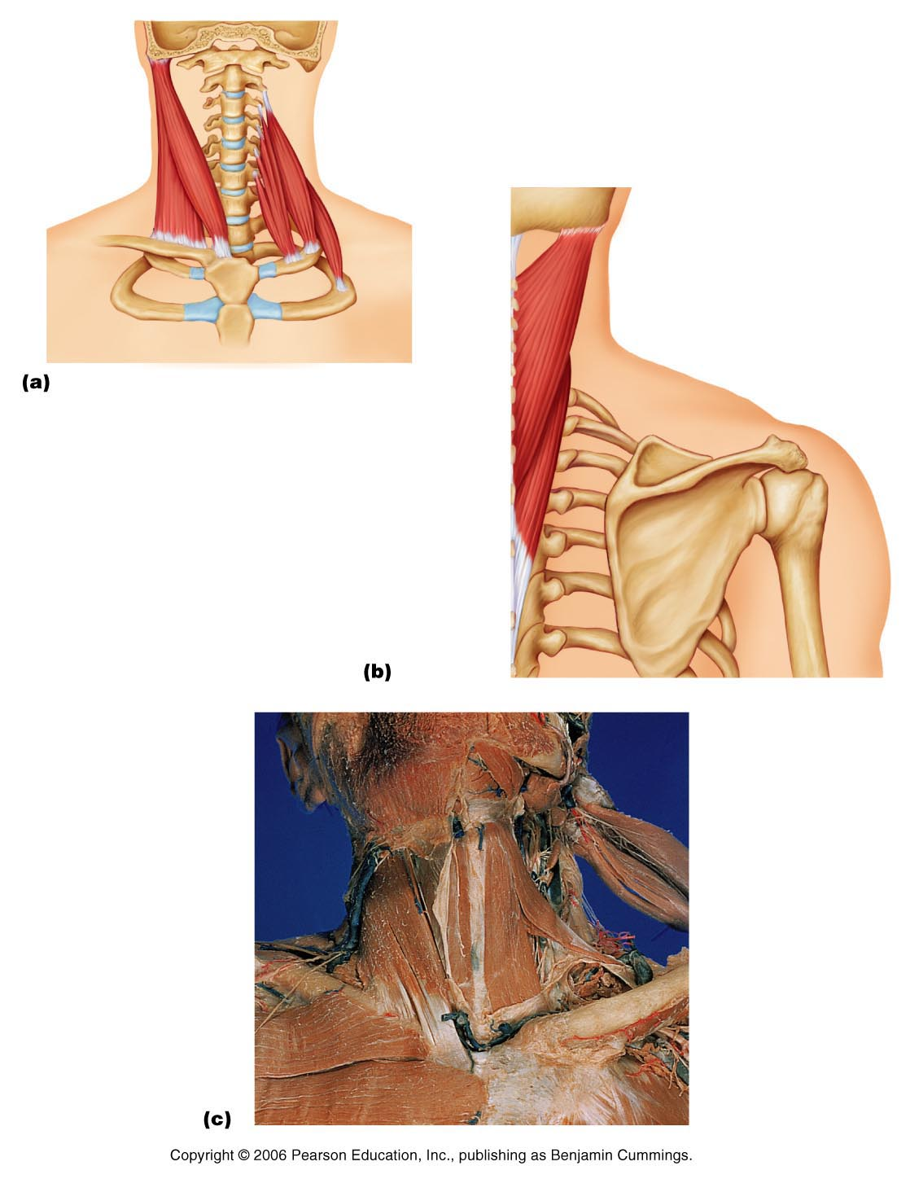
Scalenes
Elevates first two ribs (aids in inspiration). Flex and rotate neck

Slide 21
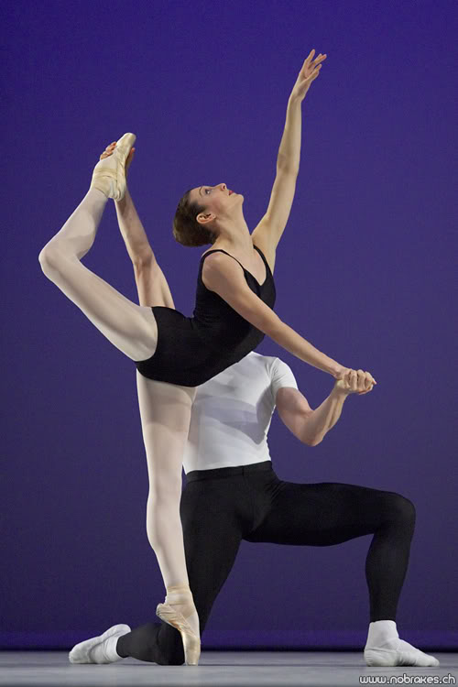
Splenius – Capitis & Cervicis
Act as a group to extend or hyperextend the head. When active on one side, head is rotated and bent laterally toward the same side
Splenius Capitis
Splenius Cervicis

