Slide 1
Muscles of the Human Body!
Muscles that Move the Thigh, Leg, Ankle, & Toes

Slide 2
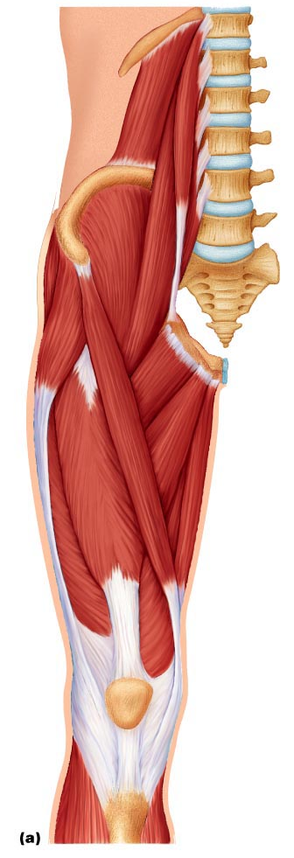

Iliopsoas (Iliacus and Psoas Major)
Prime mover of thigh flexion or flexing trunk on thigh during a bow
Iliacus
Psoas Major

Slide 3
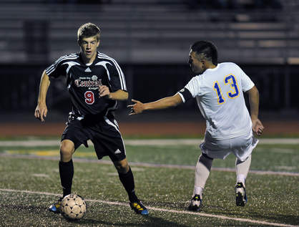
Sartorius
Flexes, abducts, and laterally rotates thigh; flexes knee (weak) as in a soccer kick
Known as “tailor’s muscle” because it helps effect cross-legged position in which tailors are often depicted

Slide 4
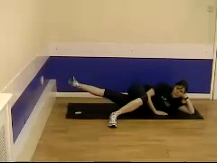
Adductors (Brevis, Longus, Magnus)
Adducts thigh, medially rotates thigh and thigh flexor; (groin muscles)
Used in movements that press thighs together
Ex. Sitting on a horse
Adductor Longus
Adductor Magnus

Slide 5
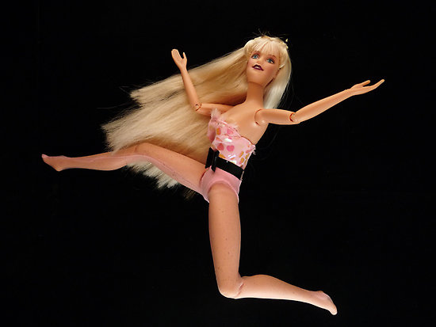
Pectineus
Adducts, flexes, and medially rotates thigh

Slide 6
Gracilis
Adducts thigh, flexes and medially rotates thigh, especially during walking; flexes knee.

Slide 7
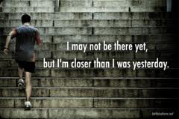
Quadriceps Femoris
(Rectus Femoris & Vastus Muscles)
Prime mover of knee extension – used in climbing, jumping, running, and rising from a seated position. Plays an important role in strengthening the knee joint

Slide 8
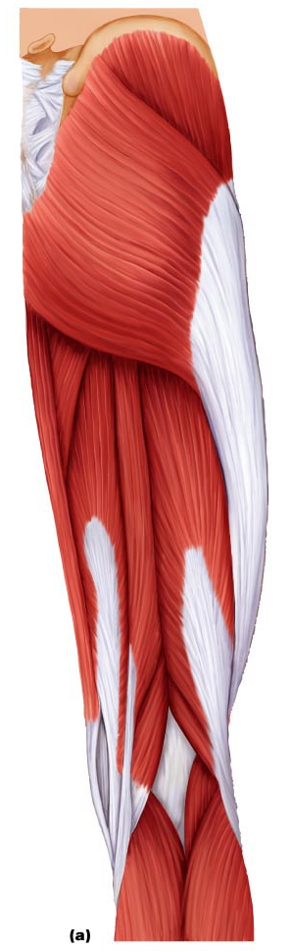
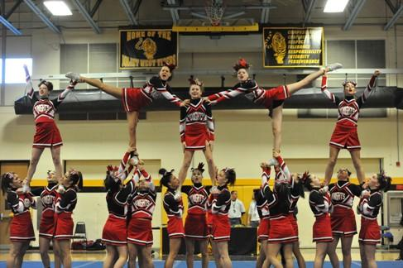
Gluteus Maximus
Prime mover in thigh extension. role in abduction and lateral rotation.

Slide 9
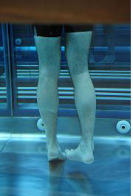
Gluteus Medius
Prime mover of abduction. Medially rotates thigh – extremely important in walking

Slide 10

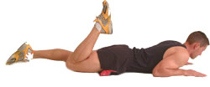
Hamstrings
(Biceps Femoris, Semitendinosus, Semimembranosus)
Prime movers of thigh extension if knee is extended, prime mover of knee flexion if hip is extended flexes knee
Biceps Femoris
Semimembranosus
Semitendinosus

Slide 11
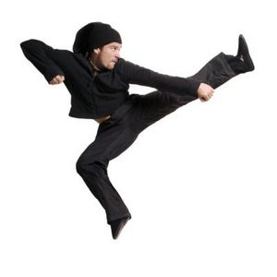
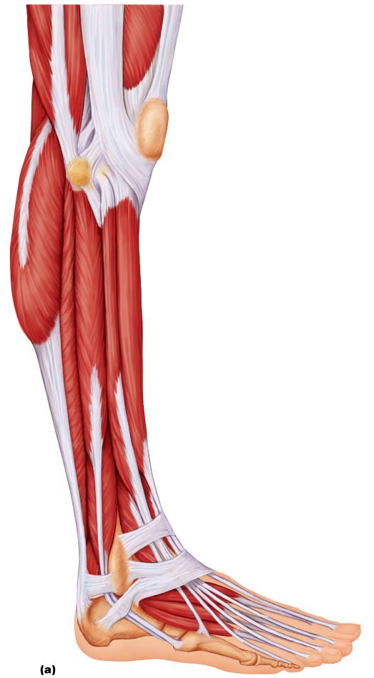
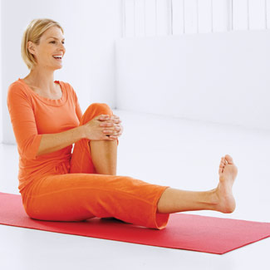
Tibialis Anterior
Prime mover of dorsiflextion; inverts foot.
Assists in supporting medial longitudinal arch of foot

Slide 12
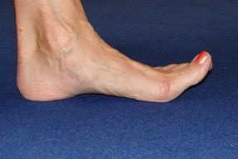
Extensor Digitorum Longus
Prime mover of toe extension. Synergist of dorsiflexion

Slide 13
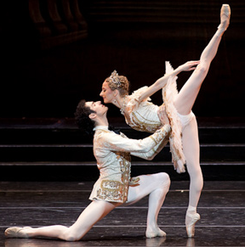
Fibularis (Peroneus) Longus
Plantar flexes and everts foot;
may help keep foot flat on ground

Slide 14
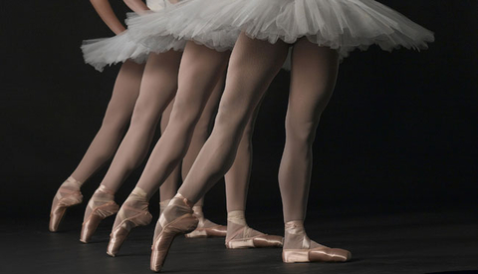
Gastrocnemius
Prime mover of plantar flexion of foot when knee is extended.

Slide 15
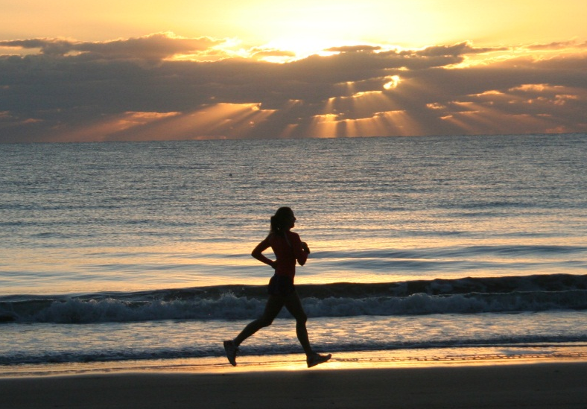
Soleus
Prime mover of plantar flexion of foot.
Important locomotor and postural muscle during walking, running, and dancing

Slide 16
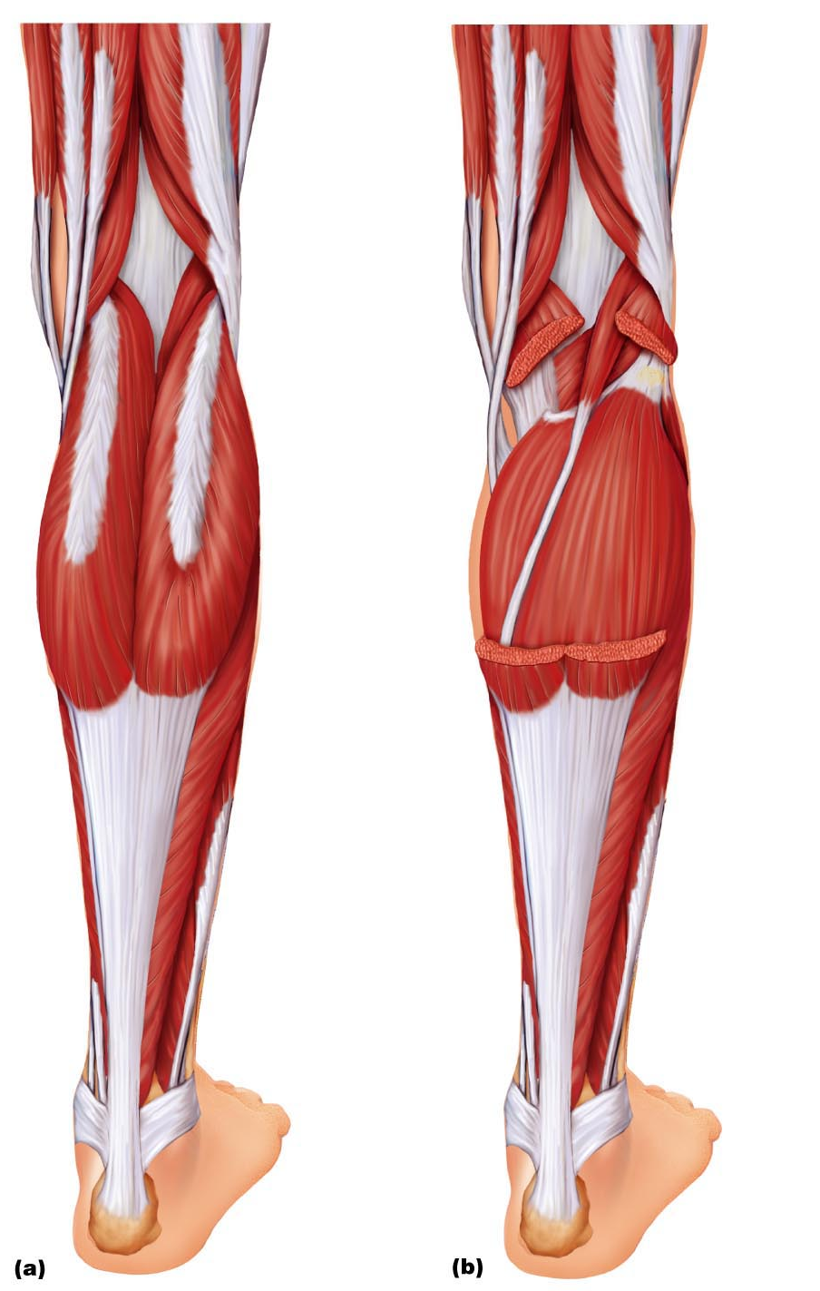
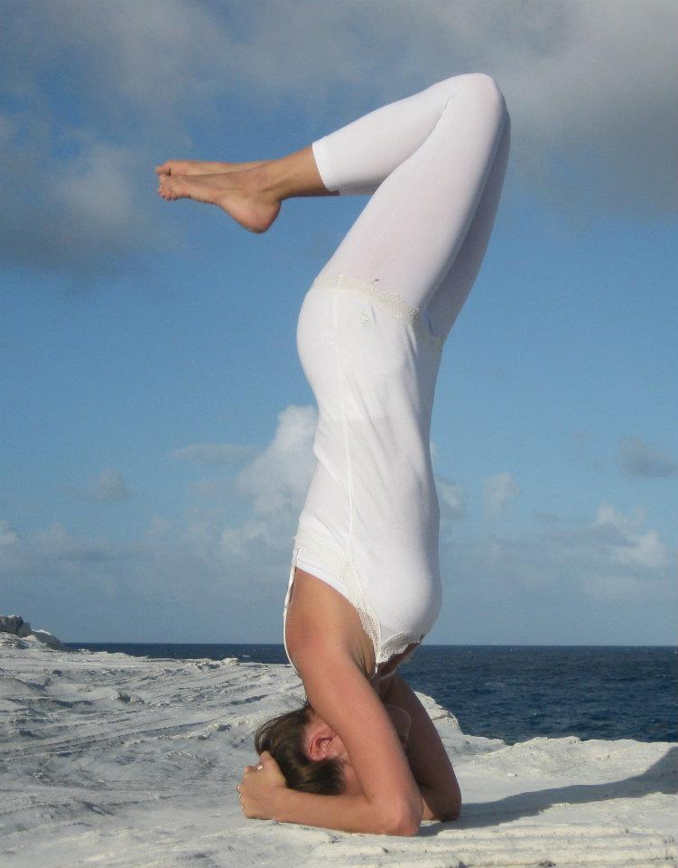
Plantaris
Assists in knee flexion and plantar flexion of foot

