Slide 1
Muscles of the Human Body!
Muscles That Move Scapula and Arm

Slide 2

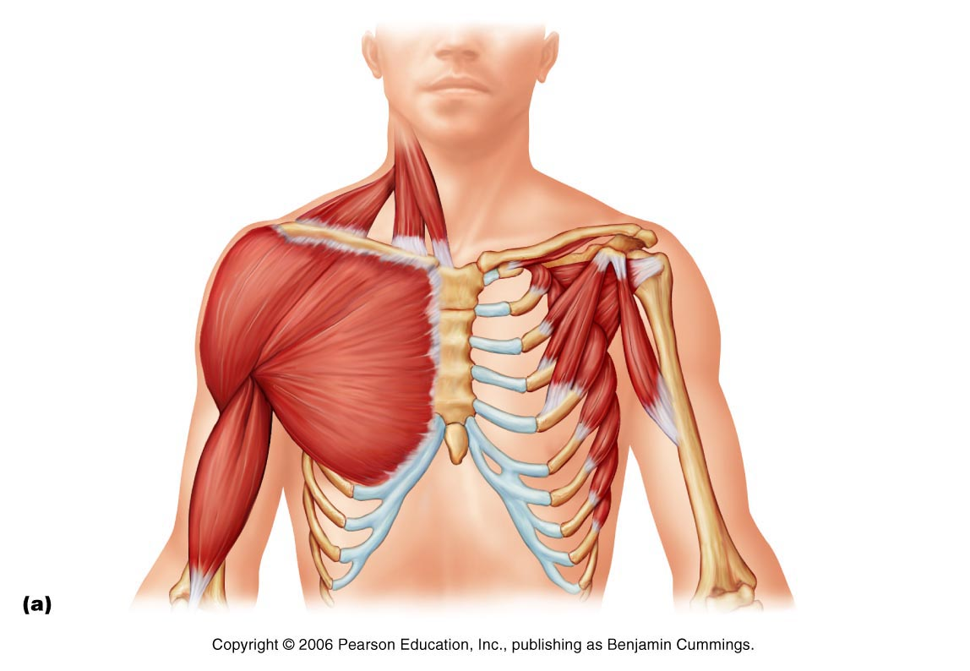
Pectoralis Minor
Draws scapula forward and down

Slide 3
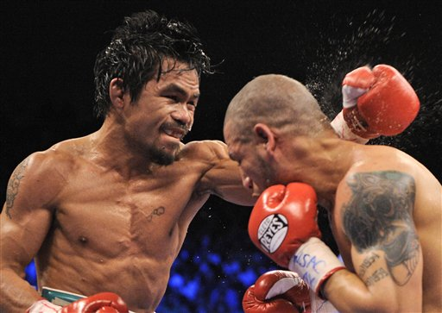
Serratus Anterior
Moves scapula upwards, out (abduction) and forward.
“boxers muscle”

Slide 4
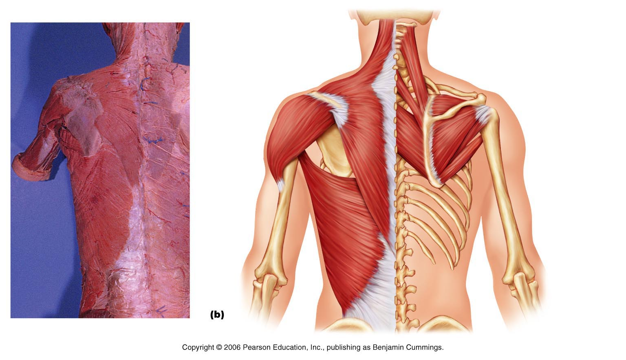
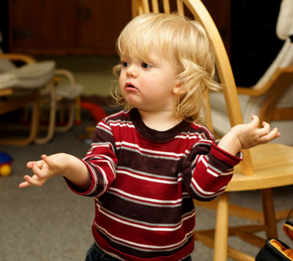
Trapezius
Stabilizes, raises (shrug shoulder), retracts (adduct), rotates scapula. Also extend head and neck

Slide 5
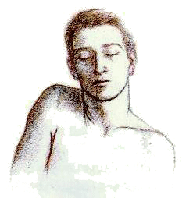
Levator Scapulae
Elevates/adducts the scapula

Slide 6
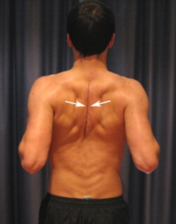
Rhomboids (Major & Minor)
Retracts/Adducts (moves together) and depressesscapula;
“squaring shoulders” (like downward motion of paddling a canoe)

Slide 7
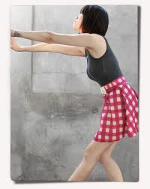
Pectoralis Major
Prime mover of arm flexion and adduction; rotates arm medially;
Can help in climbing, throwing, and pushing

Slide 8
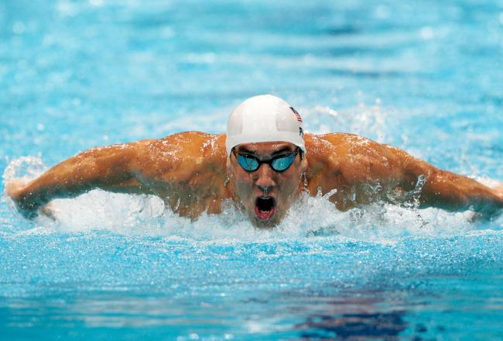
Latissimus Dorsi
Prime mover of arm extension and adductor;
medially rotates arm at shoulder.
Bringing the arm down in a power stroke (striking a blow, hammering, swimming, and rowing)

Slide 9
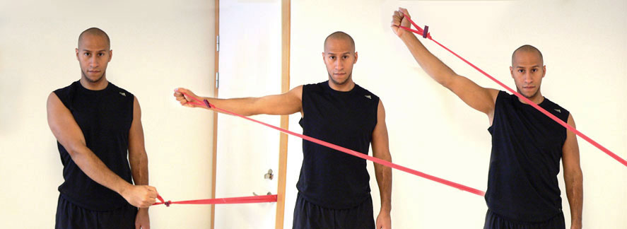
Deltoid
Prime mover of arm abduction when all fibers active
Front fibers: arm flexion. Back fibers: arm extension. (arms during walking)

Slide 10
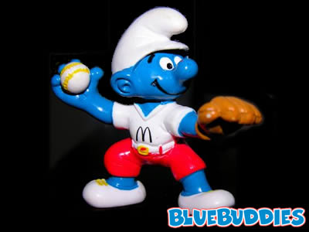
Rotator Cuff Muscles
Main function is to Reinforce the capsule of the shoulder joint to prevent dislocation of the humerus.
Subscapularis
Supraspinitus
Infraspinitus
Teres Minor

Slide 11
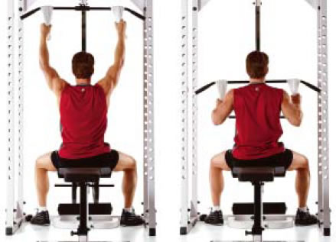
Teres Major
Extends, medially rotates, and adducts humerus; synergist of latissimus dorsi

