Slide 1
Muscles of the Human Body!
Vertebral Column and Thorax

Slide 2
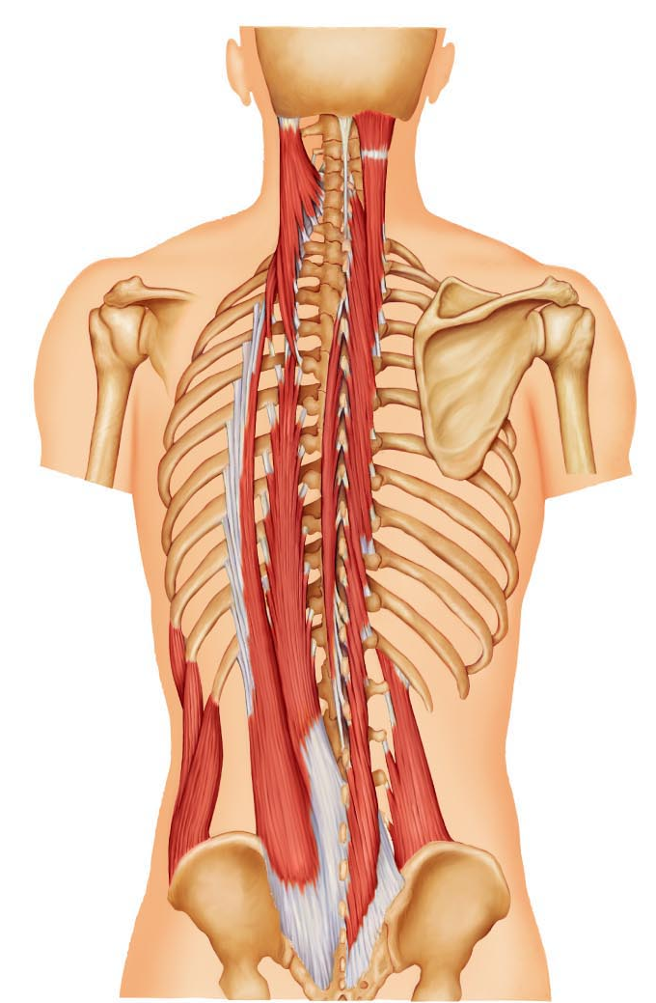
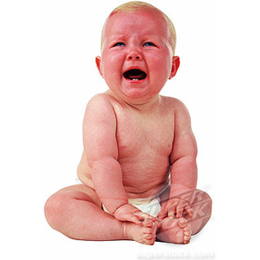
Erector Spinae ( Iliocostalis, Longissimus, Spinalis)
Prime mover of back extension (3 columns of muscles)
Elevates and straightens the spine
Iliocostalis
Longissimus
Spinalis

Slide 3
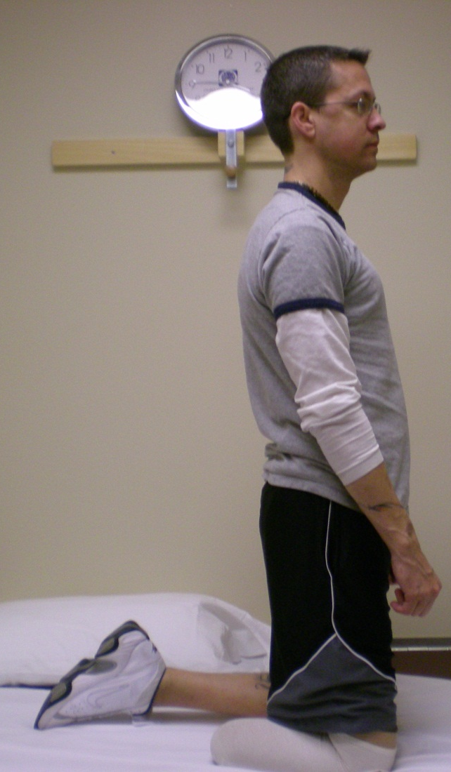
Quadratus Lumborum
When acting together, extends lumbar spine; maintains upright posture

Slide 4
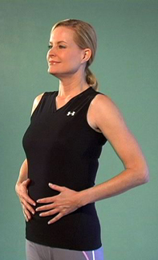
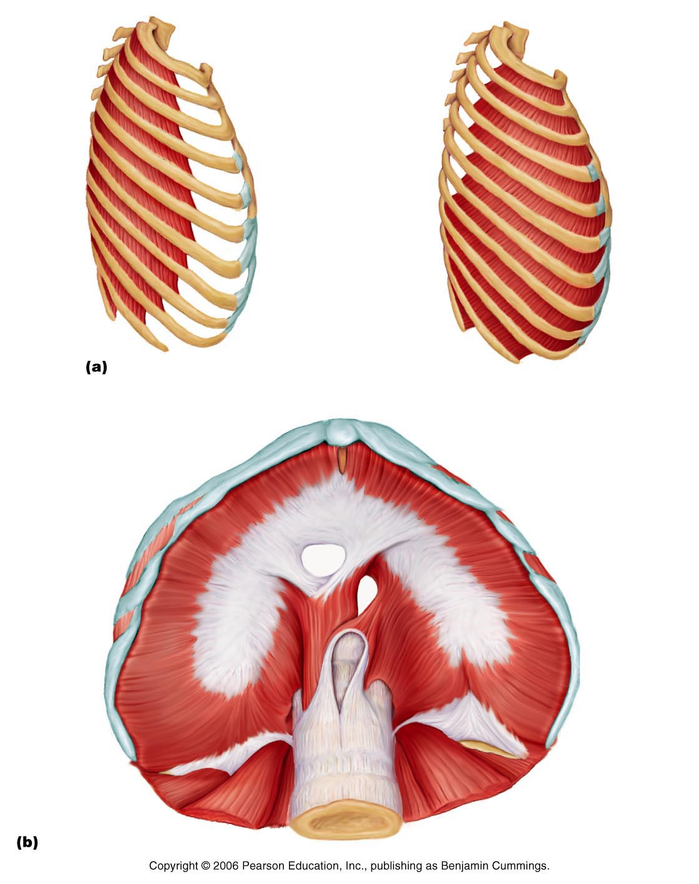
External Intercostals
Pulls ribs towards one another to elevate rib cage, aides in breathing in.

Slide 5
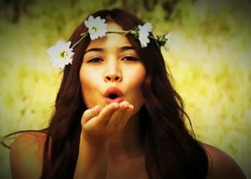
Internal Intercostals
Draw ribs together and depresses rib cage; aids in forced expiration

Slide 6
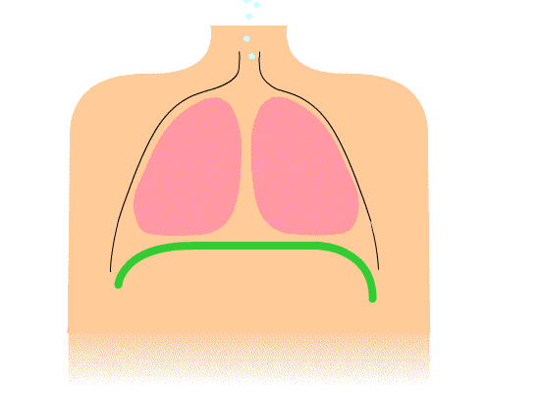
Diaphragm
Prime mover of inspiration. Dome-shaped when relaxed, flattened when contracted.

Slide 7
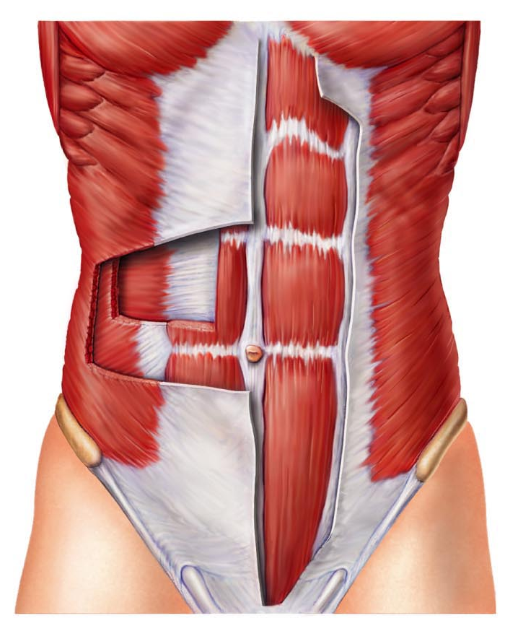
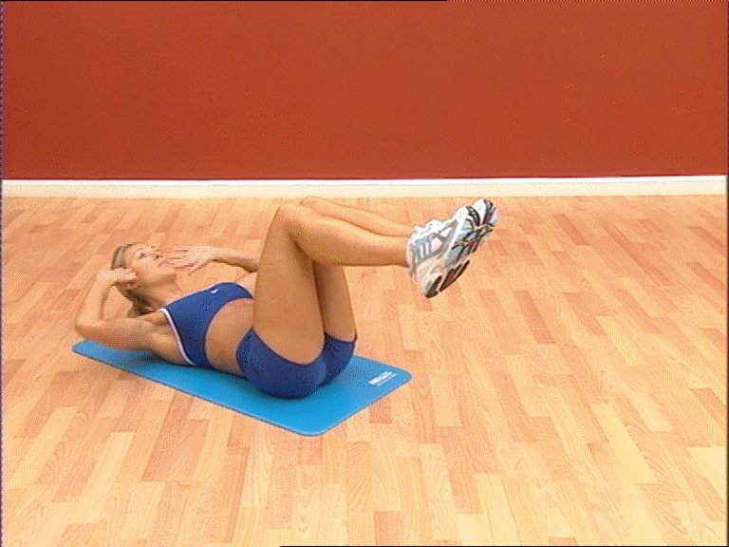
Rectus Abdominis
Flexes lumbar region of vertebral column. Flexes the vertebral column as in a sit up.

Slide 8
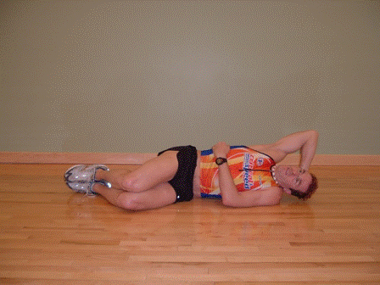
External & Internal Oblique
Synergist to Rectus abdominis when the pair contracts at the same time (sit-up). Compresses the abdomen. Acting individually, used in trunk rotation, lateral flexion (side sit up)
Internal Oblique
External Oblique

Slide 9
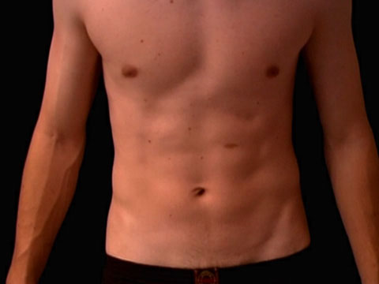
Transversus Abdominis
Compresses abdomen

Slide 10
Linea Alba
“White seam”, a tendinous seam hat runs from the sternum to the pubic symphysis. Rectus abdominis muscle fuses here

