Slide 1

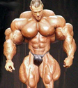

Chapter 9
Muscles and Muscle Tissue
Cellular Respiration - Hypertrophy

Slide 2
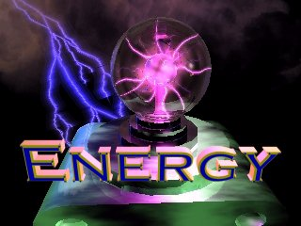
Cellular Respiration
C₆H₁₂O₆ + 6O₂ + 6H₂O → 6CO₂ + 12H₂0
Glycolysis
  Anaerobic respiration (no oxygen)
  Breakdown of glucose to pyruvic acid
    Too much pyruvic acid leads to lactic acid buildup
  Occurs in the cytoplasm
  Generates a net gain of
  2 ATP

Slide 3

Cellular Respiration
C₆H₁₂O₆ + 6O₂ + 6H₂O → 6CO₂ + 12H₂0
Mitochondrial ATP production
  Aerobic respiration (oxygen)
  Takes place inside the mitochondria
  Beakdown of pyruvic acid into hydrogen and carbon dioxide
    Hydrogen then goes on
    to make H₂O
  Generates a net gain
  of 34 ATP

Slide 4
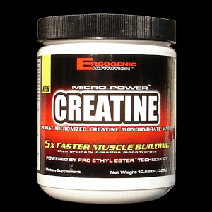
Creatine Phosphate
CP + ADP → C + ATP
During exercise, the demand for ATP soars and is used up quickly.
Creatine phosphate (CP) helps to quickly restore ADP into ATP
Together this gives muscles the ability to contract maximally for about 15 s (short bursts
of activity)
Muscle cells store 4-5x’s as much CP
as ATP

Slide 5
Creatine Supplementation
Synthesized in body and derived from food
Adults need to ingest 2g daily to replace what is lost through urination.
Some studies have shown improved performance during intense exercise if taken a supplement
    More muscle mass, lifting gains, sprinting performance
Other studies have failed to show performance-enhancing effects
Ingesting extra creatine decreases body’s own synthesis. It is not known if given time the body can recover this natural synthesis.

Slide 6
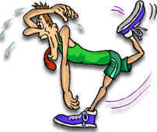
Muscle Fatigue
Inability of a muscle to contract forcefully after prolonged activity.
Even before this is actually reached the person generally has the “feeling” to stop the activity → thought to be a protective mechanism to prevent muscle damage → Central fatigue
Several factors contribute → low levels of ATP, calcium, creatine phosphate, oxygen, glycogen, other nutrients, and build up of lactic acid
Ex. Writers cramp

Slide 7
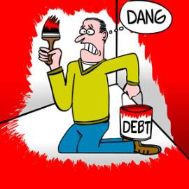
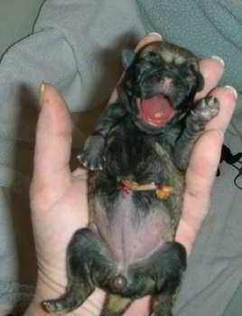
Oxygen Debt
The extra amount of oxygen that must be taken in by the body after exercise.
Pay back or restore metabolic conditions to resting levels
  Convert lactic acid → pyruvic acid → glycogen stores
  Make creatine phosphate and ATP
  Replace oxygen from the myoglobin

Slide 8

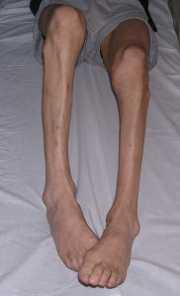
Muscle Atrophy
A- = without
-trophy = nourishment
Wasting away of muscles
Muscle fiber size decreases because of loss of myofibrils
Not a loss of muscle cells!

Slide 9
Muscle Atrophy
Occurs because muscle is not used (stimulated)
Begins as soon as muscle is immobilized
Muscle strength can decrease at a rate of 5% per day!
If too much atrophy occurs, damage is permanent

Slide 10
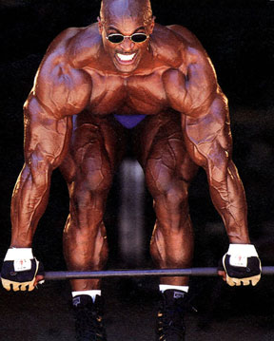
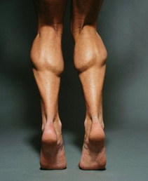
Muscle Hypertrophy
Hyper- = above/excessive
-trophy = nourishment
Increase in the diameter of muscle fibers
Fibers are filled with more myofibrils, mitochondria, etc.
Results from very forceful, repetitive activity

