Slide 1

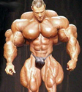

Chapter 9
Muscles and Muscle Tissue
Microscopic Anatomy

Slide 2
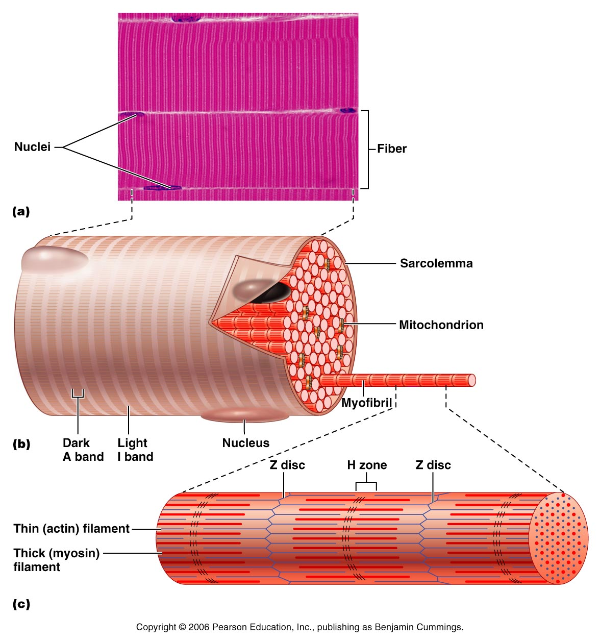
Skeletal Muscle Fibers –
Microscopic Anatomy
Cell membrane → sarcolemma
Long cylindrical cell with multiple oval nuclei.
Nucleus is just below the cell membrane
Diameter 10 – 100um (10x’s larger than average body cell)

Slide 3
Skeletal Muscle Fibers –
Microscopic Anatomy
Cells are long → up to 30 cm
Why so big?
  Each skeletal muscle fiber is actually a produced by the fusion of hundreds of embryonic cells!
  Thus the multiple nuclei

Slide 4
Skeletal Muscle Fibers –
Microscopic Anatomy
Sarcoplasma (cytoplasm)
  Contains unusually large amounts of glycogen (sugar)
  myoglobin (a unique oxygen binding protein) red pigment that stores oxygen (similar to hemoglobin that transports oxygen in the blood)

Slide 5
Skeletal Muscle Fibers –
Microscopic Anatomy
Sarcoplasma (cytoplasm)
  Usual organelles present
  Unique organelles – myofibrils and sarcoplasmic reticulum and T tubules

Slide 6
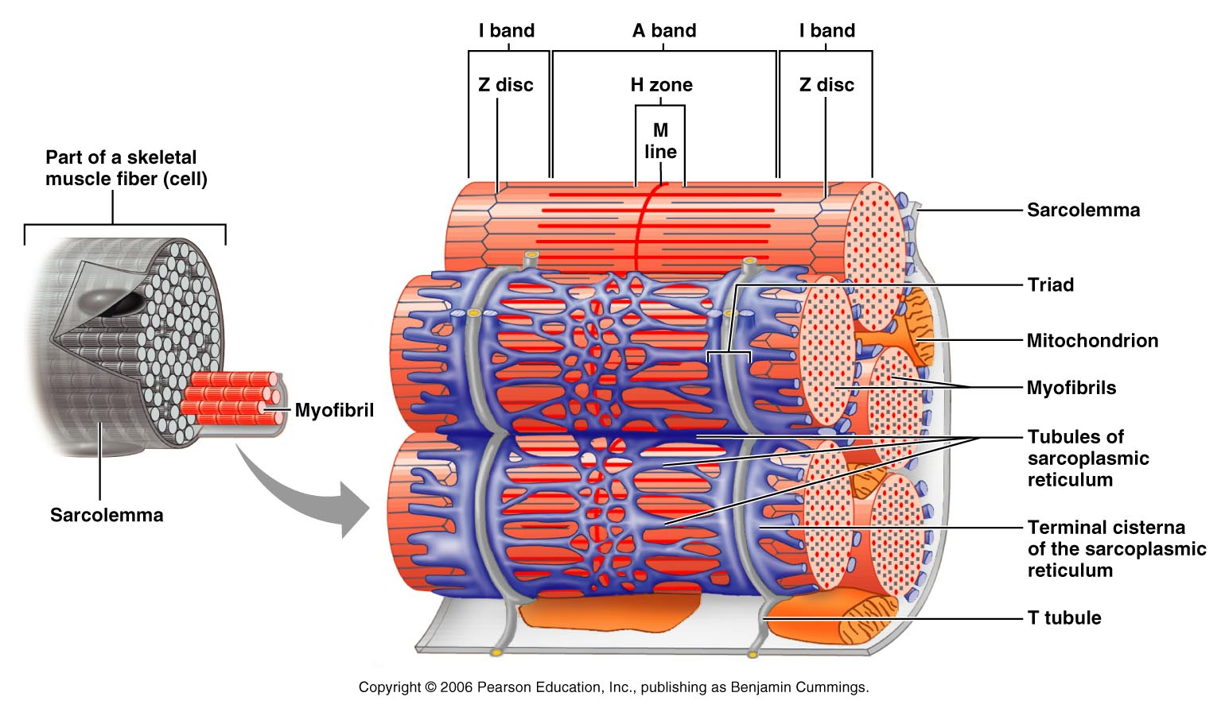
Skeletal Muscle Fibers –
Microscopic Anatomy
T Tubules
  The sarcolemma of the muscle fiber penetrates into the cell to form an elongated tubule (transverse tubule → t tubule)

Slide 7
Skeletal Muscle Fibers –
Microscopic Anatomy
T Tubules
  A skeletal muscle fiber is very large; all regions of the cell must contract simultaneously → Allows the electrical stimulus and extracellular fluid to come in close contact with deep cell regions → makes reaction occur quicker → horse vs. car traveling

Slide 8
Skeletal Muscle Fibers –
Microscopic Anatomy
Sarcoplasmic reticulum
  Smooth ER
  Surround myofibril
  Regulates calcium → stores and releases Ca for contraction
  We will discuss why calcium is important later

Slide 9
Skeletal Muscle Fibers –
Microscopic Anatomy
Myofibrils
  Inside the muscle fiber → contractile unit of the muscle
  Each muscle fiber contains 100’s – 1,000’s myofibrils

Slide 10
Skeletal Muscle Fibers –
Microscopic Anatomy
Myofibrils
  Account for 80% of cell volume
  Run entire length of fiber
  Very densely packed → all other organelles are squeezed between them

Slide 11
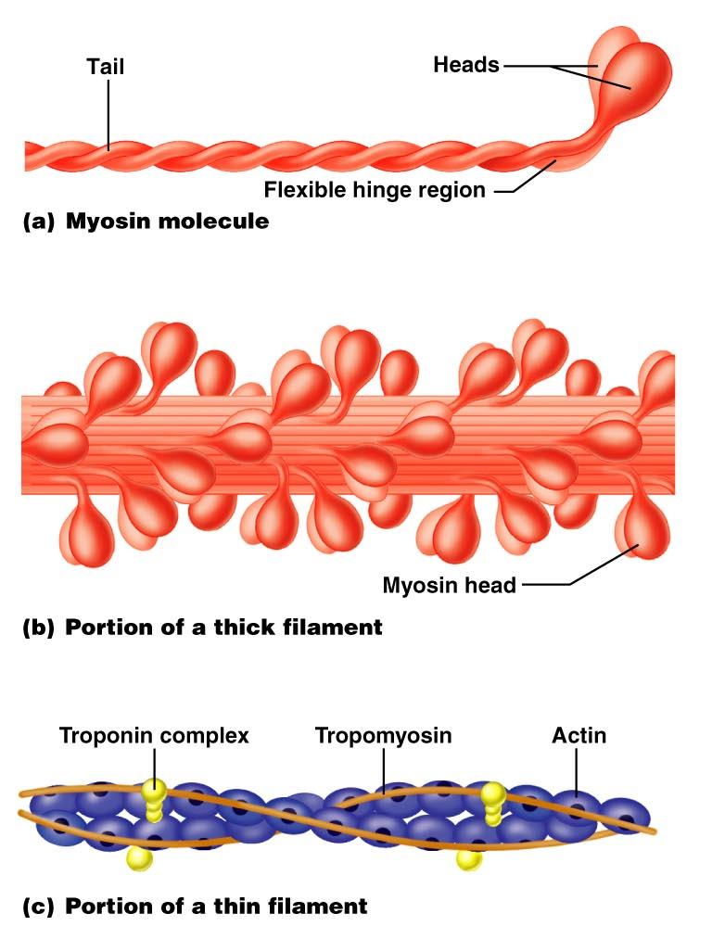
Skeletal Muscle Fibers –
Microscopic Anatomy
Myofibrils
Can actively shorten; responsible for skeletal muscle fiber contraction
Consist of bundles of myofilaments
  Actin → thin filaments
  Myosin → thick filaments

Slide 12
Skeletal Muscle Fibers –
Parts of Myofibrils
Myosin – Thick Filaments
Contains roughly 500 myosin molecules twisted around each other
  Each myosin molecule has a rodlike tail terminating in two globular heads
  Heads face outwards and tails face inwards – smooth middle

Slide 13
Skeletal Muscle Fibers –
Parts of Myofibrils
Myosin – Thick Filaments
Heads also called cross-bridges (“business end”)
  Heads link the thick and thin filaments together during contraction
Heads contain ATP binding sites

Slide 14
Skeletal Muscle Fibers –
Parts of Myofibrils
Actin - Thin filaments
Bears active sites for the cross-bridges (heads of myosin)
  Active site is covered when muscle is relaxed
Has a site to bind calcium atoms

Slide 15
Skeletal Muscle Fibers –
Parts of Myofibrils
Actin - Thin filaments
Titin – attaches thick and thin filaments to z disc
Elastic so allows muscle cell to spring back into place

