Slide 1
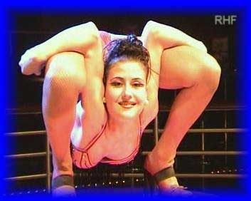
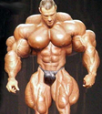
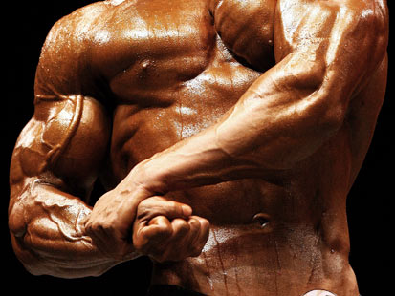
Chapter 9
Muscles and Muscle Tissue
Sarcomere and Contraction

Slide 2
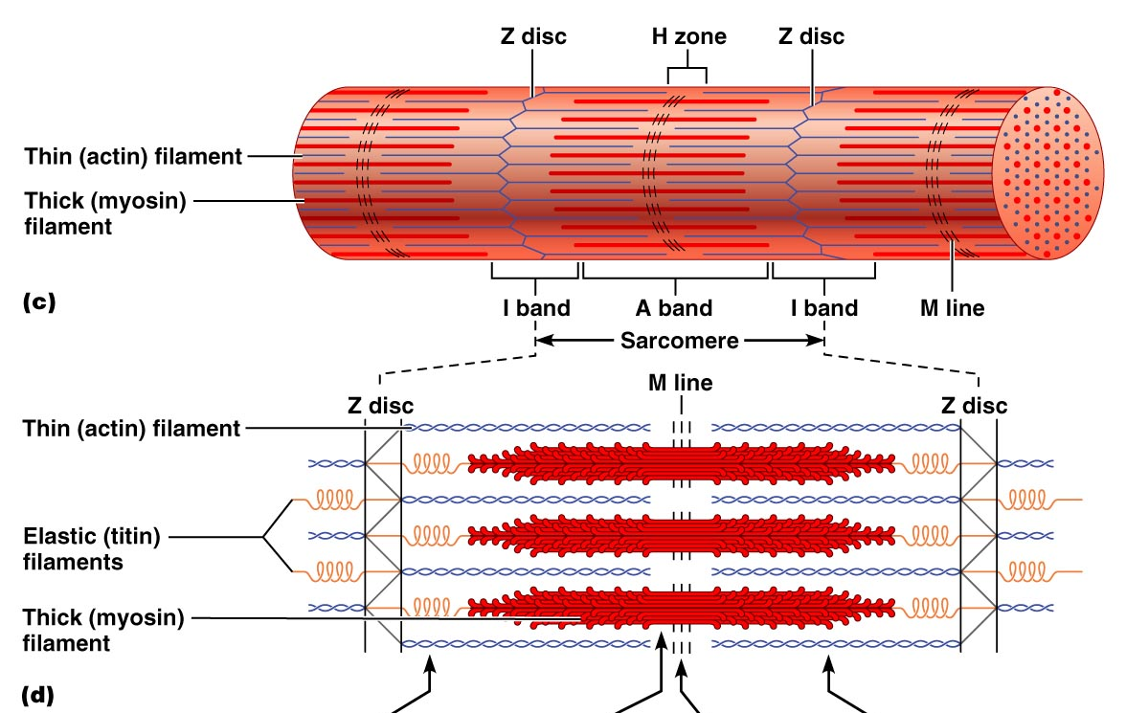
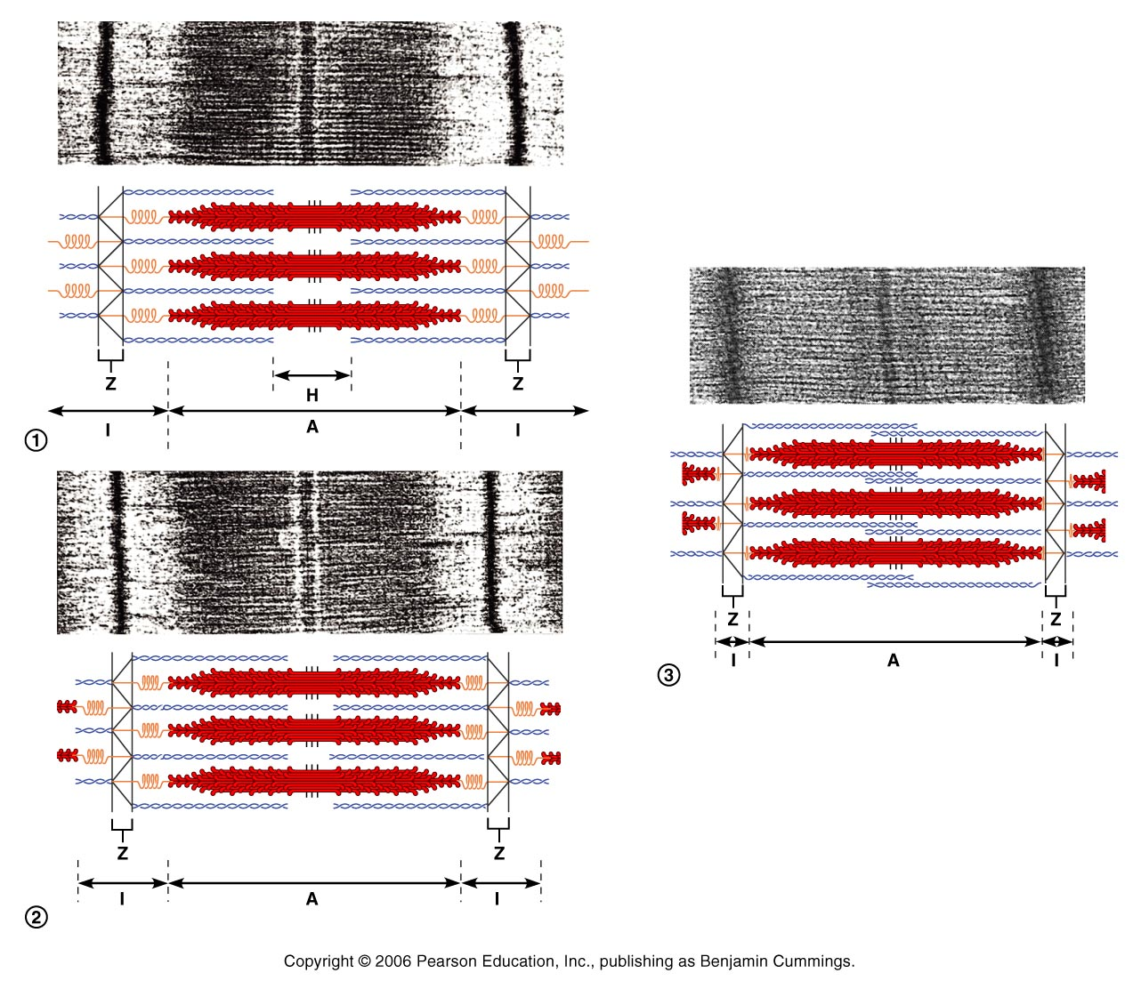
Skeletal Muscle Fibers –
Regions of the Sarcomere
Sarcomere
  the smallest functional unit of the muscle fiber.
  Interactions between the thick and thin filaments of sarcomeres are responsible for muscle contraction

Slide 3
Skeletal Muscle Fibers –
Regions of the Sarcomere
A band – Dark band; mainly thick filaments
I band – Light band; mainly thin filaments
  Note: In skeletal muscle fibers, these bands are almost perfectly aligned giving the striped appearance known as striations.

Slide 4
Skeletal Muscle Fibers –
Regions of the Sarcomere
M line – Central portion of each thick filament
H zone/line – lighter region on either side of the M line. Only seen in resting muscle fibers

Slide 5
Skeletal Muscle Fibers –
Regions of the Sarcomere
Zone of overlap – where the thin filaments are found between thick filaments
Z line- mark the boundary lines between adjacent sarcomeres (midline interruption of the I band)

Slide 6
Sliding Filament Theory
Myosin heads attach to and “walk” along the thin filaments → pulling the thin filaments towards the M line → thin filaments are sliding toward the center of the sarcomere

Slide 7
Sliding Filament Theory
Thin filaments slide inwards:
  H band gets smaller (disappears)
  I band gets smaller (disappears)
  Z lines move closer together
  A band width remains constant
  Sarcomere shortens

Slide 8
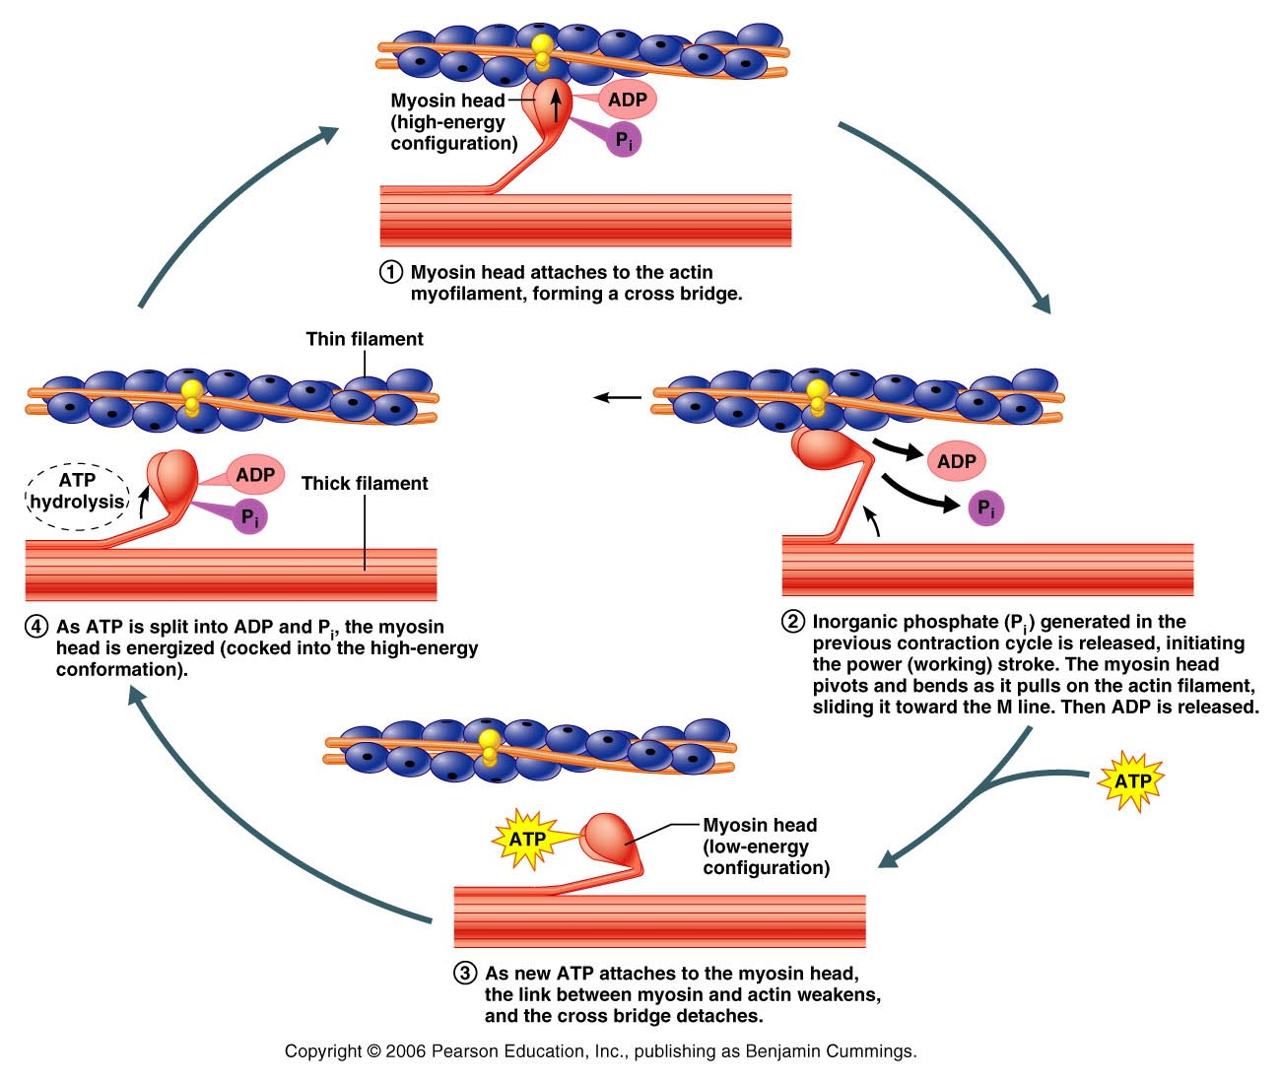
Skeletal Muscle Fiber Contraction
Nerve impulse travels to muscle cell
The impulse travels in all directions over the muscle cell and travels through the t tubules.

Slide 9
Skeletal Muscle Fiber Contraction
Impulse reaches the sarcoplasmic reticulum
Calcium ions diffuse from the SER into the sarcoplasm
Ca⁺² bind to troponin (on actin) → changes shape

Slide 10
Skeletal Muscle Fiber Contraction
6. The active site on actin is exposed
7. Actin and myosin filaments form a cross-bridge
8. Release the phosphate group (from hydrolyzed ATP)

Slide 11
Skeletal Muscle Fiber Contraction
9. Myosin heads pull actin filaments inward → myosin head falls down
10. ADP is released.
11. ATP Binds to myosin

Slide 12
Skeletal Muscle Fiber Contraction
12. Cross-bridge (myosin)releases
13. ATP on the myosin is hydrolized to ADP and a phosphate group
14. Myosin head lifts to attach to actin

Slide 13
Skeletal Muscle Fiber Contraction
15. Continues until Calcium supply is cut off
16. The muscle fiber shortens as contraction occurs

Slide 14
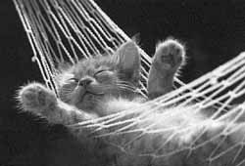
Skeletal Muscle Fiber Relaxation
Calcium ions are transported into SER
ATP causes cross-bridge between actin and myosin filaments to break apart
The binding sites on actin are blocked (there is no calcium)

Slide 15

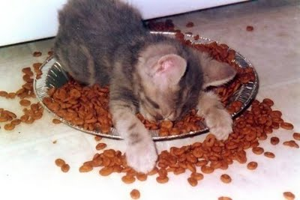
Skeletal Muscle Fiber Relaxation
Muscle fiber releases.
ATP breakdown “cocks” myosin cross-bridges.
6. Muscle fiber is ready for further stimulation

Slide 16
Muscle Contraction Videos
http://www.youtube.com/watch?v=83yNoEJyP6g
http://www.youtube.com/watch?v=WRxsOMenNQM
Day 2
http://www.youtube.com/watch?v=mWPmUqRZYls
http://www.youtube.com/watch?NR=1&v=CbfK1Gi-aCk

Slide 17
http://www.youtube.com/watch?v=0kFmbrRJq4w
http://www.youtube.com/watch?v=EdHzKYDxrKc
http://www.youtube.com/watch?v=mWPmUqRZYls
http://www.youtube.com/watch?v=kvMFdNw35L0
http://www.youtube.com/watch?v=Vlchs4omFDM

Slide 18
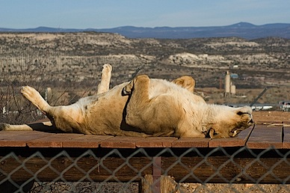
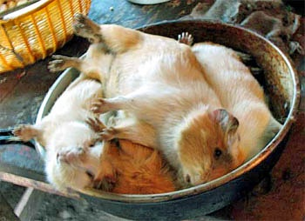
Rigor Mortis
After death, calcium ions start to leak out of SER
Causes muscle contraction cycle to start
ATP synthesis has stopped → cell runs out of ATP
Crossbridges can’t break apart → muscles in a state of contraction
Starts about 3-4 hours after
death
Lasts about 24 hours
(crossbridges are broken down)

