Slide 1
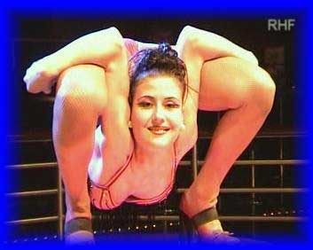
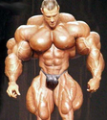

Chapter 9
Muscles and Muscle Tissue
Types, Coverings, & Gross Anatomy

Slide 2
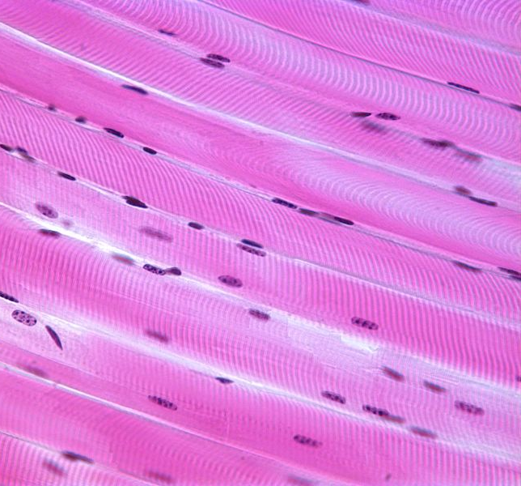
Types of Muscle Tissue
Skeletal Muscle
  Attach to and cover the bony skeleton
  Has longest fibers
  Have stripes → striations
  Voluntary muscle – subject to our conscious control
  Can contract rapidly, but tires easily; adaptable

Slide 3
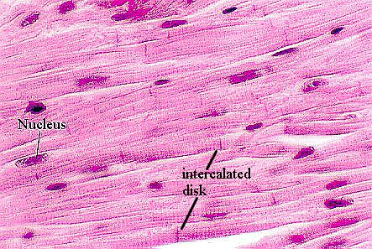
Types of Muscle Tissue
Cardiac Muscle
  In the heart → most of the mass of heart walls.
  Striated – intercalated discs
  Involuntary muscle
  Contracts at a fairly steady rate

Slide 4
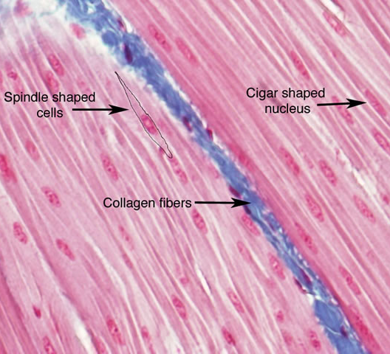
Types of Muscle Tissue
Smooth Muscle
  Wall of hollow visceral organs (stomach, urinary bladder, resp passages)
  No striations
  Involuntary muscle
  Contractions are slow and sustained

Slide 5
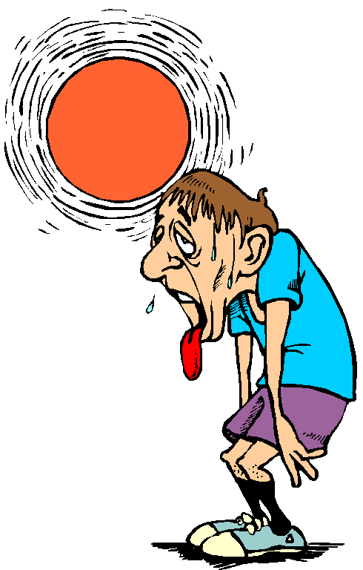


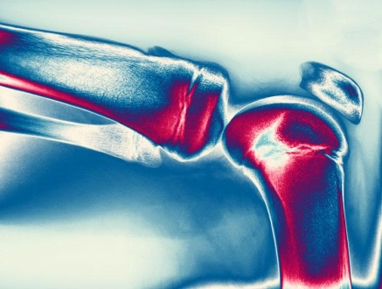
Functions of Skeletal Muscles
Produces movement
  Skeletal muscle contractions pull on tendons and moves the bones of the skeleton
Maintains posture
  Tension in our skeletal muscles maintains body posture
  Example: holding your head up, standing
Generates heat
  Generate heat as they contract
  Important in maintaining normal body temperature
  Released through integumentary system
Stabilizes joints
  Tendons of muscles extend over the joint

Slide 6
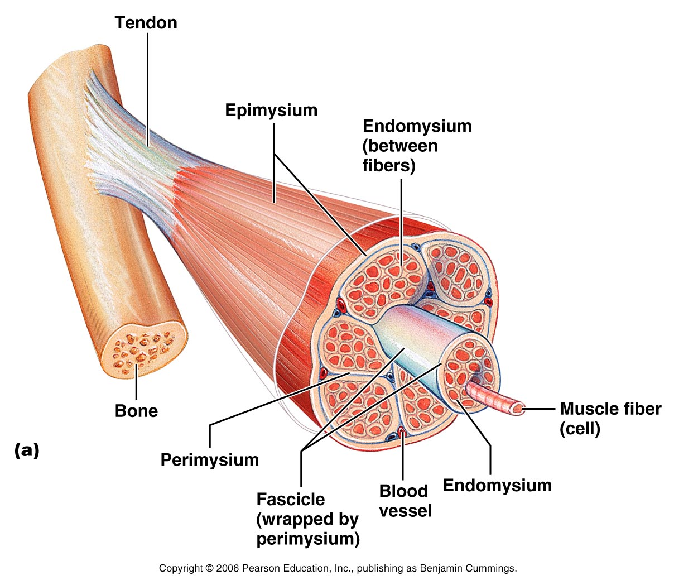
Skeletal Muscle – Gross Anatomy
Connective Tissue Wrappings
Epimysium (“outside the muscle)
  Surrounds the entire muscle
  Composed of dense irregular connective tissue

Slide 7
Skeletal Muscle – Gross Anatomy
Connective Tissue Wrappings
Perimysium (middle)
  Surround the fascicles
  Fascicles – bundles of muscle fibers

Slide 8
Skeletal Muscle – Gross Anatomy
Connective Tissue Wrappings
Endomysium
(“within the muscle”)
  Surrounds individual muscle fibers

Slide 9
Skeletal Muscle – Gross Anatomy
Tendons
Attach muscle to bones
  Collagen fibers from all the coverings are interwoven with the periosteum and extend into the bone matrix, providing a firm attachment
  Any contraction of the muscle will pull on its tendon thereby exerting a pull on the bone

Slide 10
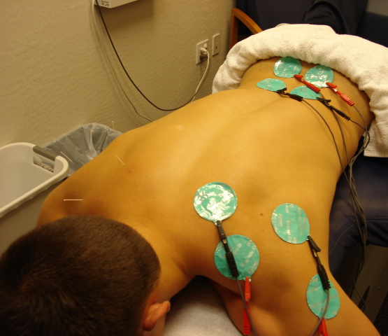
Skeletal Muscle – Gross Anatomy
Nerves
Skeletal muscles can only contact with stimulation from the CNS
Nerves are seen throughout each layer of muscle
Generally served by only one nerve

Slide 11
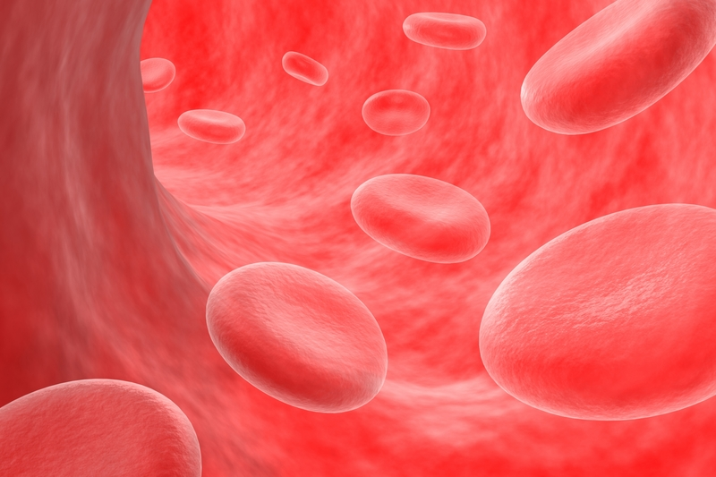
Skeletal Muscle – Gross Anatomy
Blood Supply
Generally served by one artery and by one or more veins.
Contracting muscle fibers use huge amounts of energy and give off large amounts of metabolic wastes → need a continuous supply of blood!

