Slide 1

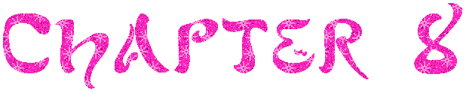

Cartilaginous & Fibrous

Slide 2
Joints
Also called articulation
Place where two or more bones meet

Slide 3
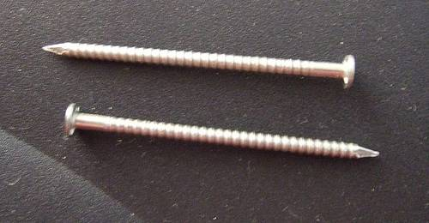
Classification of Joints
Structural
  Looks at how and what binds bones together.
  Looks at if a joint cavity is present
  What we will focus on
Functional
  Looks at the amount of movement allowed.

Slide 4
Types of Structural Joints
Fibrous
  Connected by fibers
Cartilaginous
  Connected by cartilage
Synovial
  Complex
  We are most familiar with these!
  Lots of movement!

Slide 5
Fibrous Joints
Bones joined by fibrous tissue
No joint cavity
Most permit no movement

Slide 6
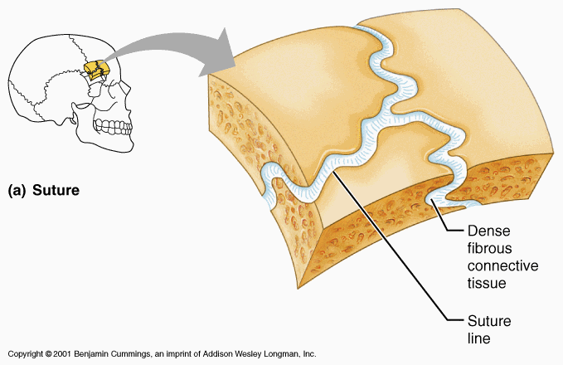
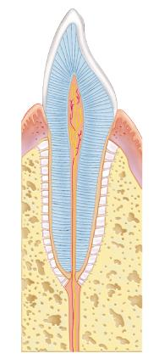
Types of Fibrous Joints
Sutures
  “seams”
  Skull bones
Gomphoses (gom-fo-sis)
  Peg in socket
  Teeth

Slide 7
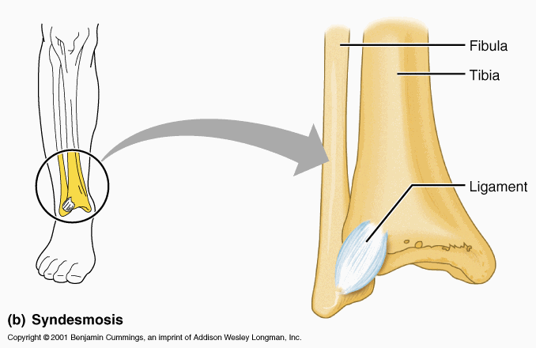
Types of Fibrous Joints
Syndesmoses (sin-des-mo-sez)
  Bones connected by a cord or sheet of fibrous tissue (interosseous membrane)
  Radius and ulna

Slide 8
Cartilaginous Joints
Bones are joined by cartilage – usually hyaline
No joint cavity

Slide 9
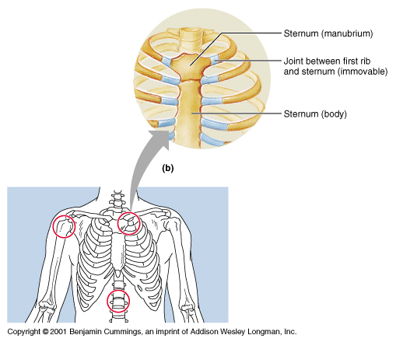
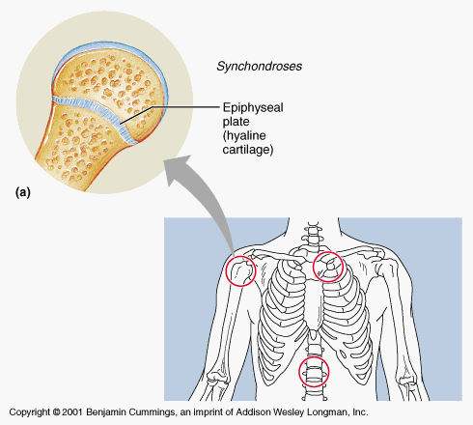
Types of Cartilaginous Joints
Synchondroses (sin-kon-dro-sis)
  “junction of cartilage”
  Provide sites for bone growth
  Epiphyseal plates

Slide 10
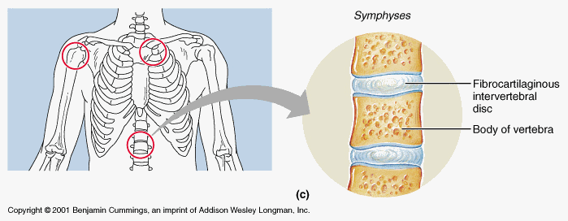
Types of Cartilaginous Joints
Symphyses (sim-fih-sez)
  “Growing together”
  Articular surfaces of the bone is fused to intervening pad/plate of fibrocartilage
  Intervertebral joints

