Slide 1

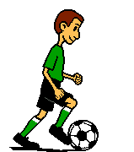

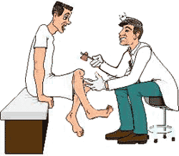





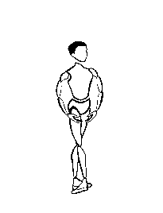
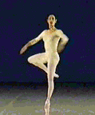
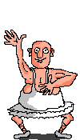

Synovial

Slide 2
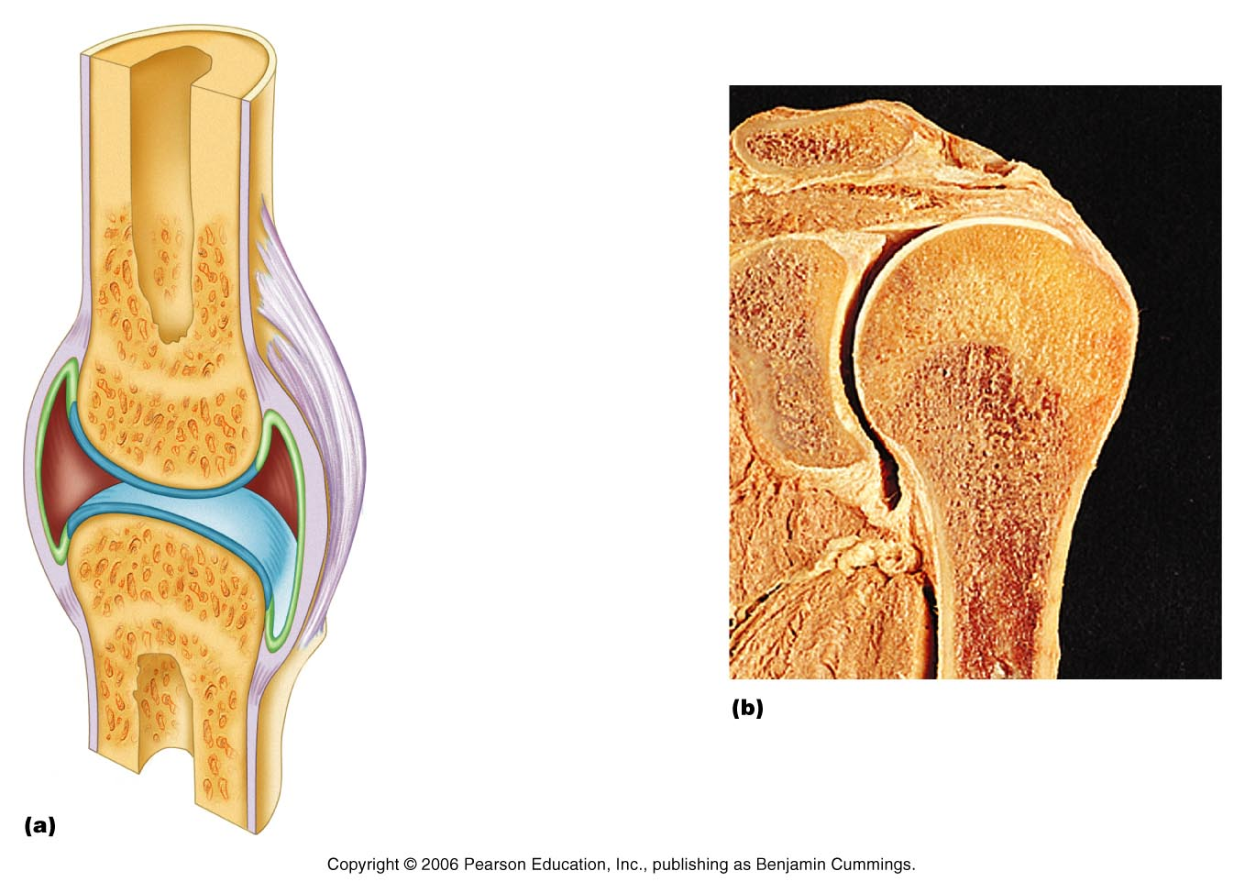
Synovial Joints
Joint (synovial) cavity
  Not an actual space – “potential space”
Articular Cartilage (hyaline)
  Covers bone surfaces, makes slick and smooth
  Protects bones from being crushed – matrix has more water
  No perichondrium

Slide 3
Synovial Joints
Synovial Fluid
  Slippery fluid that fills the joint cavity
    Has a viscous, egg white consistency
  Reduces friction between the cartilages (bones)
  Helps with shock absorption
  Provides nutrients

Slide 4
Synovial Joints
Articular Capsule
  Encloses the joint cavity
  Double layer of articular cartilage

Slide 5
Synovial Joints
Reinforcing ligaments
  Surrounds the joint cavity
  Reinforces and strengthens by many ligaments

Slide 6
Types of Synovial Joints
Plane Joints
Hinge Joints
Pivot Joints
Condyloid Joints
Saddle Joints
Ball and Socket Joints

Slide 7
Types of Movement
Gliding
Angular motion
  Flexion, extension, abduction, adduction, circumduction (2)
Rotation
  Rotation, protation, and supination
Special
  Inversion, eversion, dorsiflexion, plantarflexion, opposition, protraction, retraction, elevation, depression

Slide 8
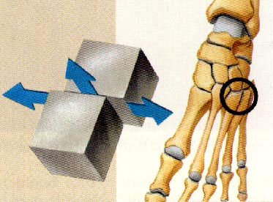
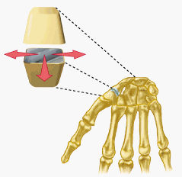
Synovial Joints - Plane
Flat bone surfaces
Intercarpal and intertarsal joints

Slide 9
Movement Allowed
Gliding
  Simplest movement
  One “flat” bone surface glides or slips over another similar surface

Slide 10
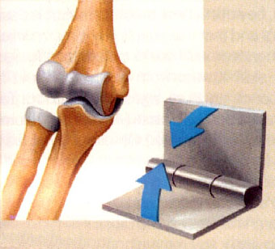
Synovial Joints - Hinge
A convex or cylindrical projection of one bone fits into a trough-shaped surface on another
Fingers, knees, elbow, toes

Slide 11
Movement Allowed
Flexion
  Bending movement that decreases the angle of the joint
  Brings two articulating bones closer together
Extension
  Exact opposite!

Slide 12
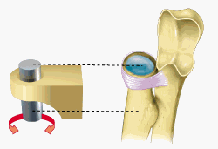
Synovial Joints - Pivot
Rounded or conical end of one bone protrudes into a “sleeve” or ring of bone of another
Axis and Dens
Radius and Ulna

Slide 13
Movement Allowed
Rotation
  Turning of bone along it’s own long axis
  Supination – “turning backward”
    Bones “back”!!
    Palms forward and superior
  Pronation – “turning forward”
    Bones “forward”
    Palms backwards

Slide 14
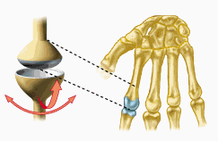
Synovial Joints - Condyloid
Both articular surfaces are oval
Very similar to hinge but allows more movement
Wrist and knuckles

Slide 15
Movement Allowed
Flexion & extension
Abduction – “Moving away”
  Movement of limb away from the midline
Adduction – “Moving towards”
  Movement of limb towards the midline
Circumduction – “To draw a circle”
  Distal end moves (circle) while proximal end is pretty much stationary

Slide 16
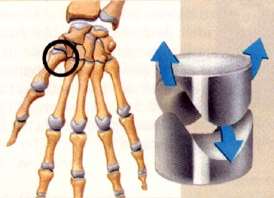
Synovial Joints - Saddle
The articular surface is shaped like a saddle
Thumb (carpo-metacarpal joint)

Slide 17
Movement Allowed
Circumduction
Opposition
  Movement of thumb towards the palm
  This is why you can pick stuff up! ☺

Slide 18
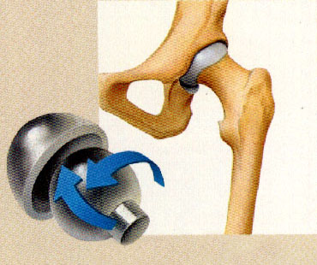
Synovial Joints –
Ball and Socket
Head of one bone (ball) fits into the socket of another
The most freely moving
Hip and Shoulder

Slide 19
Movement Allowed
All combinations of angular movement
Rotational movement including circumduction

Slide 20
http://www.youtube.com/watch?v=LDTw2wlUf4Q
http://www.youtube.com/watch?feature=endscreen&v=5YcNAPzDxDg&NR=1
http://www.youtube.com/watch?feature=fvwp&NR=1&v=rUNK0uQBvc8

